Slide 1
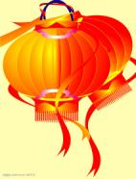
Module 10 Unit 2
My mother’s cleaning our house and sweeping away bad luck.
WWW.PPT818.COM

Slide 2
Objectives:
1. To understand the passage about festivals;
2. To read the passage and grasp the general idea

Slide 3
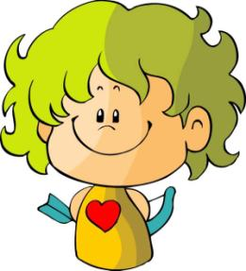
What do you do when Spring Festival is coming?

Slide 4
Brainstorming
clean house
decorate the doors
set off fireworks
Do somethings
sweep the floor
learn a lion dance
buy clothes

Slide 5
Some festivals of foreign countries
Thanksgiving Day
Easter
Christmas
Festivals
Carnival
Mother’s Day
Halloween
Valentine’s Day

Slide 6
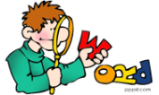
Review
Words and expressions

Slide 7
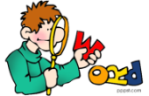
Read the words and expressions loudly.

Slide 8
Words and expressions
Christmas
February
January
before
sweep away
luck
table
celebrate
n. 圣诞节
n. 二月
n. 一月
prep. 在……之前
扫去
n. 运气
n. 桌子
v. 庆祝

Slide 9
Words and expressions
traditional
dumpling
programme
sweater
coat
mean
lucky
merry
Merry Christamas
adj. 传统的
n. 饺子；团子
n. (电视)节目
n. 厚运动衫；毛线衣
n. 外套
v.
adj. 幸运的
adj. 愉快的；高兴的
圣诞快乐
意思是; 意味着

Slide 10
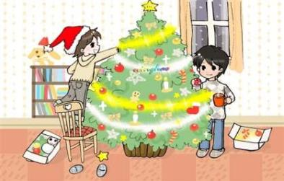
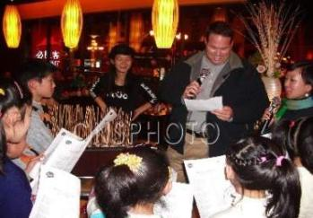
Look and Say
看图片和提示，用动词-ing形式完成句子。
decorating the Christmas tree
We are _____________
_____________.
singing
They are ______ Christmas songs.
Fenny is ______ a Christmas tree.
buying
buy

Slide 11
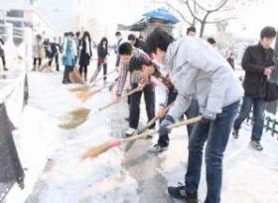
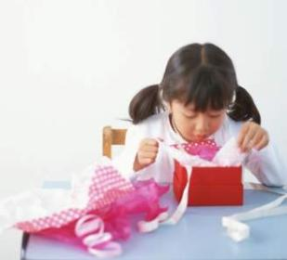
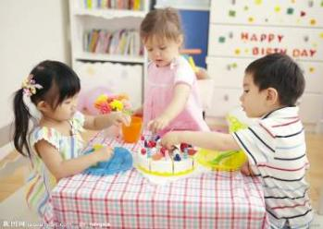
The students are _____________________.
sweeping away the snow
Lily is ___________________.
opening a present box
The children are __________ Little Tom’s ________.
celebrating
birthday

Slide 12
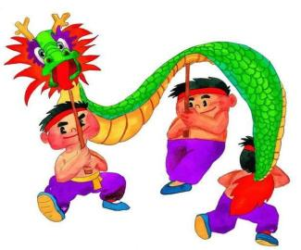
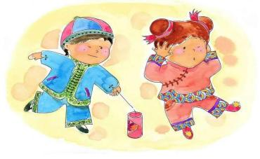
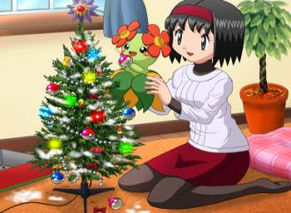
They are _____________________.
learning a dragon dance
The two children are _________________.
setting off fireworks
Linda is ________________________.
decorating a Christmas tree

Slide 13
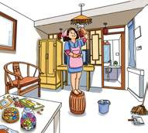
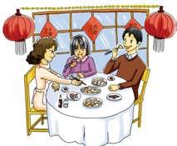
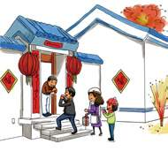
1 Work in pairs. Look at the pictures and talk about what’s happening.
①
②
③
— What’s Li Shan’s mother doing?
— She’s cleaning the house.

Slide 14
Read the passage and match the paragraphs with the pictures in Activity 1.
①
②
③
A
B
C

Slide 15
Language points
We are celebrating Spring Festival with a traditional family dinner …
在除夕夜, 我们以传统的年夜饭来庆祝春节……
with prep. 和，带有，用
She goes shopping with me.
她和我一起去逛街。
Uncle Li is a tall man with a long
white beard.
李叔叔是一位留着长胡子的高个头男士。
We decorate the windows with paper cuts.
我们用剪纸装饰窗户。

Slide 16
2. It’s a few days before Spring Festival.
这是春节前的几天。
few n. 一些，很少
Few people enjoy this music.
几乎没人欣赏这种音乐。
There are a few people in the
classroom.
教室里有几个人。
few作形容词，表示否定的概念, 为“几乎没有”，修饰可数名词复数。
a few一些，表示肯定的概念，修饰可数名词复数。

Slide 17
3 Complete the passage with the correct form of the words and expression from the box.
celebrate dumpling few luck mean programme sweep away traditional
celebrate
We (1)_______ Spring Festival in January. A (2)____ days before Spring Festival we clean our homes and (3)__________ all the bad (4)____. (5)__________ food, such as jiaozi—a kind of (6)________. We usually watch a special (7)__________ on television, and parents usually give their children a hongbao. It ______ lucky monkey.
few
sweep away
luck
traditional
dumpling
programme
means

Slide 18
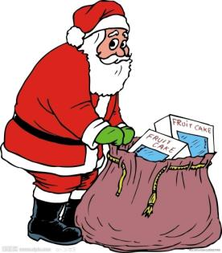
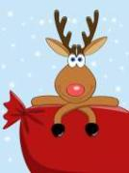
Writing
Match the notes with the headings.
Getting ready
a go shopping for presents
e get lots of food ready
h have a Christmas tree

Slide 19
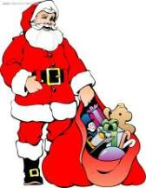
Presents
d put the presents next to the Christmas tree
Traditional things on Christmas Day
b have a traditional family dinner
c have a Christmas tree
f sing Christmas songs
g say Merry Christmas to family and friends

Slide 20
5 Write sentences with notes in Activity 4.
eg. go shopping for presents;
get lots of food ready.
→They go shopping for presents and they
get lots of food ready.
→They go shopping for food and get lots
of food ready.

Slide 21
have a traditional family dinner; open presents on Christmas Day
They have a tradiotinal family dinner and they open presents on Christmas Day
They have a tradiotinal family dinner and open presents on Christmas Day
2. sing Christmas songs
say Merry Christmas to family friends
They sing Christmas songs and they say Merry Christmas to family and friends
They sing Christmas songs and say Merry Christmas to family and friends

Slide 22
一、单项选择。
1. We have ____ food.
A. lots of B. a few C. many
2. There ____ dragon and lion dancing.
A. is B. are C. be
3. Everyone ____ got a piece of cake.
A. is B. has C. there is
4. Red ____ good luck.
A. means B. meaning C. mean
5. We ________ ready for Spring Festival.
A. are gets B. are getting
C. getting for

Slide 23
二、根据汉语意思完成句子。
1. 你正在学舞龙吗 ？
___ you _____________________?
2. 你的母亲在装饰房子吗？
__ your mother __________________?
3. 我们对数学感兴趣。
We ______________ maths.
4. 他们给他CDs或一些书。
They give him CDs _____________.
5. 我们在为圣诞节做准备。
We __________________ Christmas.
Are learning a dragon dance
Is decorating the house
are interested in
or some books
are getting ready for

Slide 24
6. 我们必须马上把树叶扫掉。
We must __________ the leaves at once.
7. 中秋节是中国的一个传统节日。
The Mid-Autumn Festival is a Chinese
________________.
8. dumplings 是什么意思？
_________ dumplings _____?
9. 我们有好几天不打扫家居。
We _________ the house ____________.
10. 红包带给我们好运。
Hongbao __________________.
sweep away
traditional festival
What does mean
don’t clean for a few days
brings our good luck

Slide 25
Homework
发挥想象，连词成文(50-100字).
tradition, paint, decorate, paper cut, dumpling, fireworks, all the year round
要求: 主要用现在进行时。

Slide 26
Preview
To preview Present continuous
2. To practise the vocabulary

Slide 27
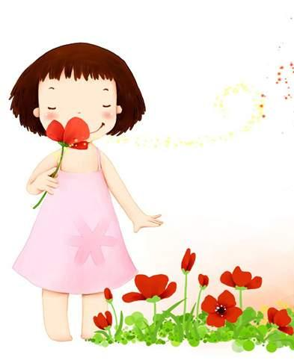
Byebye!

