Slide 1
Unit6 Is this your skirt?
人教精通版三年级下册
WWW.PPT818.COM

Slide 2
Review
Let’s chant

Slide 3
Review
Look and say
Is this your skirt?
Yes, thank you.

Slide 4
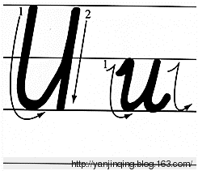
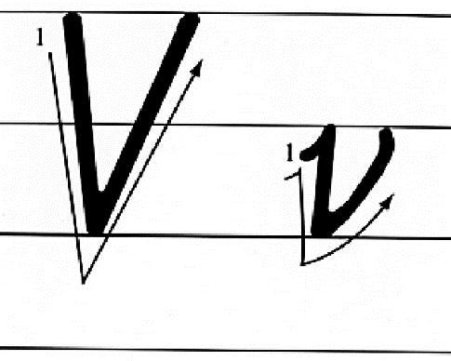
Presentation
Let’s learn

Slide 5
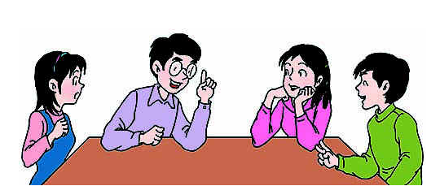
Presentation
Discussion
你都知道哪些含有字母u或v的单词呢？
uncle, mum, quail, seven, twelve, …

Slide 6
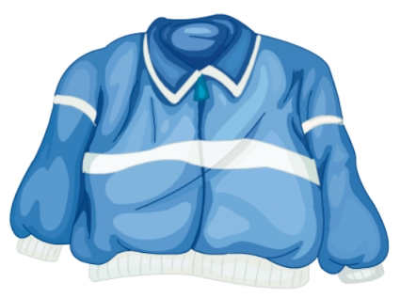
Presentation
Let’s learn
What’s this?
uniform

Slide 7
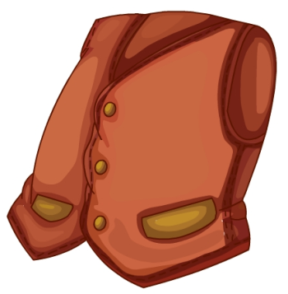
Presentation
Let’s learn
What’s this?
vest

Slide 8
Practice
Game1
Magic fingers
skirt
T-shirt
uniform
vest

Slide 9
Practice
Game2
What’s missing?

Slide 10
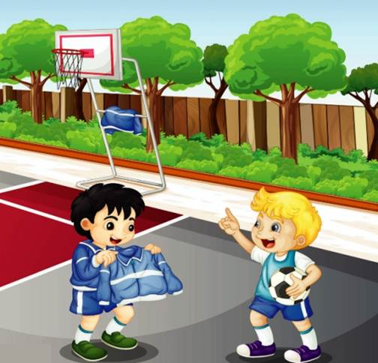
Presentation
Listen and say
Who is he?
He is Peter.
Is this Peter’s uniform?
No, it isn’t.

Slide 11
Presentation
Let’s learn
Hi, Peter. Is this your uniform?
Hmm, no. That’s my uniform.

Slide 12
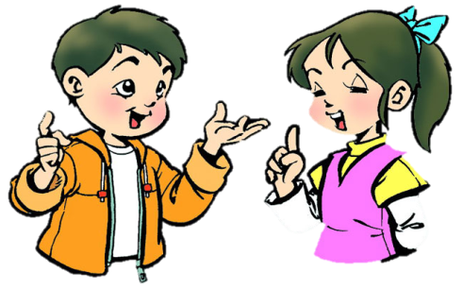
Practice
Role-play
分角色朗读对话，注意模仿语音语调。
两人一组，试着表演出来吧。

Slide 13
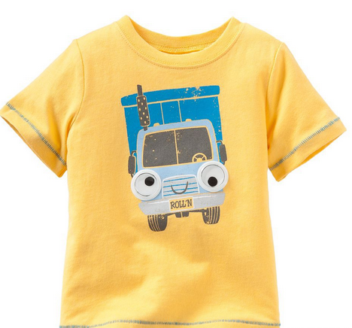
Practice
Let’s guess
Is this your vest?
No. That’s my T-shirt.

Slide 14
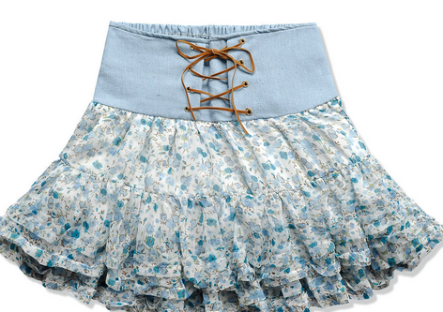
Practice
Let’s guess
Is this your uniform?
No. That’s my skirt.

Slide 15
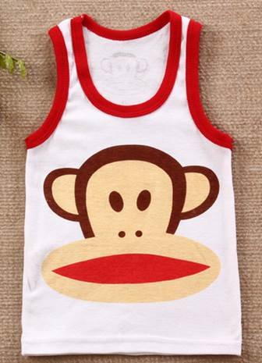
Practice
Let’s do
This is my ____.
vest
A: ______________?
B: Yes.
Is this your vest

Slide 16
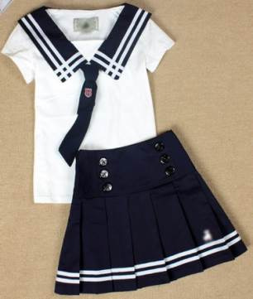
Practice
Let’s do
This is my _______.
uniform
A: Is this your vest?
B: ___. That’s my ______.
No
uniform

Slide 17
Practice
Let’s do
Show me the letter U. And show me your uniform.

Slide 18
Summary
本课学到的重点单词：
uniform
vest
本课学到的重点句型：
—Is this your …?
—No. That’s my ...

Slide 19
Homework
1. 观看Just talk部分的课文动画，跟读对话并注意语音、语调。
2. 运用本课所学的知识，用英文询问你身边的朋友或家人某物是否是他们的。
3. 预习Lesson 33。
Close

