Slide 1
Unit 9
I like music that I can dance to. Section A (第1课时)
WWW.PPT818.COM

Slide 2
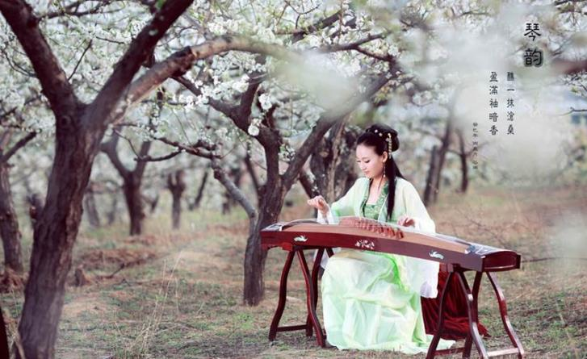
Warming up
What kind of music do you like?

Slide 3
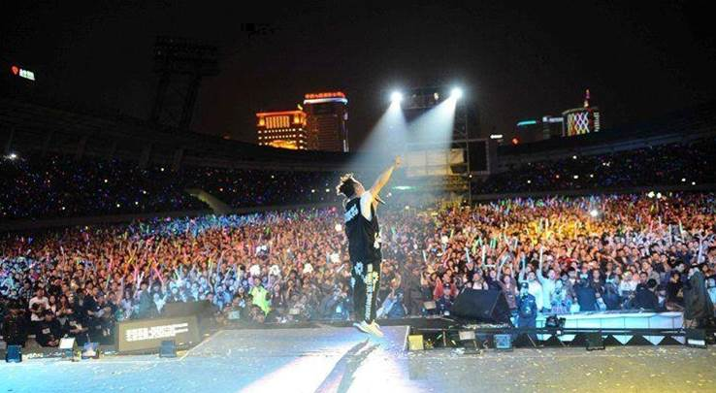

Slide 4
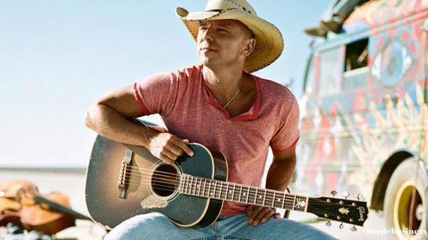

Slide 5
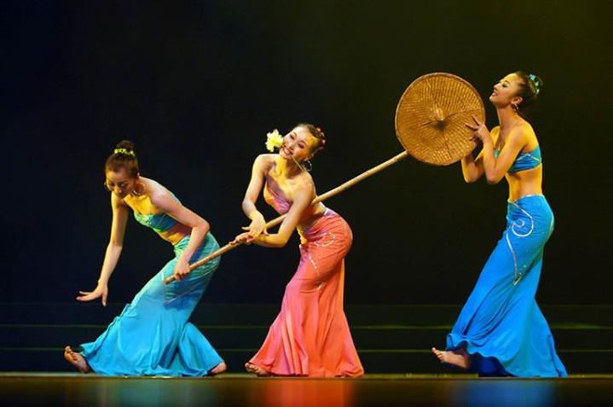

Slide 6
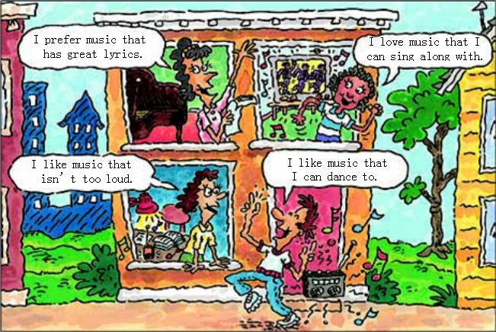
What kind of music do you like? Look at the picture and circle the sentences you agree with.Then write your own sentence.
1a
Your sentence:
I like music that
____________
____________.

Slide 7
Listen and check (✔) the kinds of music Tony and Betty like.
1b
 | Music that I can dance to | Music that has great lyrics | Music that I can sing along with
Tony
Betty
✔
✔
✔
✔

Slide 8
Make conversations about the music that you like.
1c
A: What kind of music do you like?
B: I like music that I can sing along with.
What about you?
A: I prefer music that has great lyrics.

Slide 9
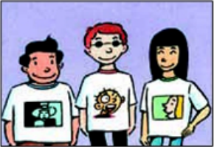
Listen and circle T for true and F for false.
2a
1. Carmen likes musicians who play
different kinds of music. T F
2. Xu Fei likes the Australian singer
Dan Dervish. T F
3. Carmen likes electronic music that's loud. T F
4. Xu Fei prefers groups that play quiet and
slow songs. T F

Slide 10
Listen again. Complete the sentences.
2b
Carmen says | 1. I really love Dan Dervish. I like musicians ___________________________. 2. The Modern are really great. I love electronic music __________.
Xu Fei says | 3. I like musicians ______________________. 4. I think The Modern are too noisy. I prefer groups _________________________.
who play different kinds of music
that's loud
who write their own songs
that play quiet and slow songs

Slide 11
Make conversations using the information in 2a and 2b.
2c
A: Does Xu Fei like The Modern?
B: No, he doesn't. He prefers ...

Slide 12
Role-play the conversation.
2c
Jill: What are you doing this weekend, Scott?
Scott: Not much. I suppose I'll just listen to the new CD I bought.
Jill: Oh, what CD is this?
Scott: Well, it's all music. There's no singing. I like smooth
music that helps me relax after a long week at work.
Jill: Sounds nice. Well, if you have spare time, do you want to
watch a movie with me? The director is really famous.

Slide 13
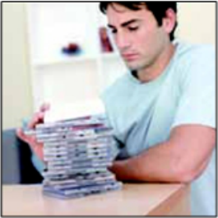
Scott: Hmm, depends which movie. I only like movies
that are funny. I just want to laugh and not think too much.
You know what I mean?
Jill: Oh, in that case, I’ll ask someone
who likes serious movies.
Scott: What’s the movie about?
Jill: It’s about World War II. I prefer movies
that give me something to think about.

Slide 14
Language Points
1. I like music that I can dance to.我喜欢能伴随着跳舞的音乐。(教材第65页)
（1）that I can dance to是定语从句，修饰先行词music，其中 that 是关系代词，在从句中作宾语。
（2）dance to 随着……跳舞，相当于dance along with。
【拓展】sing along with 跟着……唱

Slide 15
2. prefer
prefer是动词，过去式为 preferred,意为“更喜欢，更喜
爱”，相当于 like better；prefer...to...，相当于
like...better than...
其常见用法有：
（1）prefer to do sth. 更喜欢做某事。
（2）prefer (doing) sth. to (doing) sth.
喜欢（做）某事胜过（做）某事。
（3）prefer to do sth. rather than do sth. 宁愿做某事而不愿
做某事，相当于prefer doing sth. to doing sth.

Slide 16
3. He likes musicians who play different kinds of music.
他喜欢演奏不同种类音乐的音乐家。(教材第66页)
（1）当关系代词在句子中作主语时，谓语动词的单复数应与
先行词保持一致。
e.g.:He likes the person who is outgoing.
（2）different kinds of +n. “不同种类的……”
4. in that case 既然那样
e.g.:They may not offer me much money. In that case, I won't
take the job.

Slide 17
Exercise
一、根据汉语提示填空。
1. I _______ (猜想) it will rain tomorrow.
2. The boy is playing ________ (电子的) music.
3. The ______ (悦耳的) music makes us happy.
4. He is busy and has no ______(空闲的) time.
suppose
electronic
smooth
spare

Slide 18
二、单项选择。
( )1. Most of my classmates prefer loud music _____
they can dance to.
A.that B.who C.whose D.where
( )2. I like friends who _____ friendly and easy-going.
A.is B.are C.have D.has
( )3.Tony loves music______ he can dance______.
A.which;with B.who;along
C.that;to D.that;in
( )4.I prefer_____ some shopping to _____ camping
since the weather isn't lovely.
A.do;going B.doing;go
C.do;go D.doing;going
A
B
C
D

Slide 19
Homework
1.Listen and read after the tape at home.
2.Read and recite 2d.

Slide 20
Thank you!

