Slide 1
Unit8 Topic 3
Let’s celebrate!
Section B
WWW.PPT818.COM

Slide 2
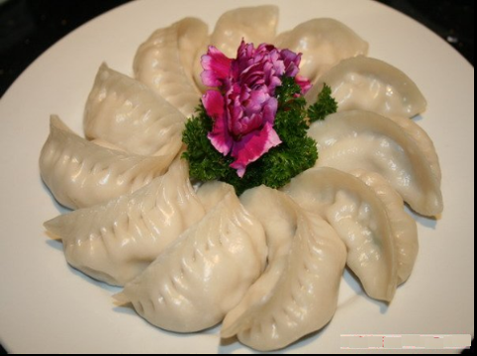
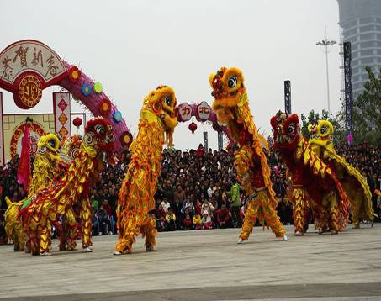
Let's talk!
What festival is it?
When is …?
How do people celebrate …?

Slide 3
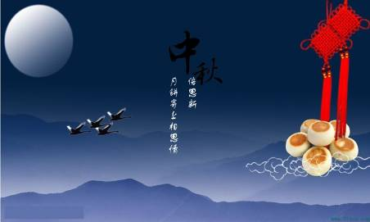
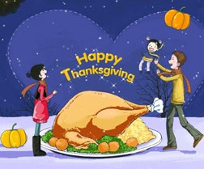
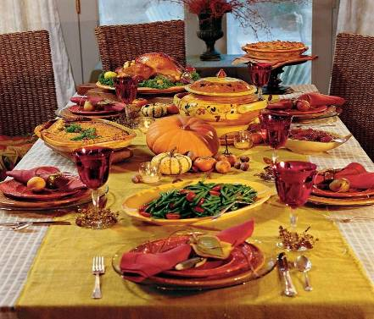

Slide 4
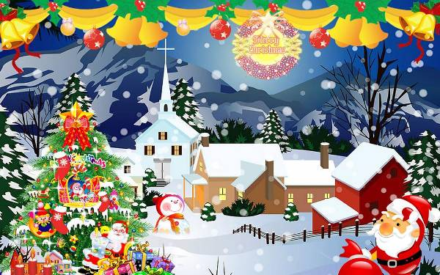
Christmas
What do you know about Christmas ?
Christmas is the most important festival in many countries.
最重要的

Slide 5
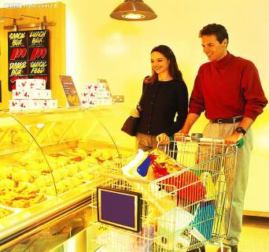

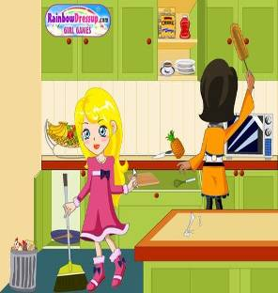
Before Christmas Day
go shopping
clean their houses
People are busy preparing for it.

Slide 6
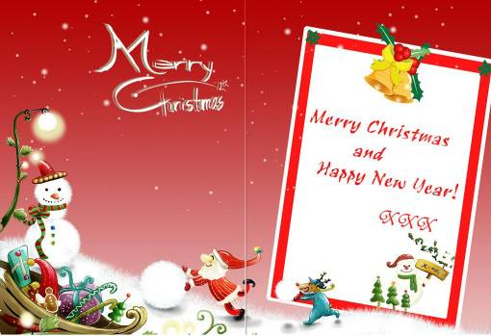
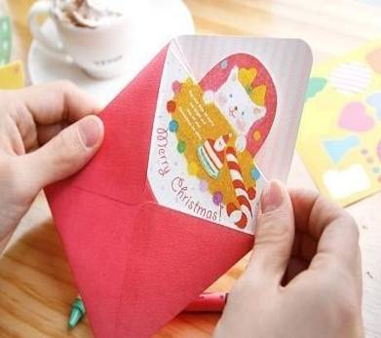
Christmas card
They often give Christmas cards to their friends.

Slide 7
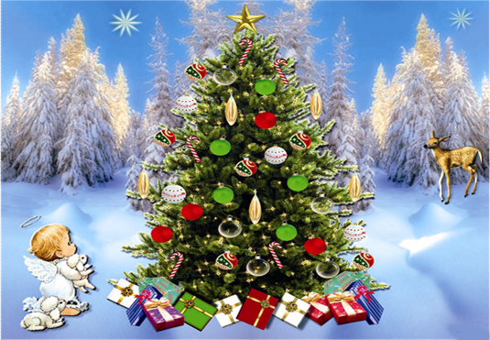
Christmas tree
装饰
People decorate Christmas trees with colorful lights, balls, stars and so on.
颜色鲜艳的

Slide 8
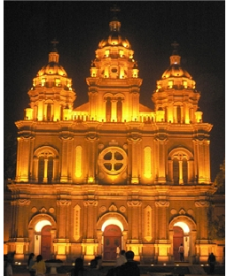
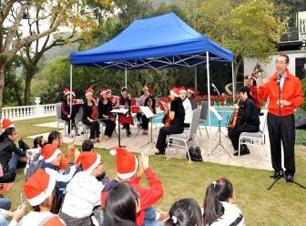

On Christmas Eve
教堂
church
去教堂
go to church
Families often go to church and sing Christmas songs.

Slide 9
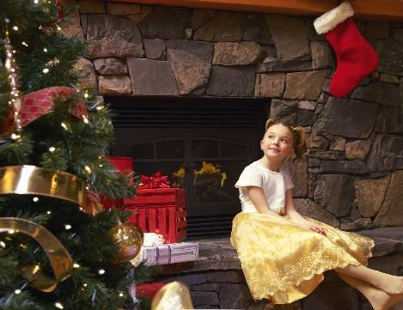
长筒袜
stocking
put up stockings
挂起
壁炉
Children put up stockings by the fireplaces or at the end of their beds before they go to bed.

Slide 10
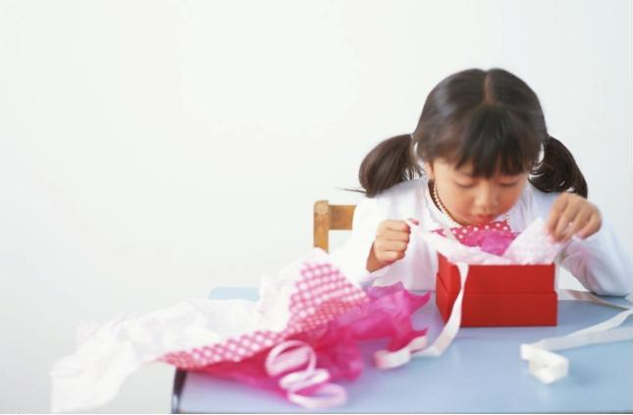
On the morning of Christmas Day
open the presents

Slide 11
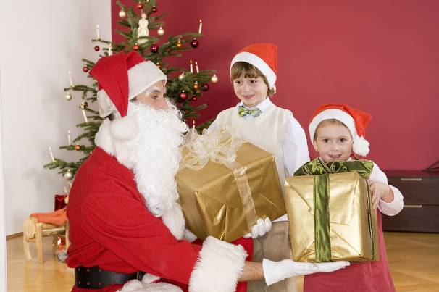
圣诞老人
Santa Claus
Children always think presents must be from Santa Claus.
一定是来自于

Slide 12
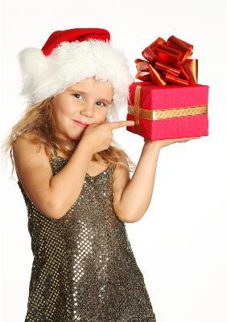
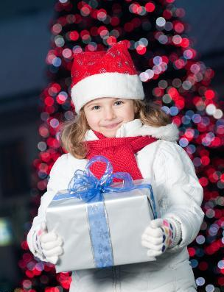
They often give gifts to each other.

Slide 13
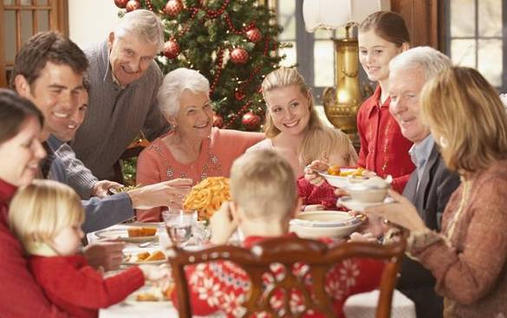
Families usually have a get-together with a special dinner.
特别的，专门的
They usually greet each other and say,“Merry Christmas!”.
问候

Slide 14
Read 1a and check(√) the activities people do during Christmas time.
Before Christmas |  | On Christmas Eve |  | On Christmas Day
go shopping |  | go to church |  | get up late
decorate Christmas trees |  | play games with apples |  | open the presents
eat turkey |  | sing Christmas songs |  | have a get-together
clean their houses |  | give each other presents |  | have a special dinner
give friends Christmas cards |  | put up stockings at the end of their beds |  | say"Merry Christmas" to each other
√
√
√
√
√
√
√
√
√
√
√

Slide 15

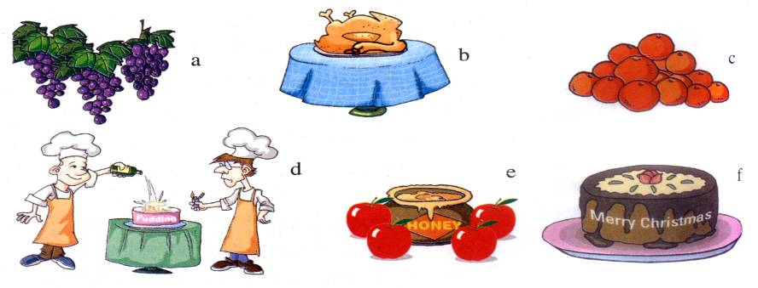
Listen to the passage about New Year and choose the right pictures.
grape
honey
c
New Year’s Day ____________
New Year’s Eve _____________
a, e

Slide 16
Listen again and complete the sentences.
1. Some Chinese people eat_________for good luck.
2. In Spain, people eat _________ grapes for good luck in the new year.
3. Some Jewish people eat _______ with honey for a sweet new year.
oranges
twelve
apples
犹太人

Slide 17
Summary
1. Learn some new words and phrases:
important, decorate, church, put up, open, grape
2. (1)Talk about festivals.
It (Christmas) is on December 25th.
On Christmas Eve, the night of December 24th, families often
go to church and sing Christmas songs.
(2)Talk about customs and culture.
Children put up stockings by the fireplaces or at the end of their
beds before they go to bed.
Some Jewish people eat apples with honey for a sweet new year.
3. Express wishes and congratulations.
Merry Christmas!
Happy New Year!

Slide 18
1. Recite 1a.
2. Finish Section B in your workbook.
3. Preview Section C.
4. Use your own words to write something about Christmas.

