Slide 1
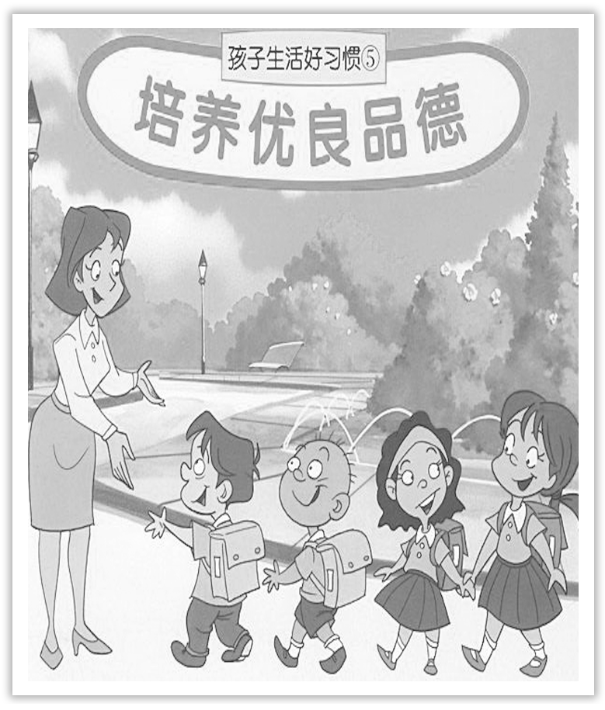
Unit 2 Morals and Virtues
Section Ⅲ Reading and Thinking(2)
WWW.PPT818.COM

Slide 2
Ⅰ.单词语境记忆——根据英汉提示写出单词的适当形式
1.Don’t let the noise ____________(使惊恐) you; it’s only the wind.
2.Can anything ____________(取代) a mother’s love and care?
3.She often ____________(抱怨) that he is dishonest.
4.We ____________(雇用) a driver to take us on a tour of the city yesterday.
scare
replace
complains
hired

Slide 3
5.He was afraid she would ____________(拒绝) him because he was a foreigner.
6.Charles declared the result of the ____________(elect).
7.She won a ____________(scholar) to go to university.
8.There has been very little ____________(respond) to our call for help.
9.The news of their ____________(marry) was not made public until three months later.
10.The ____________(major) of his books are kept upstairs.
reject
election
scholarship
response
marriage
majority

Slide 4
Ⅱ.短语语境填空——根据汉语提示写出适当的短语
1.Their faith and courage __________________________(帮助他们渡过难关) at last.
2.We ________________(往往) meet up for lunch once a week.
3.New students should pay the whole year’s ________________(学费) at registration.
4.I am working as a ________________(住院医师) in one of the first rate hospitals in China.
5.He was sorry for the soldier who ________________(弥留之际) in Algiers.
6.I ________________(毕业于) Nanjing University in June，2000.
carried them through
tend to
tuition fees
resident physician
lay dying
graduated from

Slide 5
Ⅲ.句式语境仿写
1.To a person nothing is more precious than their life...
对一个人来说，没有什么比他们的生命更加珍贵的了……
[仿写] “再没有比这更好的了。”他想。
“_______________________________，” he thought.
2.She immediately became the first woman ever to be hired as a resident physician in the OB-GYN department of the PUMC Hospital.
她很快成为了第一个被聘为北京协和医学院妇产科住院医师的女性。
[仿写] 他总是第一个来，最后一个走。
He is always ________________________ and ________________________.
Nothing could be better than this
the first to come
the last to leave

Slide 6
记单词
Ⅰ.语境串记多义词
1.Of course，we can respond to their response.
当然我们能以牙还牙。
2.You can hire a bike，because there are many bicycles on hire in his area.
你可以租一个自行车，这地方有许多自行车出租。

Slide 7
Ⅱ.构词法助记派生词
名词后缀：－age，－ity，－se，－ship，－ion，－ing，－ance
marry(v.)→marriage(n.)
major(adj.)→majority(n.)
respond(v.)→response(n.)
scholar(n.)→scholarship(n.)
reject(v.)→rejection(n.)
elect(v.)→election(n.)
save(v.)→saving(n.)
insure(v.)→insurance(n.)

Slide 8
句型公式
1.“否定词＋形容词/副词比较级＋than...”结构，用比较级结构表示最高级的含义。
2.在the first，the second，the last，the next，the only等词和形容词最高级后或在被这些词修饰的名词/代词后，常用不定式作定语。

Slide 9
Understanding in context
MOTHER OF TEN THOUSAND BABIES
“Life is precious....To a person nothing is more precious than their life，and if they entrust me with that life，how could I refuse that trust，saying I’m cold，hungry，or tired？” These words of Dr Lin Qiaozhi give us a look into the heart of this amazing woman，and what carried her through a life of hard choices.

Slide 10
[文化视窗]
林巧稚是首届中科院院士中唯一的女院士；她是北京协和医院首位中国籍妇产科主任；她为中国妇产科学研究领域作出巨大贡献。她曾说，“医生给病人开的第一张处方，应是关爱。”

Slide 11
1.To a person nothing is more precious than their life...

Slide 12
①What a wonderful novel! I have never read a more moving one.
多么好的一本小说啊！我从未读过比这更感人的了。
②Li Yang studies harder than anyone else in his class.
李洋在班里学习最努力。
③I have never spent a more worrying day.
我从来没有经历过比这更令人担忧的一天了。

Slide 13
[巩固内化]
单句语法填空/补全句子
①I have never heard a ____________ (good) voice than hers.
②No other book has had a ____________(great) effect on my life.
③Canada has more fresh water ____________ any of the other countries in the world.
④Tom is ____________________________________________________ in his class.
汤姆是他班上最聪明的学生。
⑤Nothing is __________________________________________________ practice.
实践最为重要。
better
greater
than
more intelligent than any other student/all the other students
as/so important as(＝more important than)

Slide 14
2.carry sb through sth帮助某人渡过难关
①We have not enough money to carry the plan through.
我们没有足够的钱来完成这项计划。
[短语记牢] 记牢下列短语
carry on 继续；坚持
carry on with sth/doing sth 继续做某事
carry out 实行；执行；进行；履行(诺言、义务等)
carry off 赢得；获得(奖品、荣誉等)

Slide 15
②Why not study at medical college like Lin Qiaozhi and carry on her good work?
为什么不像林巧稚一样在医学院学习并继续她的美好事业呢？
③Jane carried off all the prizes，which made her parents proud.
简赢得了全部奖品，这使她的父母非常自豪。

Slide 16
[词块积累]
carry her through safely 她安然渡过了难关
carry on with her work 继续做她的工作
[巩固内化] 介副词填空
①In my opinion，the plan should be carried ____________ immediately.
②You’ll have an accident if you carry ____________ driving like that.
out
on

Slide 17
Understanding in context
As a five-year-old girl，Lin Qiaozhi was deeply affected by her mother’s death.At age 18，instead of following the traditional path of marriage like the majority of girls，she chose to study medicine.“Why should girls learn so much? Finding a good husband should be their final goal！” her brother complained，thinking of the high tuition fees.She responded，“I’d rather stay single to study all my life！”
[文化视窗]
林巧稚就读于鼓浪屿女子师范学校时，有一次上手工编织课，老师夸奖她说：“手很灵巧啊，当个大夫挺合适。”这句话对林巧稚震动很大，她下决心当医生。

Slide 18
3.majority n.大部分；大多数；大半 major adj.较大的；较多的；主要的 vi.主修
n.主修课 minority n.少数 minor adj.小的，不重要的，不严重的 vi.副修
[合作探究] 体会majority的用法和意义
①It is reported that women are in the majority in online shopping.
据报道女性在网购中____________。
②The majority of children in our class have blue eyes.
我们班____________孩子都是蓝眼睛。
[自主发现]
③the majority ____________... 大多数的……
④be ____________ a/the majority 占多数；过半数
占多数
大多数
of
in

Slide 19
[巩固内化] 单句语法填空
①The majority of them ____________(be) in favor of the proposal then.
②In Britain women are ____________ the majority.
[名师提醒] “the majority of＋可数名词复数”作主语时，谓语动词用复数形式；“the majority of＋不可数名词”作主语时，谓语动词用单数形式。
were
in

Slide 20
4.respond vt.回答；回复 vi.做出反应；回应 response n.反应；回复；回答；响应
[合作探究] 体会黑体部分的用法和意义
①She responded to my letter with a phone call.
＝She made a response to my letter with a phone call.
她收到我的信，给我回了个电话。
②The product was developed in response to customers’ demand.
这种产品是为了满足顾客的需要而开发的。

Slide 21
[自主发现]
③________________ 回应……；对……做出反应
④____________ response to 响应；反应(通常作状语)
⑤make (no) response ____________ 对……(不)做出反应/回答
respond to...
in
to

Slide 22
[词块积累]
respond by a nod点头答应
respond with a smile 以微笑表示回答
respond to her questions 回答她的问题
[巩固内化] 介词填空
①The woman conductor kindly responded ____________ my question.
②She laughed in response ____________ his jokes.
to
to

Slide 23
Understanding in context
Eight years later，Lin graduated from Peking Union Medical College (PUMC) with the Wenhai Scholarship，the highest prize given to graduates.She immediately became the first woman ever to be hired as a resident physician in the OB－GYN department of the PUMC Hospital.Within six months，she was named a chief resident physician，a position that usually took four years to achieve.After working for a few years，she was sent to study in Europe and then，in 1939，in the US.She greatly impressed her American colleagues，who invited her to stay.Dr Lin，however，rejected the offer.She wanted to serve the women and children at home.

Slide 24
[文化视窗]
1921年夏，林巧稚到上海报考北京协和医学院。考试时，一个女友突然晕倒了，林巧稚毅然放下未完成的试卷去照顾病人。主考官被她舍己为人的精神以及卷面的才华所感动，录取她入学。1929年，林巧稚以优异的成绩毕业，获博士学位，被留在北京协和医院当妇产科医生。

Slide 25
5.She immediately became the first woman ever to be hired as a resident physician in the OB-GYN department of the PUMC Hospital.她很快成为了第一个被聘为北京协和医学院妇产科住院医师的女性。
【句式解读】 句中不定式短语to be hired as a resident physician作后置定语，修饰the first woman。
【用法总结】
(1)在the first，the second，the last，the next，the only等词和形容词最高级后或在被这些词修饰的名词/代词后，常用不定式作定语。

Slide 26
(2)在time，way，chance，ability，promise等抽象名词后，常用不定式作定语。
①The Impressionists were the first painters to work outdoors.
印象派画家是第一批在户外写生的画家。
②The best way to travel is to take a high-speed train.
最好的旅行方式是坐高铁。
③The chance to go for a picnic has been ruined.
我们去野餐的机会被毁了。

Slide 27
[巩固内化] 补全句子
①He is the only man ________________________.
他是唯一知道真相的人。
②The public never had faith in his ability ______________________.
公众从来不相信他有能力做好这一工作。
③The next man ________________________ was selling expensive pens and watches.
接着向我走过来的那个人是卖高档钢笔和手表的。
to know the truth
to do the job well
to approach me

Slide 28
6.hire vt.聘任；雇用；租用 n.租借；租用
[合作探究] 体会hire的用法和意义
①This car is for/on hire.
这辆车是____________的。
②We hired a driver to take us on a tour of the city.
我们雇了一个司机带我们游览这个城市。
[自主发现]
③____________ hire 供出租；出租
④hire sb ____________... 雇用某人做某事
出租
for/on
to do

Slide 29
[词块积累]
be in the hire of sb 受雇于某人
hire a bus 租辆公共汽车
[巩固内化] 介词填空
①There are boats ____________ hire on the lake.
②The hospital hired him ____________(do) some work.
for/on
to do

Slide 30
Understanding in context
In 1941，Dr Lin became the first Chinese woman ever to be appointed director of the OB-GYN department of the PUMC Hospital，but just a few months later，the department was closed because of the war.Thinking of all the people still in need of help，Dr Lin opened a private clinic.She charged very low fees to treat patients and often reduced costs for poor patients.At times she was even seen riding a donkey to faraway villages to provide medical care.

Slide 31
[文化视窗]
1941年底，太平洋战争爆发，北京协和医院关门。林巧稚在北京弄堂小胡同开办私人诊所。她有一个特殊的出诊包，包里总带着现钱，对贫病交困的病人，不收分文药费，还予以资助。

Slide 32
7.appoint vt.任命；委派；指定；约定；确定 appointment n.任命；约会；约定
[合作探究] 体会appoint的用法和意义
①I was appointed as a volcanologist twenty years ago.
二十年前我____________火山学家。
②We must appoint somebody to finish the tough task.
我们得指定一个人去完成这项艰难的任务。
[自主发现]
③appoint sb ____________/to be... 任命某人(某职)
④appoint sb ____________ sth 委派某人做某事
被任命为
as
to do

Slide 33
[巩固内化] 单句语法填空
①The man has been appointed ____________(be) managing director of the department.
②I’ve got a cold and I’ll make an ____________ (appoint) with my doctor.
to be
appointment

Slide 34
Understanding in context
The new People’s Republic of China saw Dr Lin Qiaozhi playing a key role.In 1954，she was elected to the first National People’s Congress and，over the next several decades，she held many important positions.Her heart，however，was elsewhere.She was more interested in tending patients，publishing medical research on care for women and children，and training the next generation of doctors.“The OB－GYN department cares for two lives，” she told new staff in her department.“As doctors，we should be responsible for the patients and treat them as our sisters.”

Slide 35
[文化视窗]
林巧稚高明的医术和崇高的医德得到政府和人民的尊重。1959年，她被推选为中国科学院学部委员，在当时是唯一的女学部委员。她是第一届至第五届全国人大代表，第三届起当选为全国人大常务委员，还担任全国妇联副主席。

Slide 36
8.elect vt.选举；推选；选择 election n.选举；推选；当选
[合作探究] 体会elect的用法和意义
①The old man elected to live on a mountain for his rest life.
老人决定在山上度过余生。
②In addition，I have such a good command of English that I am elected as assistant to my English teacher.
另外，我英语掌握得很好，____________英语课代表。
被选为

Slide 37
[自主发现]
③elect ____________ sth 决定/选择干某事
④elect sb (to be/____________)... 选某人为……
[巩固内化] 单句语法填空
①Within three months of his ____________(elect) he was forced to resign.
②California elected ____________(become) the thirty-first federal state of the USA in 1850.
to do
as
election
to become

Slide 38
9.tend vt.照顾；照料；护理 vi.倾向；趋于 tendency n.倾向；偏好
[合作探究] 体会tend的用法和意义
①It means that more heat energy tends to be trapped in the atmosphere.
它意味着更多的热能将被困在大气层中。
②The sort of music I listen to varies，but I tend to/towards our folk music.
我所听的音乐形形色色，但是我更倾向于我们的民族音乐。
③He is absent from the meeting，for he is tending (to) his sick father.
他缺席会议了，因为他在____________生病的父亲。
照顾

Slide 39
[自主发现]
④tend ____________ sth 常常会做某事；倾向于做某事
⑤tend ____________ sth 趋向……；倾向……
⑥tend (____________) sb/sth(＝look after sb/sth) 照顾……；护理……
to do
to/towards
to

Slide 40
[词块积累]
tend a customer 招待顾客
tend a grocery 管理一所杂货铺
tend towards the world 走向世界
tend to put on weight 往往会发福
[巩固内化] 单句语法填空
①My grandmother tends ____________(go) to bed early every day.
②Most physicists tend ____________ the latter opinion.
to go
to/towards

Slide 41
Understanding in context
Though Lin Qiaozhi never married，she was known as the“mother of ten thousand babies”，having delivered over 50，000 babies in her lifetime.Dr Lin did not retire until the day she died，22 April 1983.Since she had no children of her own，she left her savings to a kindergarten and a fund for new doctors.And even as she lay dying，her final thoughts were for others：“I’m ready to go，” she said.“Don’t try to rescue me any more.Don’t waste the medicine any more.”
[文化视窗]
林巧稚不顾病魔缠身，仍抱病和学生们通力合作，经过4年努力，于1980年8月完成1部50万字的巨著《妇科肿瘤》。1983年4月22日，林巧稚病逝，终年82岁。

Slide 42
10.retire vi.& vt.退休；退职；退出
[合作探究] 体会retire的用法和意义
①She retired from the bank last year.
她去年从银行____________了。
②He is hoping to retire early on healthy grounds.
他希望以健康理由____________。
[自主发现]
③retire ____________ 从……退休
④retire early 提前退休
退休
提前退休
from

Slide 43
[词块积累]
a retired clerk退休的职员
retire from work 退休
retire from a fight 退出斗争
[巩固内化] 单句语法填空
He retired ____________ the Navy in 1986.
from

