Slide 1
Unit 6 Travel
How are you going there?
WWW.PPT818.COM

Slide 2
短语 phrase

Slide 3
by plane
坐飞机

Slide 4
by train
坐火车

Slide 5
by bike
骑自行车

Slide 6
by ship
坐轮船

Slide 7
对话练习 Dialogue Practice

Slide 8
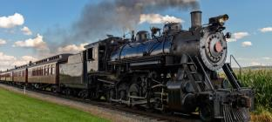
--How are you going to the Shao Lin Temple?
--By train.

Slide 9
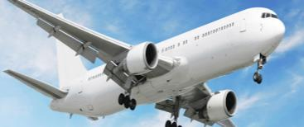
--How are you going to Mount Tai Shan?
--By plane.

Slide 10
--How are you going to Dalian?
--By ship.

Slide 11
--How are you going to Beijing?
--By car.

Slide 12
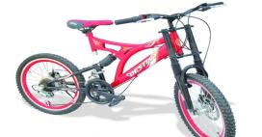
--How are you going there?
--By bike.

Slide 13
--How are you going back to Canada?
--By plane.

Slide 14
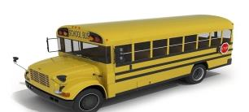
--How are you going to school?
--By bus.

Slide 15
--How are you going to Hainan?
--By ship.

Slide 16
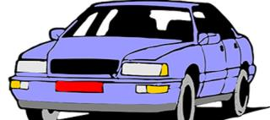
--How are you going to Shanghai?
--By car.

Slide 17
Homework
将重点词汇每个抄写10遍，重点句型每个抄写5遍。
写一篇日记介绍自己的旅行过程。

