Slide 1
Western festivals
第一课时
WWW.PPT818.COM

Slide 2
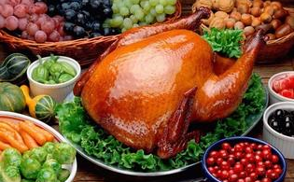
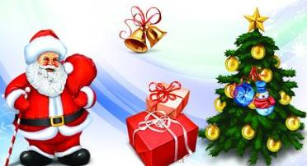
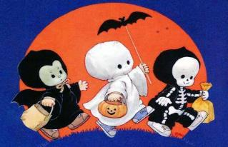
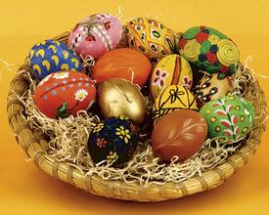
Warm up

Slide 3
Listen and number
4
3
Thanksgiving
( )
Christmas
( )
1
Easter
2
( )
( )
Halloween

Slide 4
Read and answer
1.When is Easter?
2.What do children usually do on Easter?
It’s on a Sunday in March or April.
They usually eat chocolate eggs.

Slide 5
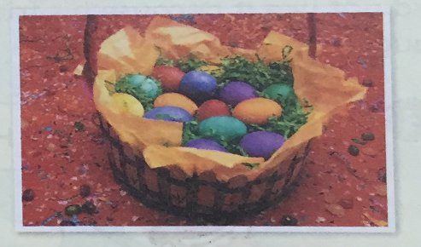
Presentation
Easter

Slide 6
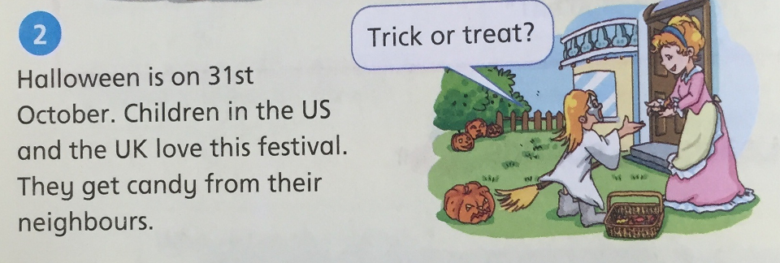
Read and answer
1.When is Halloween?
2.What do children do on Halloween?
It’s on 31st October.
They get candy from their neighbours.

Slide 7
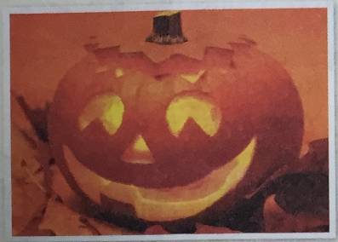
Presentation
Halloween

Slide 8
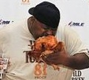
Have a try
1.When …?
It’s ….
2.What …?
They ….
eat turkey

Slide 9
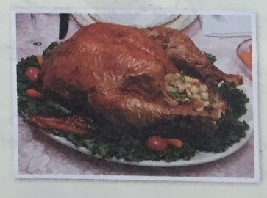
Presentation
Thanksgiving

Slide 10
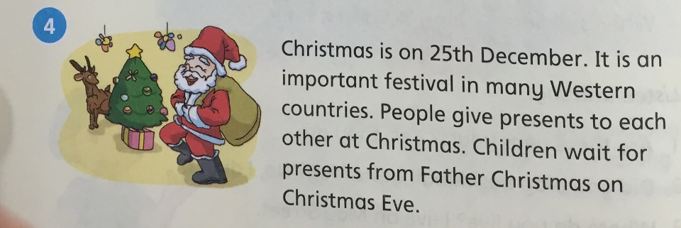
Have a try
1.When …?
It’s ….
2.What …?
They ….

Slide 11
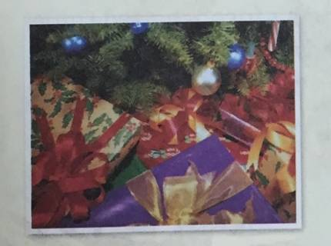
Presentation
Christmas

Slide 12
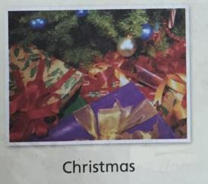
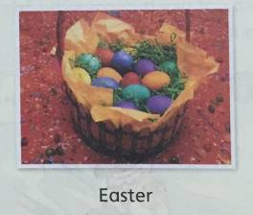
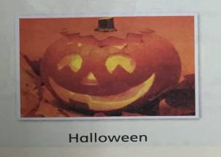
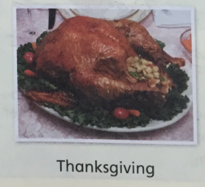
Practice
What’s missing?

Slide 13
Practice
What’s missing?

Slide 14
Practice
What’s missing?

Slide 15
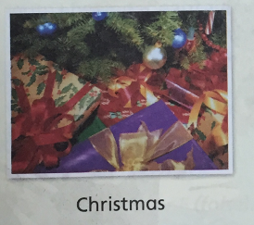
Practice
What’s missing?

Slide 16
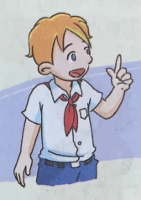
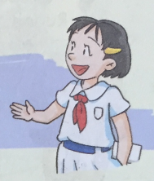
Ask and answer the questions in pairs
When is Easter / …?
It’s on ….
What do people do at this festival?
People usually ….

Slide 17
Homework
1.Tell your parents about the western festivals.
2.Finish P80 Part1.

Slide 18
The End

