Slide 1
Unit5 I like those shoes.
人教精通版四年级上册
WWW.PPT818.COM

Slide 2
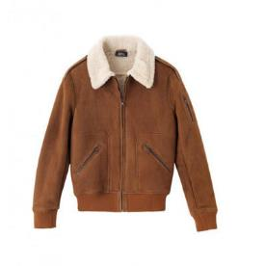
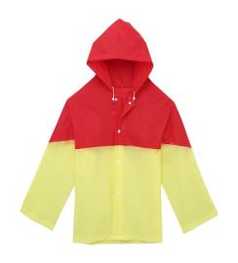
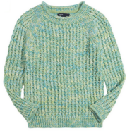
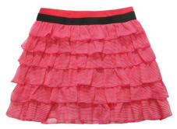
Review
Look and match
raincoat
jacket
skirt
sweater

Slide 3
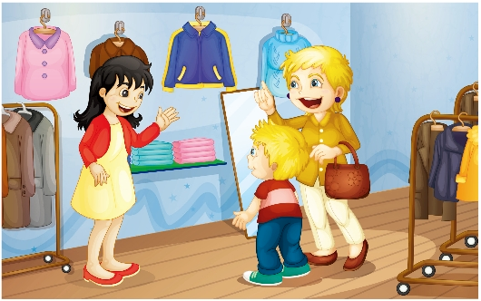
Review
Look and say
2
1
Please show me that _____.
___________?
Can I help you
jacket

Slide 4
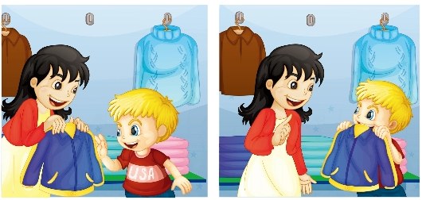
Review
Look and say
3
__________.
Here you are
5
Can I ______?
try it on
4
Thank you.
Sure!
6

Slide 5
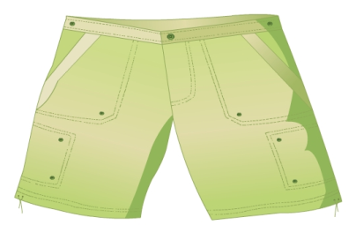
Presentation
Let’s learn
shorts
What colour are the shorts?

Slide 6
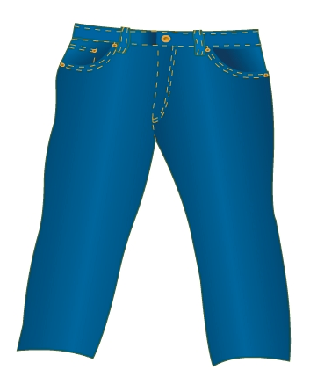
Presentation
Let’s learn
jeans
What colour are the jeans?

Slide 7
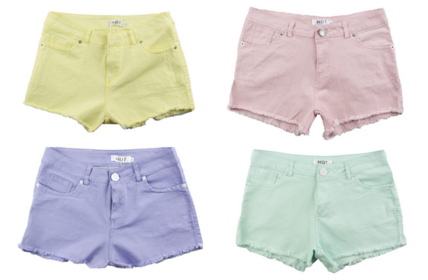
Presentation
Look and say
Look at the shorts.
They are so cool!
cool

Slide 8
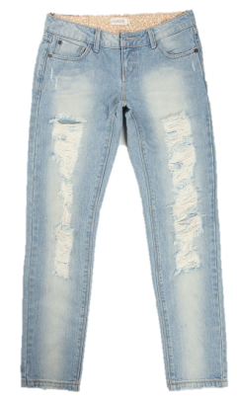
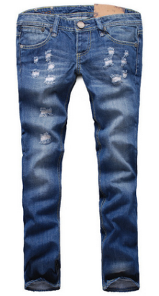
Presentation
Look and say
Look at the jeans.
Do you like them? Can we look at your jeans?

Slide 9
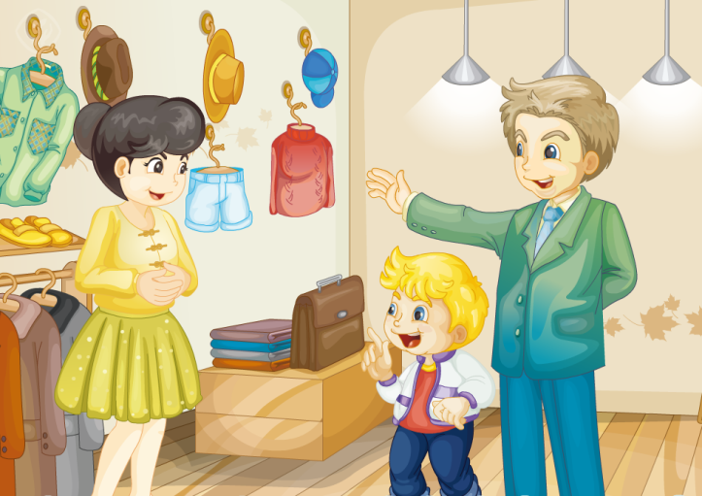
Presentation
Look and say
Guess! What are they talking about?

Slide 10
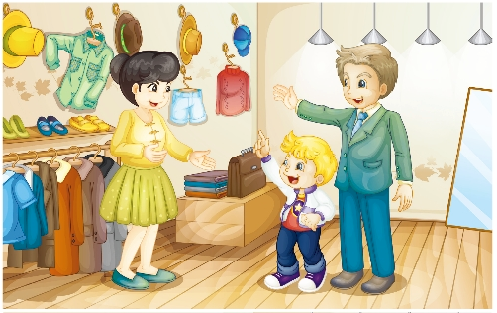
Presentation
Listen and imitate
3
2
Can we look at the blue shorts, please?
Can I help you?
Dad, look at the blue shorts. They’re really cool!
1

Slide 11
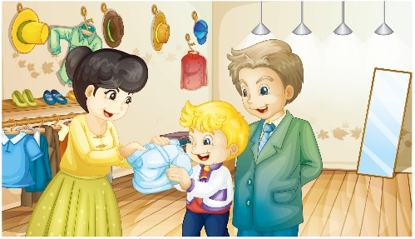
Presentation
Listen and imitate
4
Here you are.
5
Thanks.

Slide 12
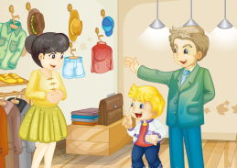
Practice
Let’s read
1
2
3
Read together.
(齐读)
Read in roles.
（分角色读）
Read in groups.
(分组读）

Slide 13
Show time
三人一组试着来表演，其他同学来评价。
 | 模仿录音中的语音语调，有感情地朗读。
 | 可以脱离课本，适当改动其中部分，语音地道。
 | 适当添加内容，意思完整，有创新，表演生动。
Good
Great
Excellent

Slide 14
Just read and write
Practice

Slide 15
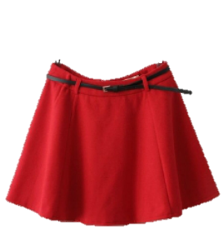
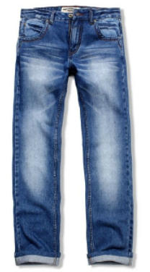
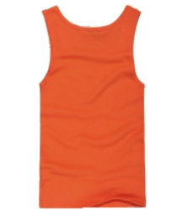
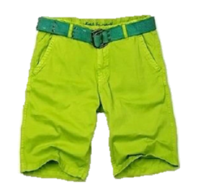
Practice
Ask and answer
A: Can we look at the _____ ___?
B: Here you are.
orange vest

Slide 16
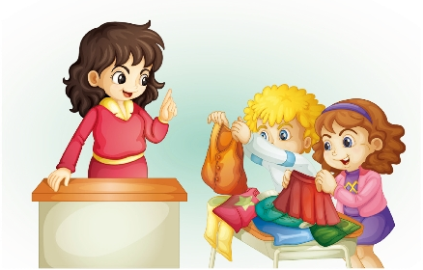
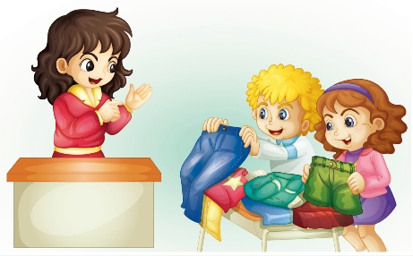
Practice
Let’s play
1
Can I look at the orange vest and the red skirt?
Group racing game：全班以小组形式进行比赛。教师或者一位同学到前面来，大声说出自己感兴趣的衣服，如：Can I look at the orange vest and the red skirt? 哪组图片的衣服和颜色与此相匹配，并能马上找到说出：Here you are. 即得一颗星。游戏结束时星多者获胜。
3
Can I look at the blue jeans and the green shorts?
2
Here you are.
4
Here you are.

Slide 17
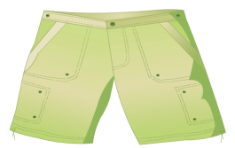
Summary
本课学习的着装类的单词有：
shorts
jeans

Slide 18
Summary
本课学习的有关购物常用语是什么？
—Can we look at …?
—Here you are.

Slide 19
Homework
1. 跟读Just talk部分的课文录音，并注意语音、语调。
2.制作本单元的单词卡片，要求卡片正面为图片，反面为对应的英文单词。
3. 预习Lesson 29。
Close

