Slide 1
The four seasons
Module 4 The world around us
12
12
第一课时
WWW.PPT818.COM

Slide 2
Look and think
12
Colours are everywhere.
But sometimes…

Slide 3
Look and think
How many seasons
are there in a year?

Slide 4
Look and learn
Four seasons
make a year.
What are they?

Slide 5
Look and feel
spring
warm
What season is it?
What colour is it?
How is the weather?
It’s spring.
It’s green.
It’s nice and warm.

Slide 6
Look and feel
summer
It’s summer.
It’s red.
It’s sunny and hot.
hot

Slide 7
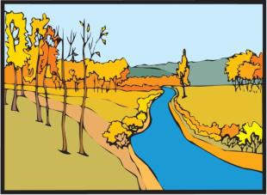
Look and feel
autumn
It’s autumn.
It’s yellow, orange, red and gold.
It’s windy and cool.
cool

Slide 8
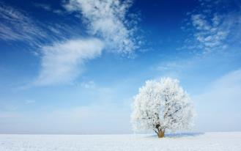
Look and feel
winter
It’s winter.
It’s .
It’s cloudy and cold.
white
cold

Slide 9
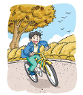
cool
summer
cold
autumn
hot
spring
winter
warm

Slide 10
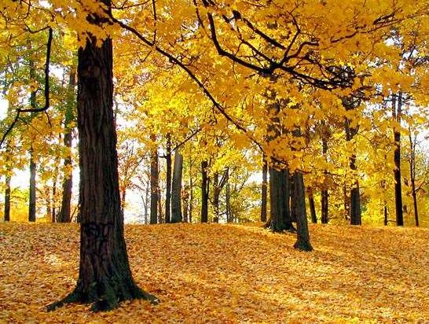
Guess
It’s…

Slide 11
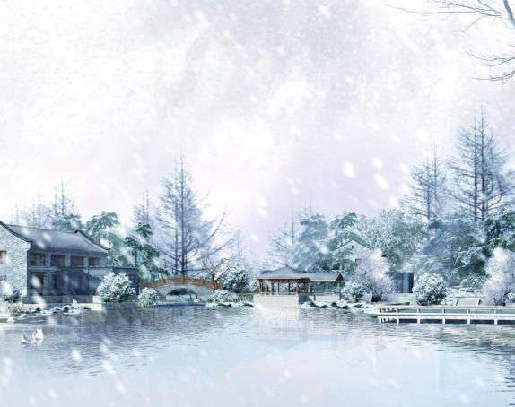
Guess
It’s…

Slide 12
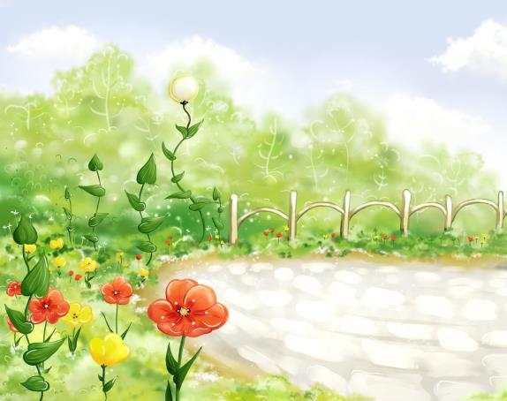
Guess
It’s…

Slide 13
Guess
It’s…

Slide 14
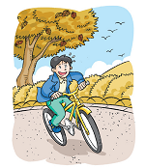
Look and read
autumn
hot
winter
warm
cool
cold
summer
spring

Slide 15
Match and say
In Spring , it is warm.
cool
cold
hot
warm

Slide 16
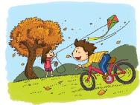
Look and chant
Spring is warm.
Summer is hot.
Autumn is cool.
Winter is cold.
Spring, summer,
autumn and winter.
Warm, hot, cool and cold.

Slide 17
What season do you like best?
What’s your favourite season?
I like spring best. It’s beautiful.
It’s green. It’s nice and warm.
Notes:
17

Slide 18
What’s your favorite season?
Group work
colour
weather
…
I like ____ best. It’s ____. It’s ____.
Notes:
18

Slide 19
Listen and write
Let’s learn more!
spring
warm
In _______, it’s _____ . The trees and grass are green. We can see beautiful glowers, too.
In _________, it’s _____. Days are long and nights are short. We can see many bees and butterflies.
In ________, it’s ______. The trees are red and brown. The grass is yellow.
In _______, it’s _____. Days are short and
nights are long. We can see white snow.
summer
hot
autumn
cool
winter
cold

Slide 20
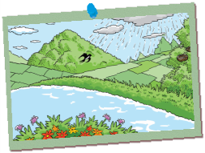
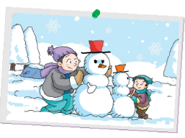
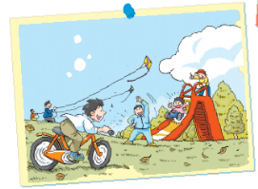
Look and chant
Spring, spring,
nice and warm.
Spring, spring,
I like spring.
____, _____,
____ and ____.
____, _____.
I like _____.
sunny and hot
nice and warm
windy and cool
cloudy and cold

Slide 21
Let’s enjoy our colourful life!

Slide 22
Homework
1 Listen and read Page 58.
2 Copy the words.
spring summer autumn winter
cool cold warm hot
3 Introduce a season.

