Slide 1
Module 2 My family
Unit 1 Is this your mum?
WWW.PPT818.COM

Slide 2
Learning aims
To learn some new words and phrases
2. 理解 “this, these, that, those”这四个指示代词的用法。
3.能用英语表达家庭成员间的人物关系，并能介绍自己的家庭。

Slide 3
Who are the family members
mentioned in this English song ?
这首英文歌曲里面都提及了
哪些家庭成员？

Slide 4
预习检测 “One by one” 说出下列单词的对应词
1. father_______ 2. sister________
3. uncle______
4. grandfather____________
5. girl______ 6.woman________
7. son_________ 8. dad_____
mother
brother
aunt
grandmother
boy
man
daughter
mum

Slide 5
预习检测
Key phrases
1. 一张…… 的照片
2. 在左边
3. 在右边
4. 在……的旁边
5. 在……的前面
6. 一个大家庭
1. a photo of
2. on the left
3. on the right
4. next to
5. in front of
6. a big family

Slide 6
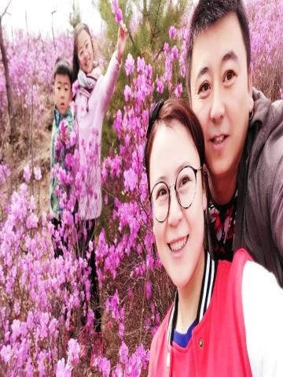
对话1 A: This / That is … B: Is this / that …? A: Yes, it is.
拿出自己的家庭照片 Practice your own dialogues with your partners 和你的同伴练习自己的对话（单数人称）

Slide 7
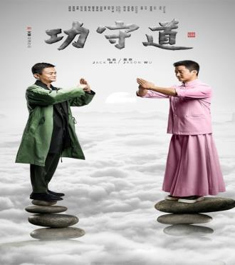
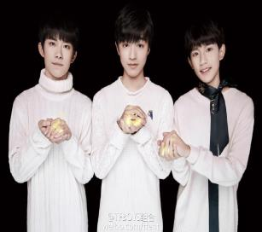
对话2
A: These / Those are …
B: Are these / those…?
A: Yes , they are.
No , they aren’t
根据自己的家庭照片 和你的同伴练习（复数人称）的对话

Slide 8
Grammar
指示代词
 | 单数 | 复数
指近处 | this | these
指远处 | that | those

Slide 9
Watch the video and try to answer these two questions.
1. Is Tony’s family a big family?
2. How many cousins does Tony have?
Yes, it is.
He has two cousins. / Two.

Slide 10
choose the correct answer:
Linda is Tony’s sister / cousin.
Liz is Tony’s mother / aunt.
Paul is Tony’s dad / uncle.
Mike is Tony’s cousin / brother.
速读大闯关！

Slide 11
Underline the correct words
Tony has a big family. In the photo his father’s parents are on the (1) left / right and his mother’s parents are on the (2) left / right. Mike and Helen are Tony’s cousins and they’re (3) in front of / next to Paul. Paul is Liz’s (4) husband / brother.
速读大闯关！

Slide 12
看看哪一组读的最棒！ Read the dialogue in your groups 评分标准（满分5分） 全员参与 1分 声音洪亮 1分 语音语调 1分 准确无误 1分 站姿端正 1分

Slide 13
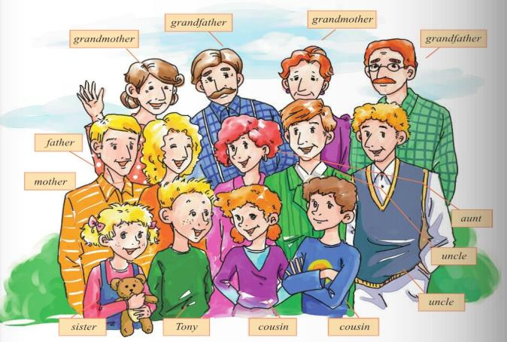
This is a photo of Tony’s family.
grandmother
grandmother
grandfather
grandfather
father
mother
aunt
uncle
uncle
sister
Tony
cousin
cousin

Slide 14
Show time
Come to the front and introuce your family
Hello, everyone !
It’s a photo of my family.
Look, this is my father ,
he is a worker. That is my …
These are my uncles,
they are policemen.
Those are my…
I love my family.

Slide 15
Sum-up
What did you learn this lesson?
本节课你都学会了什么？

Slide 16
Homework
1.写一篇介绍家庭成员的小短 文（提示：可以写家庭成员的基本信息及兴趣，爱好等。）
2. 预习下一个单元的生词（熟读并掌握汉语意思）

Slide 17
Watch a video about “Family” Family is important for us . We should love our family!

Slide 18
历届中考题训练
1. ---Who’s that boy?
--- He is ____ brother.
A.Tom B.Tom’s C.Toms
2. --- Look! What’s ____ in the sky?
--- It looks like a kite.
A. this B.that C. those
√
√

Slide 19
We should love my family and try our best to study hard!
Good bye!

