Slide 1
Unit 10
You are supposed to shake hands.
Section B Period 3 1a-2e
WWW.PPT818.COM
Notes:
1
1

Slide 2
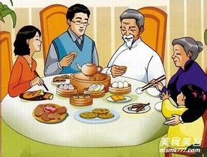
Table Manners
餐桌礼仪
There are many table manners around the world. But different countries have different manners.

Slide 3
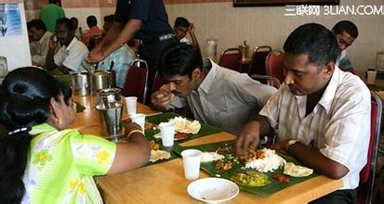
India
In China, you are not supposed to eat with your hands.

Slide 4
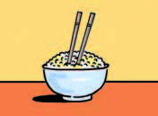
In China, you are not supposed to
stick your chopsticks into the food.
stick….into….把…插入…里

Slide 5
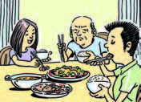
In China,the youngest person is not excepted to start eating first.

Slide 6
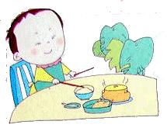
In China, you are not supposed to use your
chopsticks to hit 撞击，敲打an empty空的 bowl.

Slide 7
餐桌礼仪
1a.How much do you know about table manners
around the world?Take the following quiz测试.
Circle T for ture or F for false after each sentence.
Stick to your dream ,you’ll succeed.
坚持你的梦想，你就会成功。（stick---stuck—stuck.）
In India, you’re supposed to eat with your hands.
2. In China, you are not supposed to
stick your chopsticks into the food.
3. In Korea, the youngest person is expected to start eating first.
4. In France, you are supposed to put your bread on the table.
5. In China, it’s impolite to use your chopsticks to hit an empty bowl.
T F
T F
把….插入…里
T F
T F
T F

Slide 8
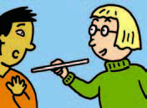
1b.Steve is going to China to study. His friend Yang Ming is telling him about the table manners in China. Listen and number the pictures in the order you hear them.
Listening
2
1
3

Slide 9
1c. Listen again. Match these sentence parts.
c
a
b
在餐桌旁
point at…指向（近处，有不礼貌之意）
point to…指向（远处）
point out指出

Slide 10
listen again and fill in the blanks.
1c
You’re not supposed to talk
B. It’s also impolite to stick your chopsticks into your food
C. you’re not supposed to start eating first
D. You shouldn’t point at anyone with your chopsticks
E. Children are not allowed to speak
F. Only parents are expected to talk
leave for..前往…=go to….
Yang Ming: You must be excited about leaving for China tomorrow, Steve!
Steve: Yeah, but I’m a little nervous, too.
Yang Ming: Why?
Steve: Well, for one thing, I don’t know how to use chopsticks very well ... and I don’t know how to behave at the dinner table.
Yang Ming: Oh, I see. Well, one important thing is that 1. _______ if there are older people at the table.
Steve: That’s interesting. In the United States, it doesn’t matter.
Yang Ming: Yeah, I know. 2. _______. 3. _______, either.
Steve: Oh, OK.
Yang Ming: Oh, and there’s one more thing you need to know. 4. _______when you’re eating dinner. 5. _______.
Steve: Wow! That’s … that’s unusual!
Yang Ming: Haha, I’m just kidding开玩笑!
C
B
D
A
E

Slide 11
1d
Talk about other table manners in your country.
Talk about other manners in your country.
A: We are supposed to…
B: Yes, It’s impolite to…

Slide 12
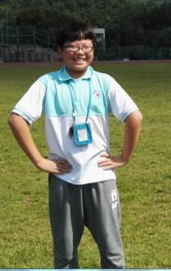
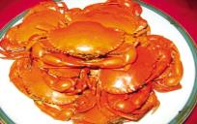
2a
My biggest challenge is learning some basic table manners. Anyway, I’d like to come next time.
went out of his way
Jack
=
Huang Lei
Huang Lei tried his best to make Jack feel at home.
Slowly, Jack got used to the life in Sanmen.
=
eating crabs
Gradually
Notes:
12

Slide 13
2a
Dear Laura,
Thanks for your message. Yes, I’m having a great time on my student
exchange program in France. I was a bit nervous before I arrived here but there was
no reason to be. My host family is really nice. They go out of their way to make me
feel at home. The grandmother knows that I miss Chinese food a lot. So she actually learned how to make Chinese food! She also has a teenage granddaughter about my age. She’s really kind and she always talks to me in French to help me practice. You wouldn’t believe how quickly my French has improved because of that. I’m very comfortable speaking French now. Although I still make lots of mistakes, it doesn’t worry me like it used to.
My biggest challenge is learning how to behave at the dinner table. As you can imagine, things are very different from the way they are at home. For example, you’re not supposed to put your bread on your plate. You’re supposed to put it on the table! I thought that was pretty strange at first, but now I’m used to it. Another example is that you’re not supposed to eat anything with your hands except bread, not even fruit. You have to cut it up and eat it with a fork. Another thing is it’s impolite to say that you’re full. If you don’t want any more food, you should just say, “That was delicious.” Also, you’re not supposed to put your elbows on the table. I have to say that I find it difficult to remember everything, but I’m gradually getting used to it. I don’t find French customs so strange anymore.
I’ll write again soon and tell you more about my life in France. Hope you’re having a good school year.
Yours,
Lin Yue
A tip
Predict from
the picture.

Slide 14
Skimming
Thanks for your message. Yes, I’m having a great time on my student exchange program in France. I was a bit nervous before I arrived here but there was no reason to be. My host family is really nice. They go out of their way to make me
feel at home. The grandmother knows that I miss Chinese food a lot. So she actually learned how to make Chinese food! She also has a teenage granddaughter about my age. She’s really kind and she always talks to me in French to help me practice. You wouldn’t believe how quickly my French has improved because of that. I’m very comfortable speaking French now. Although I still make lots of mistakes, it doesn’t worry me like it used to.
A tip: Usually the first sentence is the topic sentence.

Slide 15
Skimming
What is Lin Yue’s biggest challenge in France?
My biggest challenge is learning how to behave at the dinner table. As you can imagine, things are very different from the way they are at home. For example, you’re not supposed to put your bread on your plate. You’re supposed to put it on the table! I thought that was pretty strange at first, but now I’m used to it. Another example is that you’re not supposed to eat anything with your hands except bread, not even fruit. You have to cut it up and eat it with a fork. Another thing is it’s impolite to say that you’re full. If you don’t want any more food, you should just say, “That was delicious.” Also, you’re not supposed to put your elbows on the table. I have to say that I find it difficult to remember everything, but I’m gradually getting used to it. I don’t find French customs so strange anymore.
A tip: Usually the first sentence is the topic sentence.

Slide 16
Scanning
2b Read and answer the questions.
Why is Lin Yue in France?
Because she is on her student exchange program.
2. Does she enjoy staying with her host
family? How do you know?
Yes, she does. She says her host family is really nice.

Slide 17
3. How does she feel about making
mistakes when she speaks French?
It doesn’t worry her like it used to.
4. What is the biggest challenge she is facing?
Learning how to behave at the dinner table.

Slide 18
Read again and make a list of table manners in France.
You aren’t supposed to … | You are supposed to …
put your bread on your plate.
put it on the table.
eat anything with your hands except bread.
cut up your fruit and eat it with a fork.
say you are full.
say “That was delicious.”
put your elbows on the table.
keep your hands on the table.
Notes:
18

Slide 19
2c Read the sentences and replace the underlined words with the phrases in the box.
1. Making mistakes in French used to make Lin Yue nervous.
2. It was quite hard for her to feel good about speaking French.
3. The host family tried very hard to help Lin Yue.
4. Lin Yue has slowly learned how to be like her French friends.
(something) worry (someone)
be comfortable (doing)
went out of their way
gradually gotten used to being

Slide 20
2d Review the passage and make notes
about French customs in the chart.
Dos | Don’ts
You’re expected to put your bread on the table. | You’re not supposed to put your bread on your plate.
You’re expected to cut up your fruit and eat it with a fork.
You’re not supposed to eat anything with your hands except bread.

Slide 21
Dos | Don’ts
You’re not supposed to say you’re full.
You’re not supposed to put your elbows on the table.
You’re expected to say “That was delicious” if you don’t want any more food.

Slide 22
Free Talk
Can you compare the table manners in France and in China?

Slide 23
In France, people put their bread on the table.
But in China, we always put our food on a plate or in a bowl. We never put food on the table.

Slide 24
Do you know about the table manners in other countries?
Japan
It is OK to make noise when you eat noodles. It shows that you like the food.
It’s important to say traditional phrases of thanks before and after a meal.
Eat sushi whole. Dip the fish part rather than the rice into soy sauce.

Slide 25
Russia
Keep your hands in sight. It is not good manners to rest them on your lap. Keep your elbows off the table.
Leave some food on your plate to show that the host has given you enough to eat. Or the host will ask if you’d like to have a second helping. It’s polite to mop up excess sauce or gravy with bread.

Slide 26
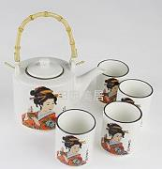
America
If you empty a bottle into someone’s glass, it obliges(强迫) that person to buy the next bottle. It’s polite to put the last drops into your own glass.

Slide 27
Homework
1. 课后阅读短文2b，试着复述短文。
2.根据2e，写一篇短文关于中国和法国不同的餐桌礼仪。

Slide 28
Thank you!

