Slide 1
Unit 4 Christmas
Lesson 21 Christmas Cards
WWW.PPT818.COM

Slide 2
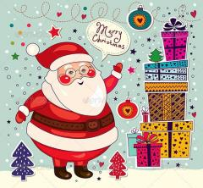
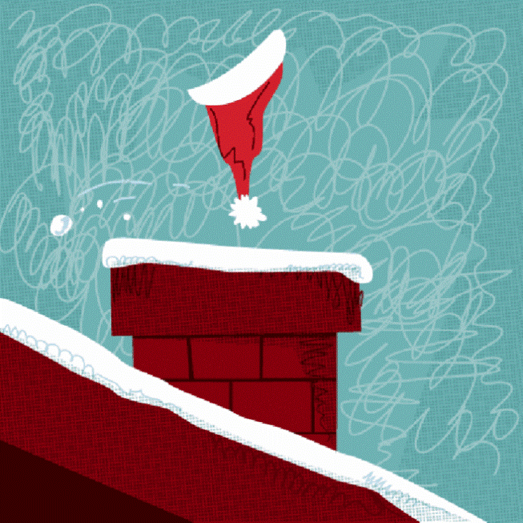
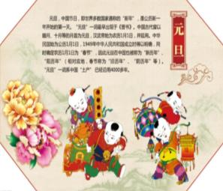
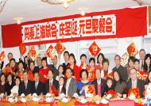
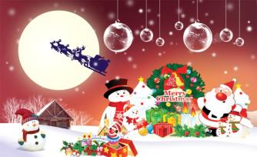
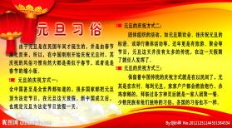
Warming up
中西方在过圣诞节和元旦的不同

Slide 3
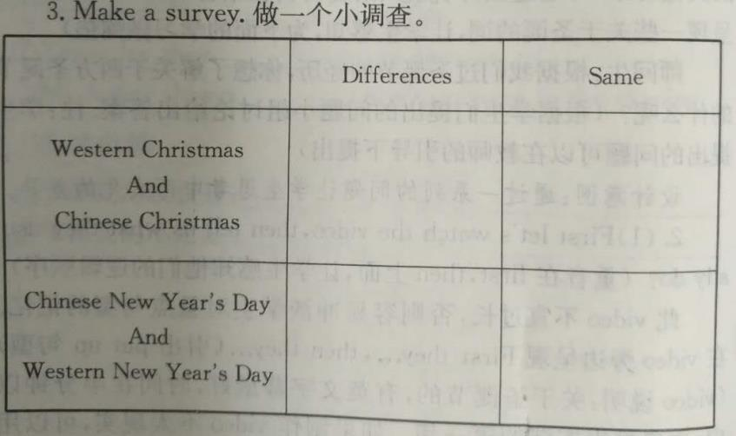
Warming up
完成习题

Slide 4
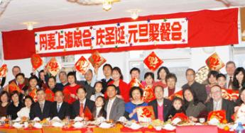
Warming up
What do you usually do
at New Year’s Day?

Slide 5
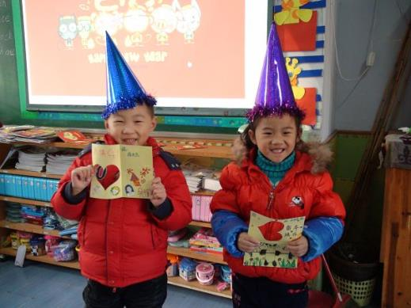
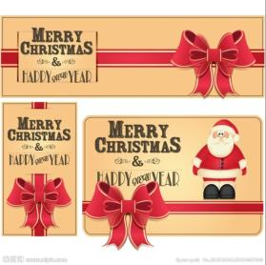
Presentation
1.What are they going to do?
They are going to
write Christmas cards to their friends and family.

Slide 6
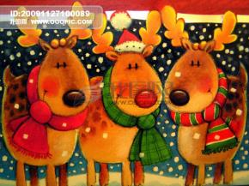
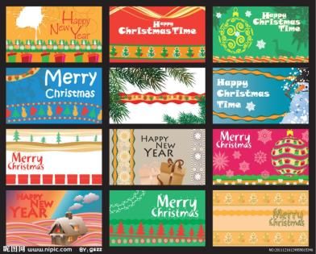
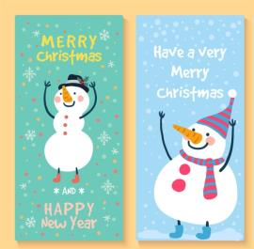
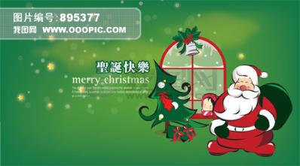
Presentation
2.Which card do you like?
I like the card with…on it.

Slide 7
Presentation
3.Which card does Li Ming like? Why?
A card with Santa on it.
Jing likes Santa.
Li Ming is going to send a card to Jing.

Slide 8
Presentation
4.听录音，完成习题
T
F
T

Slide 9
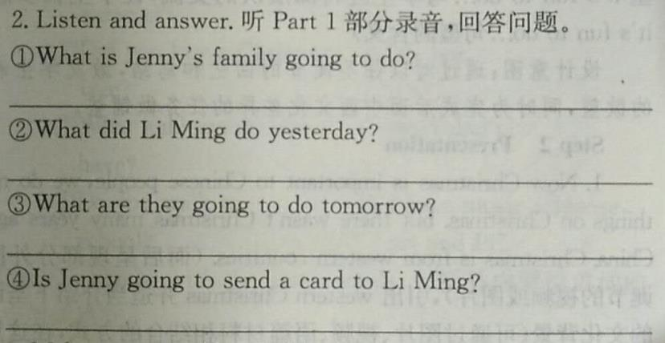
Practice
Jenny’s family is getting ready for the Christmas holiday.
He helped Jenny put up the Christmas tree.
They are going to buy Christmas gifts.
Yes, she is.

Slide 10
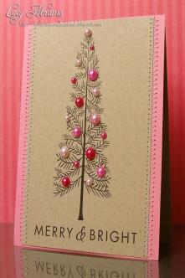
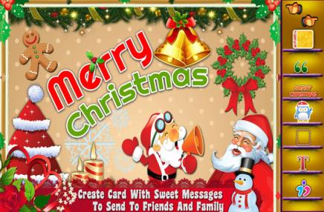
Practice
I like the card with…on it.

Slide 11
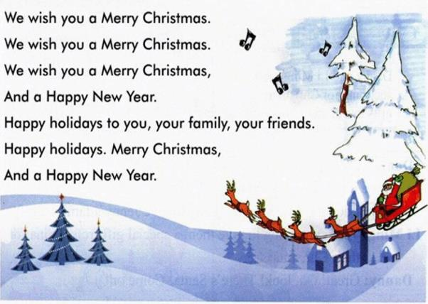
Practice
Let’s sing!

Slide 12
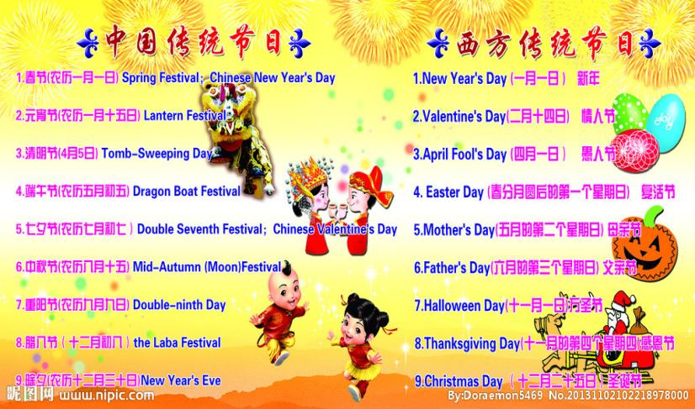
Consolidation

Slide 13
Consolidation
回忆Li Ming 和Jenny昨天做的事情，今天做的事情，并预测下明天会干什么。
 | Yesterday | Today | Tomorrow
Li Ming and Jenny

Slide 14
Summing up
1.Words:
card, family, send, find, write
2. Sentences:
be going to do…
get ready for…
help sb. do
send sth. to…
3.
这节课我的收获是：_____________
这节课我的不足是：_____________

Slide 15
Homework
1.听录音，朗读本课的第一部分
2.课后查找一些关于中西文化差异的其他信息

