Slide 1
Module 2 My family
Unit 3 Language in use
WWW.PPT818.COM

Slide 2
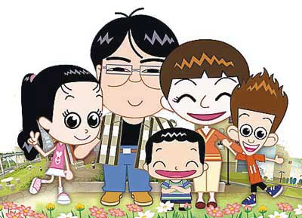
Family photo

Slide 3
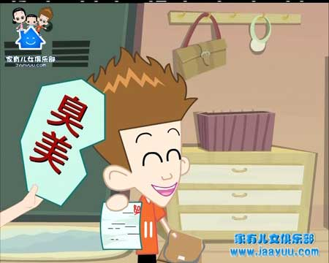
Hi! I’m
Liu Xing.

Slide 4
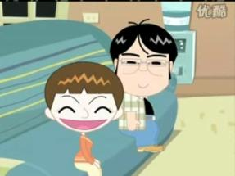
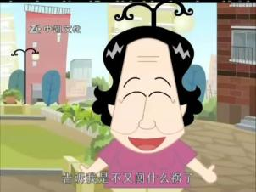
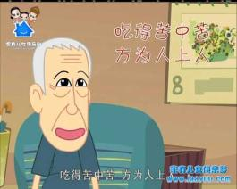
You are Liu Xing. Talk about your family to the class.

Slide 5
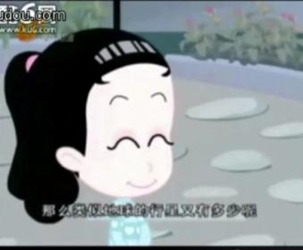
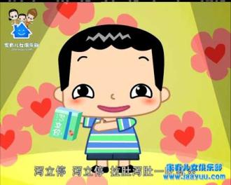
You are Liu Xing. Talk about your family to the class.

Slide 6
FAMILY TREE

Slide 7
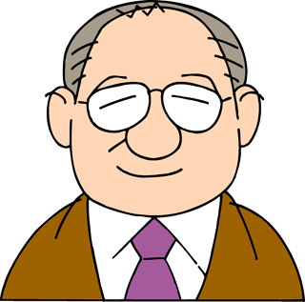
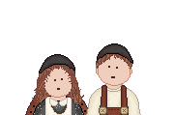
grandmother
grandfather
grandfather
grandmother
father
uncle
aunt
aunt
uncle
mother
brother
cousin
cousin
I
cousin
My family

Slide 8
Please add the words in the box to the family tree.
sister son cousin grandfather mother aunt
grandfather /grandmother
(1)
mother
aunt
father /_____
(2)
uncle/____
(3)
daughter (______)
(4)
daughter (______)
(6)
sister
______ (brother)
(5)
son
cousin

Slide 9
Match the jobs with the work places.
factory worker
manager
student
secretary
teacher
doctor
hospital
university
factory
school
hotel
office

Slide 10
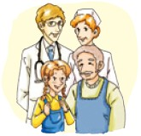
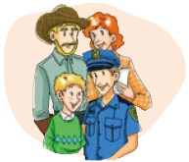
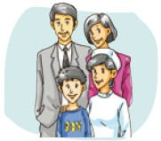
Look at the pictures and talk about the families.
Jack’s family
Father: farm worker
Mother: teacher
Uncle: bus driver
Lily’s family
Father: doctor
Mother: nurse
Grandfather: farm worker
Li Ming’s family
Father: actor
Mother: manager
Aunt: nurse

Slide 11
Write sentences about them.
This is Lily’s family. Her father is a doctor and her mother is a nurse. Her grandfather is a farm worker.

Slide 12
名词所有格的用法
英语中的名词所有格表示一种所属关系,
’s所有格多用于有生命的名词。
★ 构成:
① 在单数名词的末尾加’s构成名词的所有格,
表示 “……的”。
Tony’s mother 托尼的妈妈
Tom’s pen 汤姆的钢笔
②在以-s 或-es结尾的复数名词后只需加’。
the girls’ bags 女孩们的书包

Slide 13
③在不以-s 或-es 结尾的复数名词后，
加’s构成所有格。
Women’s Day 妇女节
④如表示无生命物体的所有关系, 一般用of。
the door of the classroom 教室的门
⑤表示时间、距离的名词所有格与有生命的
名词所有格构成方法相同。
today’s class 今天的课

Slide 14
★ 注意:
①可用名词所有格表示地点。at my aunt’s 在我姑姑家，at the doctor’s 在医生的诊所
②如果并列名词各自所拥有某物，每个名词后都加’s；若表示两人共同拥有的物品，在最后一个名词后加’s。
Linda’s and Jim’s mothers琳达和吉姆的妈妈Lucy and Lily’s room 露西和莉莉的房间

Slide 15
this, these, that, those的用法
通常我们谈论离自己近的 人或物时用this/these, 离自己远的人或物时用that/those。如：
I like these books, but I don’t like those books.
This girl is Mary.
That boy is in Class 5.

Slide 16
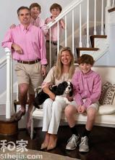
在英语中，this, these, that, those这四个词称为“指示代词”，用来指示或标识人或事物。其中，this 和 that 为单数指示代词，these 和 those 为复数指示代词。
This is my mother.
That’s my dad.
These are my parents.
Those are Paul’s son and daughter.
They are my brother and sister, too.

Slide 17
这些指示代词作主语构成一般疑问句时，答句所使用的主语变化，请观察以下句子:
Is this your bike?
Are these your grandparents?
由此可以看出，当指示代词所指的事物已确定时，后面的指示代词指人时用he, she和they来代替，指物时用it和they来代替。
—Is that a bird or a plane? —It’s a plane.
—Is this your friend Tony? —Yes, he is.

Slide 18
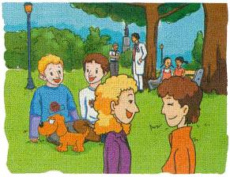
Look at the picture and complete the sentences with this, that, these or those.
These
_______ are my sons, Tom and Alex.
_______ is our dog.
_______ is my uncle.
He’s a bus driver.
3.--Is ____ man a doctor?
-- Yes, he is.
4.-- Are _____girls students?
-- Yes, they are.
This
That
that
those

Slide 19
Write sentences.
His father is a hotel manager. (Tony)
Her parents are teachers. (Sarah)
His parents are shop workers. (Wang Hui)
Tony’s father is a hotel manager.
Sarah’s parents are teachers.
Wang Hui’s parents are shop workers.

Slide 20
His mother is a nurse. (Daming)
Her father is a bus driver. (Lingling)
Daming’s mother is a nurse.
Lingling’s father is a bus driver.

Slide 21
Match the words in Column A with the words in Column B.
A
he
I
it
she
they
we
you
B
her
his
its
my
your
their
our

Slide 22
Look and learn.
I am a teacher. My students know me well.
You are students. The teachers chat with you.
She is a girl. All the students like her.
He is a boy. A lot of boys play with him.
They are lovely kids. We all like them.
We are friends. Let us help each other.
It is big and nice. We like it very much.

Slide 23
I you she he they we it
personal pronouns （人称代词）
subject form（主格）

Slide 24
me you her him them us it
personal pronouns （人称代词）
object form（宾格）

Slide 25
人称 | 单数 |  | 复数
 | 主格 | 宾格 | 主格 | 宾格
第一人称
第二人称
第三人称
me
we
us
I
you
you
you
you
he
she
it
him
they
them
her
it

Slide 26
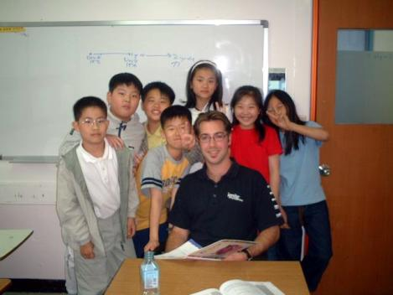
Practice
I am a teacher. My students like ____.
me

Slide 27
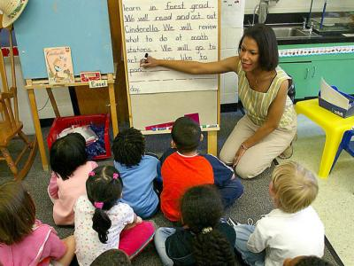
You are students. I teach _____ English.
you

Slide 28
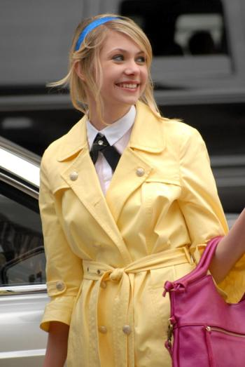
She is a girl. We call ____ Shirley.
her

Slide 29
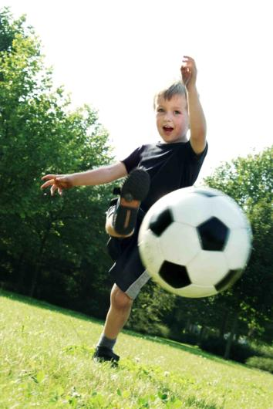
He is a boy. All the boys like ____ because he is good at football.
him

Slide 30
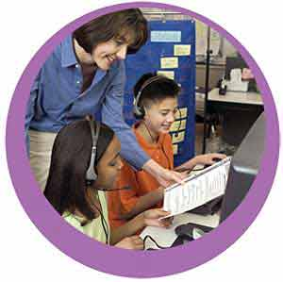
They are partners. Our English teacher likes to ask _____ to read the dialogues.
them

Slide 31
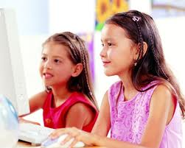
We are friends. Our classmates call ____ sisters.
us

Slide 32
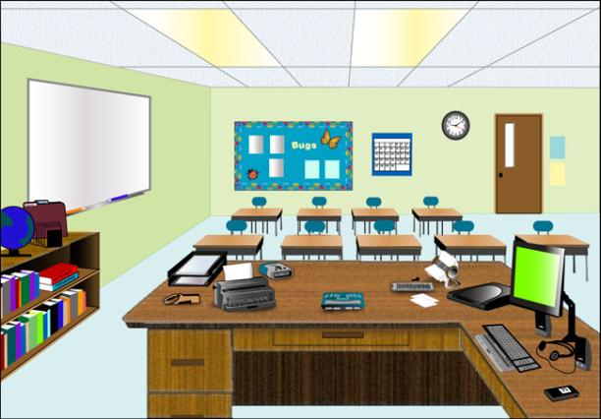
This is our classroom. It is big and nice. We like ___ very much.
it

Slide 33
Complete the passage with the words from the box.
he her his my we our she their
Hello! My name is Amy. These are _____ friends. ______ names are Jack, Lily and Mike. Jack is American. _______ father is a doctor. He is ______ family doctor. Lily isn’t American. _______ family is Chinese. Mike isn’t Chinese. _______ is English. Mike’s mother is a teacher. _______ is our English teacher. _______ are her students.
my
Their
His
our
Her
He
She
We

Slide 34
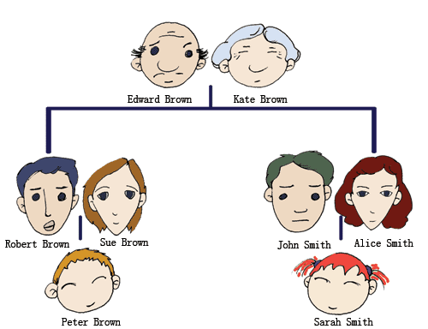
Writing about your family
Draw your family tree. Work in pairs. Talk about each other’s family.

Slide 35
Writing about your family
A sample
My family
I have a happy family. My family has five people: grandpa, grandma, father, mother, and me. My grandparents live in the countryside. They are healthy. My parents and I live in the city. My father is a worker. His work is hard. My mother is a high school's Chinese teacher. She takes bicycle to work at seven o'clock. In the afternoon, she doesn't go home. In the evening, she makes supper. The food is delicious. I am a student. I have Chinese, math and English every day. I have many friends. After class, I play with my friends. I love my family.

Slide 36
Exercises
Fill in the blanks.
1.My job is a teacher. ____work in Ninghai
Middle School.
2.My home is in Ninghai Road._____ live near
my school.
3.Sandy,_____should listen to me carefully.
4.Simon, do ____ know where Mr. Hu is?
5.Millie loves reading. _____is a member of
the Reading Club.
I
I
you
you
She

Slide 37
6.Simon loves playing football. _____often
plays football after school.
7.The cat is very lovely. ____ is climbing up
the tree.
8. “Simon and Millie, do ______work together?”
asks Miss Wang.
9.Daniel and Kitty go to school together.
_____ live near each other.
10.The children are playing basketball on the
playground. ______ are very happy.
He
It
you
They
They

Slide 38
Translate the following phrases.
1. a photo of
2. on the left
3. on the right
4. next to
5. in front of
6. a big family
一张…… 的照片
在左边
在右边
在……的旁边
在……的前面
一个大家庭

Slide 39
7. 公共汽车站
8. 公安局
9. 公交车司机
10. 在学校
11. 例如
12. 家谱
bus station
police station
bus driver
at a school
for example
family tree

Slide 40
Complete the words.
1. This is a photo of Ann’s f_____. Look! This is h__ father.
2. They are my p______, my father and my mother.
3. What is your father’s job? He is a hotel m______.
4. This is my brother. H__ is a driver.
5. Mr. Li works in a school. He is a t______.
amily
er
arents
anager
e
eacher

Slide 41
Choose the best answer.
( ) 1.-____your uncle? -He is a hotel manager.
A. What’s B. Who’s
C. Where is D. How is
( ) 2.She is an English girl. ____name is Betty.
A. His B. My
C. Her D. Hers
A
C

Slide 42
( ) 3. This is _____ bedroom.
A. Wanglin’s and Wangping’s
B. Wanglin’s and Wangping
C. Wanglin and Wangping’s
C

Slide 43
Rewrite the following sentences.
1. This is my parent. (改为复数形式）
_____ are our _______.
2. His mother is a teacher.（对画线部分
提问）
_____ is his mother’s ____?
3. What is your father? （改为同义句）
What ____ your father ___?
4. My father works at a school.
______ does your father _____?
These parents
What job
does do
Where work

Slide 44
Homework
Use I / we / you / he / she / it / they /
me / us / him / them to introduce you or your friends.
Finish the exercises on your workbook.

