Slide 1
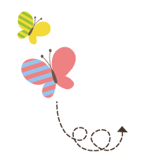
111111111111111111111111111111111111111111111111111111111111111
Unit 3 What Will You Do This Summer?
六年级下册
Lesson15 Jenny’s Summer Holiday
WWW.PPT818.COM

Slide 2
Can you swim?

Slide 3
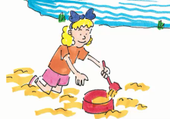
What will Jenny do this summer?
Liming: What will you do for the summer holiday, Jenny?
Jenny: My family likes to go on trips in the summer.
Last summer, we went to a lake with my grandmother and grandfather. I swam in the lake.
I played on the beach. I like playing on the beach!
This summer, we will go on a trip to the sea. I will swim in the sea!
I will watch the ships and boats on the sea.

Slide 4
知识点1
What will you do for the summer holiday, Jenny? 暑假你将要做什么，詹妮？
询问某人的计划的句型
What will +主语+do+其他？
句型结构：
例句：
What will you do this afternoon?
今天下午你将做什么？
What will your sister do after breakfast?
早餐后你妹妹将做什么？

Slide 5
holiday / 'hɒlɪdeɪ/ n. 假期
vacation假期
同义词：
on holiday在度假 summer holiday暑假
winter holiday 寒假
短语：
I will go to the Great Wall this summer holiday.
今年暑假我将去长城。
例句：

Slide 6
知识点 2
go on trips 去旅行
go on a trip去旅行
同义短语：
Let’s go on trips this summer.
今年夏天咱们一起去旅行吧。
例句：
go on trips/ go on a trip ＋to ＋地点， 意思是“去某地旅行”。
拓展

Slide 7
知识点 3
lake /leɪk /n. 湖
I swam in the lake last summer.
去年夏天我在湖里游泳了。
例句：
谱系记忆法：
ake
cake n． make v． take v． wake v．
蛋糕 制作 带走 弄醒

Slide 8
in the lake 在湖里
短语：
river小河多清澈，lake湖里鱼儿多，
grass青青草儿， flower花朵满山坡，
sky天空真辽阔，cloud白云一朵朵，
mountain 山峰一座座，forest森林木材多。
魔法记忆：

Slide 9
知识点 4
swim /swɪm / v. 游泳(过去式为swam)
I like to swim in summer.我喜欢在夏天游泳。
例句：
go swimming 去游泳
短语：
swim(原形)→ swims(第三人称单数)→ swimming(现在分词)→ swam (过去式)
词形变化：
图示记忆法：

Slide 10
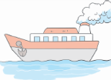
知识点 5
ship /ʃɪp/ n. 船；舰
We will go to Shanghai by ship.
我们将乘船去上海。
例句：
by ship 乘船 take a ship 乘船
短语：
对比记忆法：
ship boat

Slide 11
2. Let's do it!
Read Part 1 and answer the questions.
1．What did Jenny do last summer?
____________________________________
2．Who did Jenny go with?
____________________________________
3．What will Jenny do this summer?
____________________________________
She went to a lake.
Her family and her grandparents.
She will go on a trip to the sea.

Slide 12
2. Let's do it!
4．What will Jenny watch on the sea?
___________________________________________
5．What did you do last summer?
___________________________________________
6．What will you do this summer?
___________________________________________
She will watch the ships and boats on the sea.
I went to Beijing.
I will go on a trip to Hainan.

Slide 13
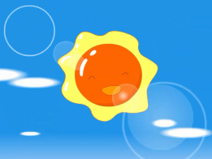
3. Let's sing!
Oh, summer's coming, coming soon.
When school is done, what will you do?
In summer, summer, summertime，
Summer, summer, summer.
Oh, I'll swim in the ocean blue.
Will you swim, too? Will you swim, too?
In summer, summer, summertime，
Summer, summer, summer.

Slide 14
一、按要求完成下列各题。
（1）I will play football with my friends.(改为一般疑问句)
________ ________ play football with your friends?
（2）Steven will go on a trip for the summer holiday. （对画线部分提问）
________ will Steven ________ for the summer holiday?
（3）I watched the ships on the sea last summer.(将last改为next，然后改写句子)
I ________ ________ the ships on the sea next summer.
Will you
What do
will watch

Slide 15
二、用括号中所给单词的适当形式填空。
（1） We want to go on ________(trip) this summer.
（2）My father and I ________(swim) in the sea last summer.
（3）Do you like _______________(play) in the park?
trips
swam
to play/playing

Slide 16
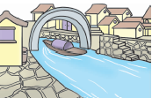
三、判断下列句子与图片内容是（T）否（F）相符。
（ ）（1）I will go there by ship．
（ ）（2）My sister swam in the lake last summer.
F
T

Slide 17
本节课我们学习了以下知识，请同学们一定加强巩固，以便能和同学们进行灵活交流哦！
重点词汇：holiday, lake, swim, ship
重点短语：go on trips
重点句式：What will you do for the summer holiday, Jenny?

Slide 18
1 熟记本节课所学的句型、短语和单词，必须会听、说、读、写。
2 将What will Jenny do this summer? 朗读流利。
3 完成配套的课后作业。

