Slide 1
八年级下册
Module 5 Cartoons
Unit 1 It's time to watch a cartoon.
WWW.PPT818.COM

Slide 2
Warming up
Think about these questions:
Do you like cartoons? What’s your favourite cartoon character?
• Can you talk with others about cartoons?

Slide 3
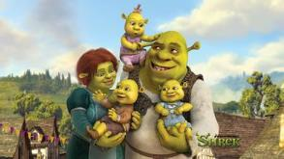
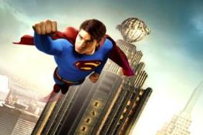
Warming up
Can you list some popular cartoon characters?
Shrek 史瑞克
Superman 超人

Slide 4
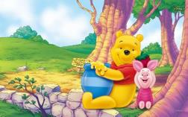
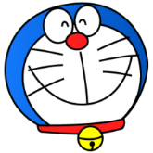
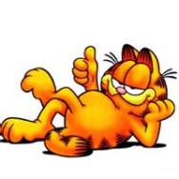
Warming up
Doraemon
叮当猫
Winnie the Pooh
维尼熊
Garfield 加菲猫

Slide 5
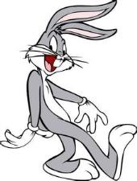
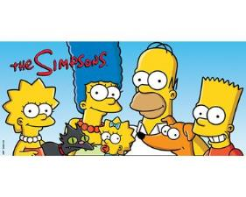
Warming up
Bugs Bunny 兔八哥
The Simpsons
辛普森一家

Slide 6
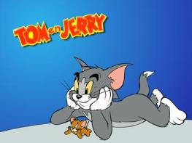
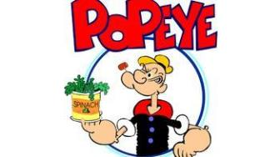
Warming up
Tom and Jerry
猫和老鼠
Popeye
大力水手

Slide 7
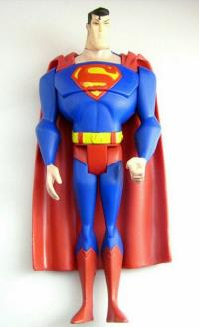
Lead in
《超人》（Superman）1938年6月于《动作漫画》创刊号上首次登场，是漫画史上第一位超级英雄。超人本是来自于氪星的一个小婴孩，被地球上的一对夫妇拾获，取名为Clark Kent，抚养成人。 Clark Kent长大后成为大都市《星球日报》的一名新闻记者。他有着与生俱来的超能力和极强的正义感和同情心，每每在危机时刻，便穿上蓝色紧身衣，披上红色斗篷，化身超人挺身而出，行侠仗义，拯救世人。
Superman

Slide 8
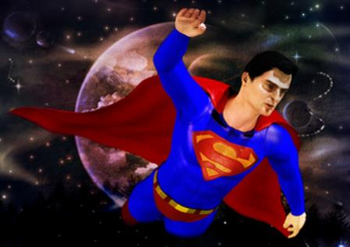
Lead in

Slide 9
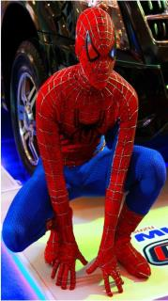
Lead in
《蜘蛛侠》(Spiderman )首次登场是在1962年8月杂志《惊奇幻想》第十五期，后来十分受欢迎才有了以他为主题的漫画。 《蜘蛛侠》(的主人公是高中生彼得·帕克(Peter Parker)，原本是个木头木脑的书呆子，在参观经过基因改造实验的蜘蛛时，意外地被一只逃跑的但体内带有放射性物质的蜘蛛咬伤。强大的放射性物质很快转移到彼得身上，从此，他发现自己拥有了不可思议的超能力，成为声名远扬的蜘蛛侠。变成蜘 蛛侠的彼得承担起了重大的社会使命，要竭尽全力打击罪恶势力，为社会除暴安良。
Spiderman

Slide 10
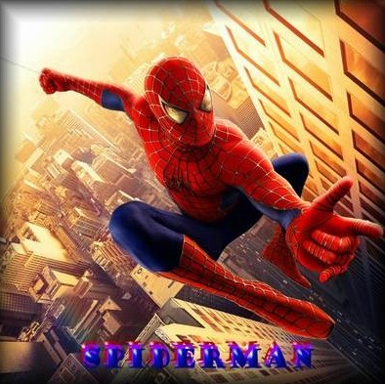
Lead in

Slide 11
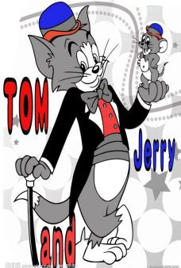
Lead in
《猫和老鼠》（Tom and Jerry )是美国好莱坞动画界的传奇。从1940年问世以来，一直是全世界最受欢迎的卡通之一。90年代引进中国后更是得到从6岁到60岁的人们的狂热喜爱。《猫和老鼠》采用了猫和老鼠的原型，故事情节围绕一只家猫汤姆和与它同居一室却难以抓住的老鼠杰瑞展开，汤姆不断地努力驱赶这位讨厌的房客，但似乎总是失败。

Slide 12
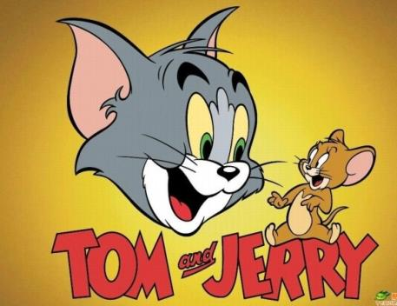
Lead in

Slide 13
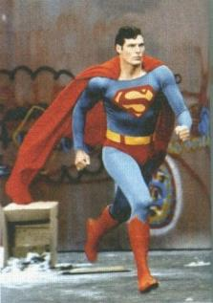
Listening and vocabulary
1.Answer the questions.
1.What kind of cartoons do you like?
2.Do cartoons always end in a happy way?
3.What cartoons do you think are funny?

Slide 14
Presentation
2. Listen and find out Betty's and Tony's answers to the questions in Activity 1.
1. What kind of cartoons do you like?
Betty likes exciting cartoons; Tony likes funny cartoons.

Slide 15
Presentation
2. Do cartoons always end in a happy way?
3. What cartoons do you think are funny?
Betty and Tony say cartoons always have happy endings.
Tony thinks Tom and Jerry is funny.
Now work in pairs and check. Do they like the same cartoons as you?

Slide 16
Presentation
3. Listen and read.
Tony: Daming, we’ve finished our homework.
It’s time to watch a cartoon.
Daming: Good idea, Tony. Let’s watch Superman!
Tony: We watched Superman yesterday. Why
don’t we watch Spiderman? It’s more
modern.
Daming: I think Superman is better. He’s
stronger than Spiderman. He can fly
through the sky and fight bad people.

Slide 17
Presentation
Tony: Spiderman can’t fly, but he climbs up
buildings with his hands and feet.
That’s cool. I want to be someone like
him.
Daming: Well, Superman is brave. He keeps
fighting bad people. That’s a real hero!
Tony: I don’t think we agree.
Daming: All right. Let’s watch Tom and Jerry
then.

Slide 18
Presentation
Tony: Yeah! I like humorous cartoons. Tom
and Jerry are very funny. I can’t help
laughing when I watch them.
Daming: Yes, Jerry is too smart for Tom.
Tony: The cute mouse always beats the cat!
They fight a lot, but they really love
each other. Sometimes they protect
each other and work together. I think
there’s a lesson there!

Slide 19
Presentation
Now answer the questions.
What does Tony think about Spiderman?
2. Why does Daming think Superman is better?
It is more modern and Spiderman is cool.
Superman is stronger than Spiderman. He can fly through the sky and fight bad people and he is a real hero.

Slide 20
Presentation
3. Why do they both like Tom and Jerry?
4. What lesson can Tony learn from Tom and Jerry?
It’s humorous and Tom and Jerry are very funny.
He can learn a lot about people and life from them — although they fight a lot, they love, help and protect each other too.

Slide 21
Presentation
4. Complete the passage with the correct form of the words in the box.
cartoon fight hero humorous laugh lesson
Children and adults all over the world love (1)_________. Some, like Tom and Jerry, are (2)__________, and people enjoy (3)_________ at the funny stories in them. Others, like Superman and Spiderman, are about (4)_____ .They (5)______ bad people to protect the world. These cartoons are not just stories — they also teach (6)_______about good and bad.
cartoons
humorous
laughing
hero
fight
lesson

Slide 22
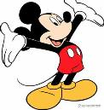
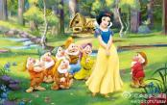
Presentation
5. Work in pairs. Describe your favourite cartoon character or the characters below. Use the words in the box in Activity 2 to help you.
☺ Nezha
☺ Mickey Mouse
☺ Pleasant goat
☺ Snow White

Slide 23
Presentation
Example:
— I think Nezha is brave.
— Yes, I think so too. / No, I think he is…
Please describe what characters do or can do, and what they are like.

Slide 24
Summary
本课时主要短语和句型
1.keep doing sth.
2. can’t help doing sth.
3. It’s time to…
4. I don’t think we agree.
5. We’ve finished our homework.
6. Why don’t we…?

Slide 25
Exercise
根据句意和汉语提示写单词。
1. He is so __________ (幽默的）that he always makes people laugh.
2. Soldiers should _________ (保护) their country.
3. They _______(与……战斗）bad people.
4. He is a ____________(英俊的) young man.
5. A ______ (勇敢的)fireman saved the woman.
humorous
protect
fight
handsome
brave

Slide 26
Homework
1.Learn the new words and expressions in this module.
2.Write a short paragraph about your partner’s favourite cartoon character.

