Slide 1
Unit 4
Is it in your schoolbag?
WWW.PPT818.COM

Slide 2
Is the English book in the schoolbag?
Yes, it is./ No, it isn’t.

Slide 3
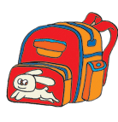
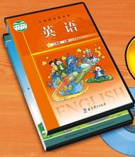
schoolbag
an English book

Slide 4
TV

Slide 5

方位介词:
on
in
under
behind
in front of
在…上面
在…里面
在…下面
在…后面
在…前面
near 在…附近
beside 在…旁边

Slide 6
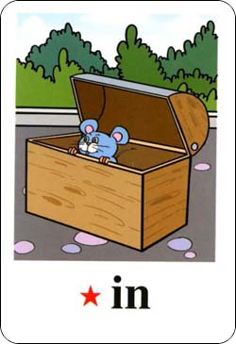
Where is it?

Slide 7
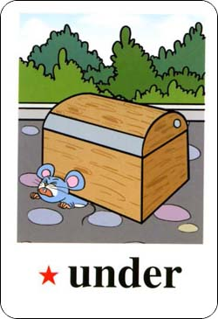
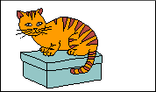
0n

Slide 8
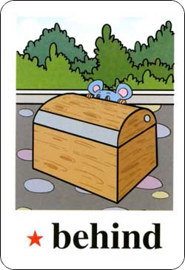
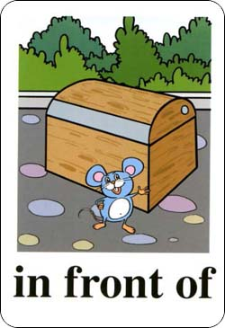

Slide 9
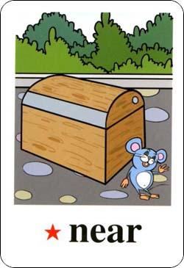
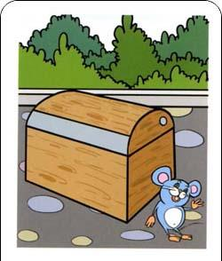

Slide 10
里面 in,上面 on,
under 就在正下方。
前面就是in front of,
后面就用behind.
在旁边beside,
near near是附近,
距离远近要明确。

Slide 11
Look and say
________the pencil?
It’s____ the table.
Where’s
on

Slide 12
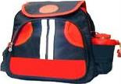
________the schoolbag?
It’s _______ the table.
Where’s
In front of

Slide 13
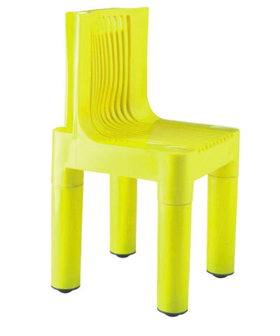


Where's the pen?
It’s the chair.
near

Slide 14
Where's the pen?
It’s the chair.
beside

Slide 15
Where's the pen?
It’s the chair.
behind

Slide 16


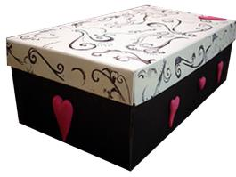
Pair work
A: Where’s the… …?
B: It’s in/on/under/near/behind…

Slide 17
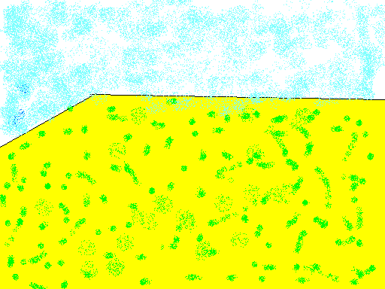

Is the schoolbag on the chair?
Is the TV on the table?
No, it isn’t.
Yes, it is.

Slide 18
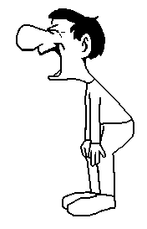
Guessing Game:
Where’s the TV?
Is it on / in / under / …?
It’s on the table.

Slide 19
Where’s the chair ?
Is it on / in / under / …?
It’s near the table.

Slide 20

Where’s the English book ?
Is it on / in / under / …?
It’s behind the TV.

Slide 21
Where’s the schoolbag?
Is it on / in / under / …?
It’s under the chair.

Slide 22
Where is the schoolbag?
Is it on / in / under / …?
It is in front of the TV.

Slide 23

Where are the cats?
Are they on/in/under/behind…?
They’re on the bike.

Slide 24
里面 in,上面 on,
under 就在正下方。
前面就是in front of,
后面就用behind.
在旁边beside,
near near是附近,
距离远近要明确。

Slide 25
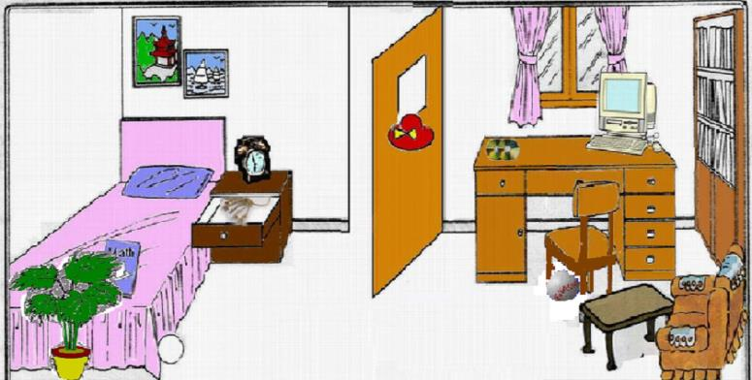
practice
This is my room. It’s very nice(漂亮). The computer(电脑) is ___the desk. The ball is ______ the chair. My ____ __ are in the bookcase（书架）. Near the ____ ,you can see my plant（盆栽）. _______ my red hat ? Oh, it’s behind the door.
on
under
books
bed
Where’s

Slide 26
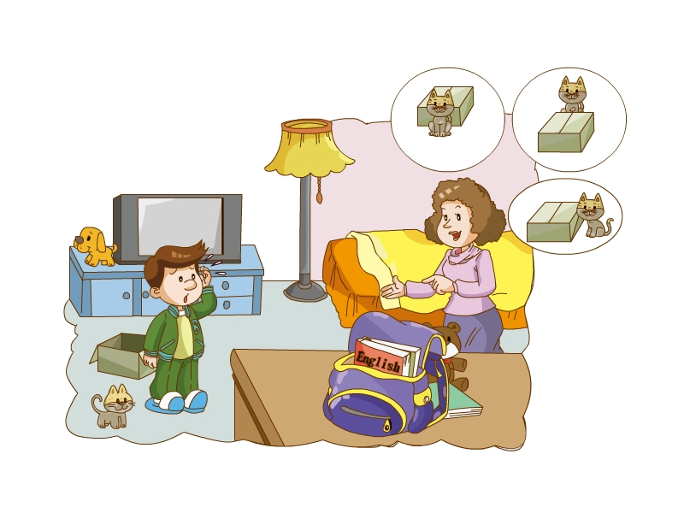
Listen and say.
Fun with language.

Slide 27
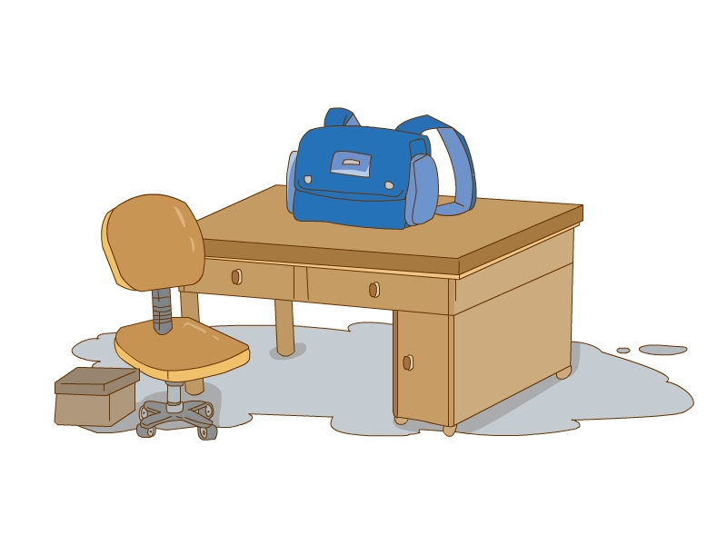
Listen and draw.

Slide 28
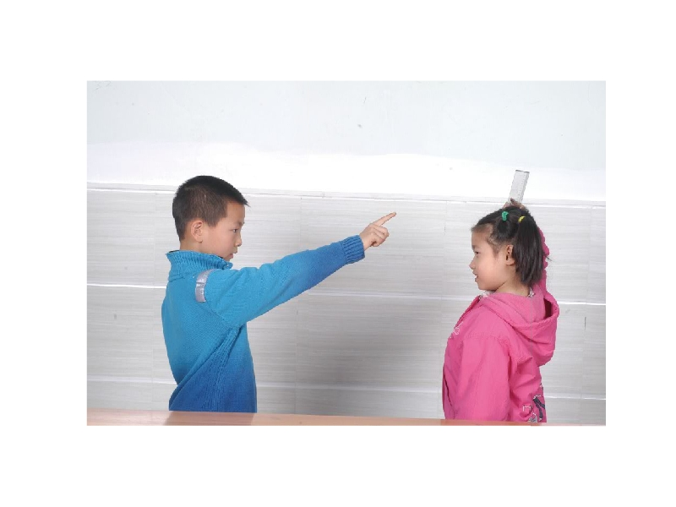
say and do.

Slide 29
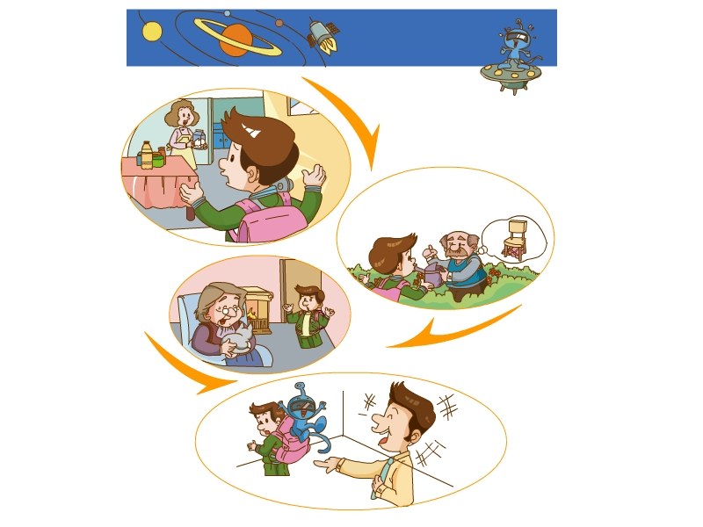
story.

Slide 30
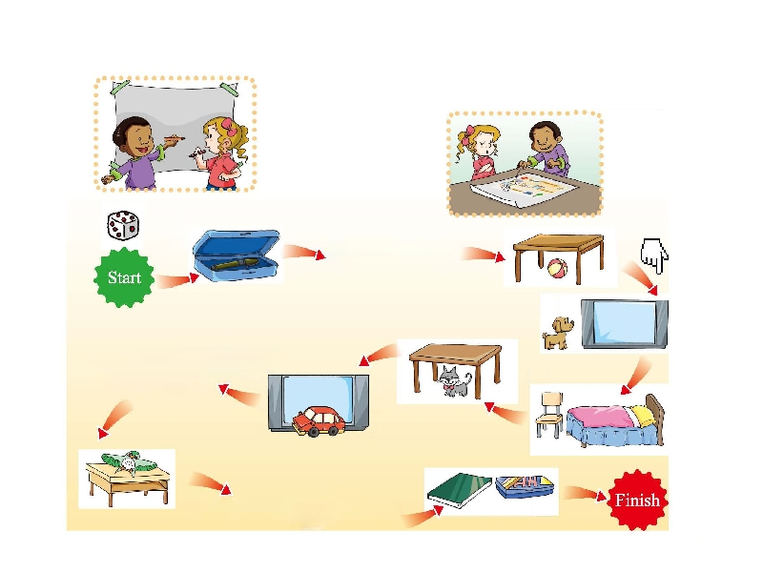
Do the project.

Slide 31
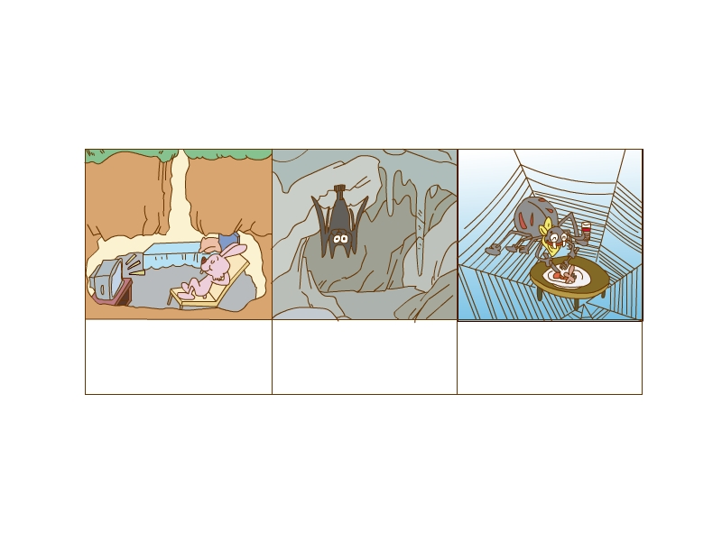
Animal homes.

