Slide 1
冀教版英语 七年级下册
Unit 8 Summer Holiday Is Coming!
Summer Plans
WWW.PPT818.COM

Slide 2
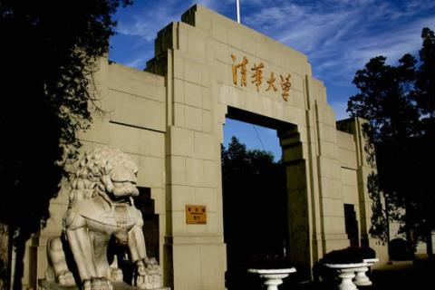
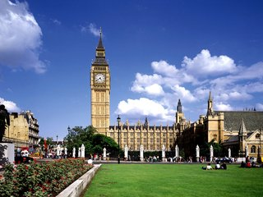
New Words
university n. 大学

Slide 3
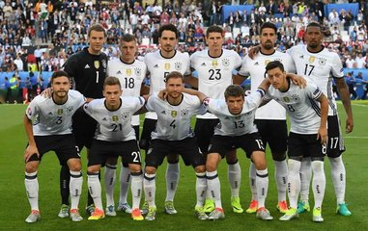
Germany n.德国
German n.德语 ；德国人
adj. 德国的；德语的， 德国人的

Slide 4
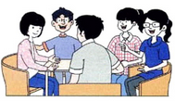
Text Reading
It's the last day of school. The students are talking about their summer plans.
Ms. Liu：Do you have any plans for this summer?
Wang Mei：Yes. I am going to
work at the library.
I will volunteer
there for four weeks.
I'm going to read
storybooks to❶ young children.
PPT模板：www.1ppt.com/moban/ PPT素材：www.1ppt.com/sucai/
PPT背景：www.1ppt.com/beijing/ PPT图表：www.1ppt.com/tubiao/
PPT下载：www.1ppt.com/xiazai/ PPT教程： www.1ppt.com/powerpoint/
资料下载：www.1ppt.com/ziliao/ 范文下载：www.1ppt.com/fanwen/
试卷下载：www.1ppt.com/shiti/ 教案下载：www.1ppt.com/jiaoan/
PPT论坛：www.1ppt.cn PPT课件：www.1ppt.com/kejian/
语文课件：www.1ppt.com/kejian/yuwen/ 数学课件：www.1ppt.com/kejian/shuxue/
英语课件：www.1ppt.com/kejian/yingyu/ 美术课件：www.1ppt.com/kejian/meishu/
科学课件：www.1ppt.com/kejian/kexue/ 物理课件：www.1ppt.com/kejian/wuli/
化学课件：www.1ppt.com/kejian/huaxue/ 生物课件：www.1ppt.com/kejian/shengwu/
地理课件：www.1ppt.com/kejian/dili/ 历史课件：www.1ppt.com/kejian/lishi/

Slide 5
Tao Xiaolin：My parents and I are planning a trip to Germany
this summer. I will take lots of pictures.
Li Lin：I'm going to take swimming lessons. I will go
swimming three times a week.
Li Ming：I'm really excited about my summer plans. I'm going to live with a family in the countryside. It will be a good experience.
Ms. Liu：It's going to be a fun summer. You all have
wonderful plans.
Tao Xiaolin：How about you，Ms. Liu？What are your plans for the summer？
Ms. Liu：Well，I'm going back to school！

Slide 6
All the students：Going back to school？
Ms. Liu：Yes. I am going to take summer classes at Beijing
University. I want to keep learning❷.
Wow! Even teachers keep learning.

Slide 7
Dig In
Ms. Liu never wants to stop learning❸.She is a lifelong learner. It's important to keep learning. Learning doesn't stop after school. Learning happens every day and everywhere. John Dewey，a famous educator, said，“Education is not preparation for life；education is life itself.”

Slide 8
Main phrases in text
1.一周三次___________ 2.制定一个旅行计划__________
3.上游泳课______________ 4.住在乡村____________
5.回到学校___________ 6.暑假计划__ ___________
7.拍很多照片________ 8.一个极好的计划_________
9.最后一天_____________ 10.和某人生活在一起__________
11.小朋友__________ 12.上暑假课程__________
13.停止干某事__________ 14. …..的计划 __________
15.一个很好的经历__________
16.一个终生学习的人_________
17.不断学习__________
18.志愿做某事_______________

Slide 9
Language Points
1
read...to...
read sb. sth. (双宾语) “给某人读某物”，
read sth.to sb. “读某物给某人”。
eg：Wang Mei is going to volunteer to read
storybooks to young children at the library.
I often read newspapers to my grandpa at home.
我经常在家里给我的爷爷读报纸。
考向

Slide 10
keep doing sth.一直做某事
2
eg：To learn English well，you must
keep practicing it every day!
为了学好英语，你必须坚持每天练习！

Slide 11
—Don't give up, my children.
Keep________(work) hard and you will do
well in the final exams.
—Thank you, Mr. Zhang. We'll try our best.
working
【Note】考查keep doing sth.的用法，根据上面第一句句意“不要放弃，我的孩子们。”推理可知后句应该是一直努力，坚持不懈。

Slide 12
stop v. 停止
3
stop doing sth.停止做某事；停止正在做的事
eg：Stop thinking, and let's do it.
不要想了，咱们做吧。
stop to do sth.停下来去做(另一)某事
eg：Let's stop to have a good rest！
咱们停下来好好休息一下吧！

Slide 13
You look too tired. You'd better ________ a good rest？(甘肃.天水)
A．stop to have B．stop having
C．to stop to have D．to stop having
stop to have
【Note】固定句型和stop后跟不定式及现在分词用法的考查。You'd better后跟动词原形意为“你最好……”，是固定句型；stop to do sth.意为“停下后去做某事(另一件事)”；stop doing sth.意为“停下自己正做的事”。根据句意“你看起来太累了。你最好停下来去好好休息一下。”

Slide 14
Exercise
Fill in the blanks with the correct forms of given words.
1. Don't keep your mother________ (wait).
2. She is very________(excite) about her winter plan.
3. It's good________(eat) more vegetables.
4. My sister is going to take________(dance) lessons next month.
5. Stop ________(make) so much noise. The children are sleeping.
waiting
excited
to eat
dancing
making

Slide 15
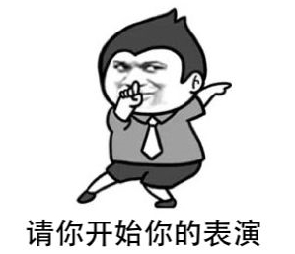
Show Time
Making dialogue by role-paly

Slide 16
Conclusion
本节课主要学习了暑假计划及相关表达，
掌握知识点read...to, keep doing,和stop doing sth.用法，提高大家的阅读理解和综合运用语言的能力。

Slide 17
Homework
1.熟记本课时的词汇及短语
2.完成本课时的课后作业及而配套练习

