Slide 1
Unit6 What Subjects Do They Have This Morning? 第3课时
陕旅版四年级上册
WWW.PPT818.COM

Slide 2
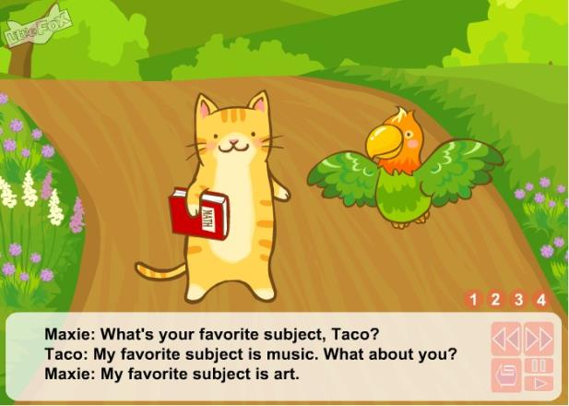
动画欣赏:What’s your favorite subject？

Slide 3
Review
用英语表达所学科目：
(1) —How many subjects do you have this morning?
—We have four.
—What are they?
—They are…
(2) —What subjects do they have this morning?
—They have…/ Let me see…

Slide 4
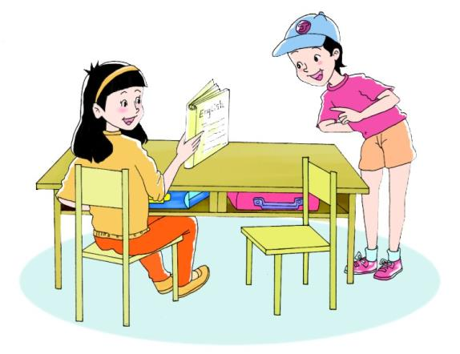
Let’s learn more
听录音，回答问题：
Does Li Shan like English?

Slide 5
It’s an English book.
What’s in your hand?
Do you like English?
Yes. I like it very much.

Slide 6
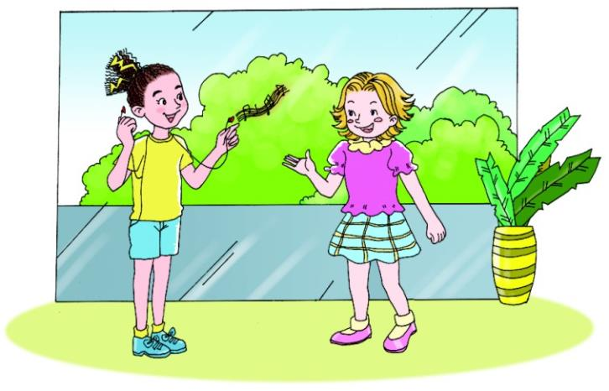
Let’s learn more
听录音，回答问题：
What subject Alice like?

Slide 7
Do you like Music, Alice?
No, I don’t. I like Art. I’m good at drawing.
That’s great! I like Art, too. But I’m not good at it.

Slide 8
Summary
表达对不同学科的喜好用句型：
—Do you like+学科名词？
—Yes. I like it very much./ No, I don’t./
I’m good at…我擅长……

Slide 9
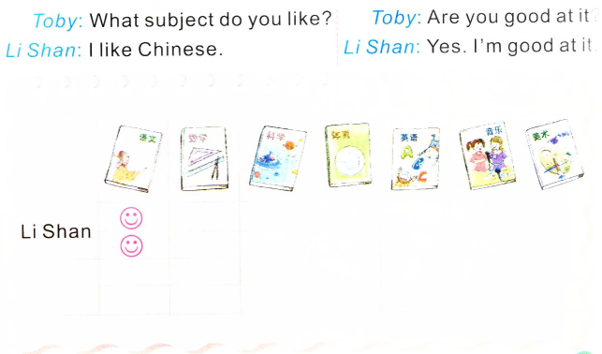
Ask and draw

Slide 10
Free talk
同桌之间根据自己学校的里学的科目互相询问对方喜欢哪门科目，擅不擅长这个科目？
例如：
—What subject do you like?
—I like…
—Are you good at it?
—Yes, I am./ No, I’m not.

Slide 11
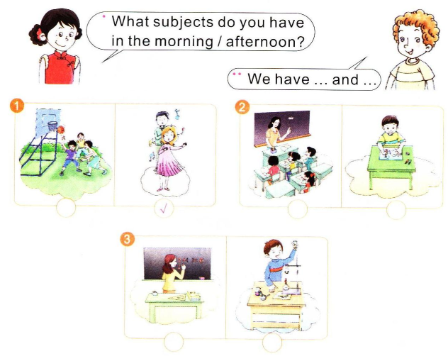
Look, guess and talk

