Slide 1
陕旅版小学英语三年级下册
Unit7 There Is a TV in the Classroom
第3课时
WWW.PPT818.COM

Slide 2
学习目标
1. 能听说11-20的数字并掌握-teen的规律：eleven, twelve, thirteen, fourteen, fifteen, sixteen, seventeen, eighteen, nineteen, twenty
2. 学生在运用句型的基础上结合数字以及名词 单复数：
There is a/one 名词单数…
There are …可数名词复数

Slide 3
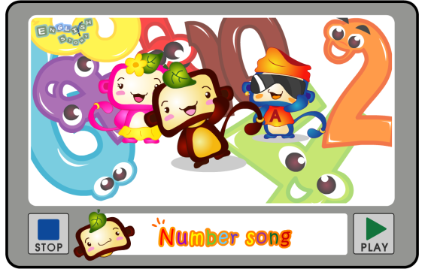
导入歌曲Number song

Slide 4
Part B Let’s count
We’ve learned numbers from one to ten. Do you want to know more numbers? OK, let’s learn more numbers from eleven to twenty.

Slide 5
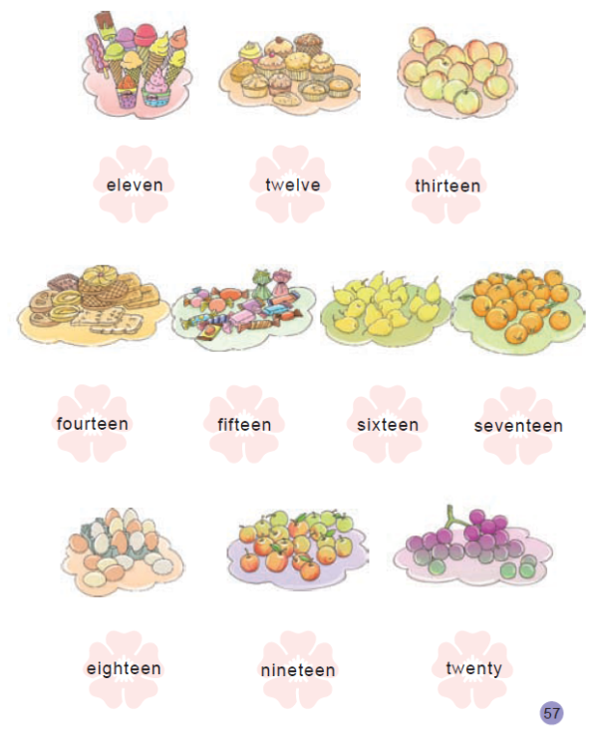
11
12
13
14
15
16
17
18
19
20

Slide 6
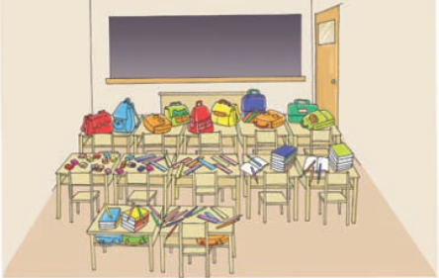
Part A Look and count
What’s in the classroom?
How many blackboards?
How many doors?
How many desks and chairs?
How many books?

Slide 7
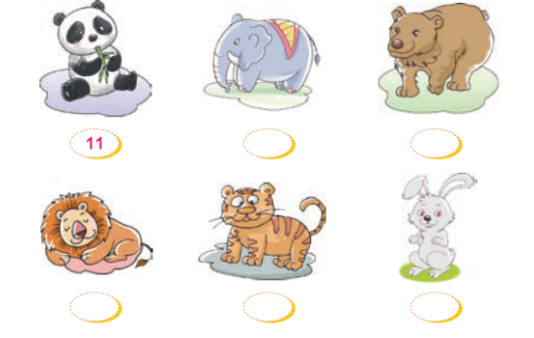
Part C Listen and write
9
12
1
18
10

