Slide 1
Unit8 Celebrating Me!
Be Yourself!
WWW.PPT818.COM

Slide 2
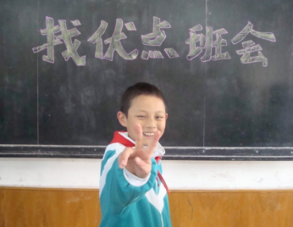
Warm-up
What are your strong points and weak points?

Slide 3
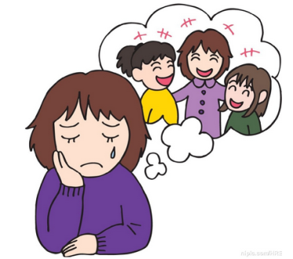
Did you ever write to a doctor or another
person for help?
What can I do?

Slide 4
Presentation
New words
average
stupid
smart
impossible
weak
mirror
一般的；平均的
愚蠢的；傻的
聪敏的
不可能的
弱的；无力气的
镜子

Slide 5
Read and tick the things that are mentioned in the lesson.
What are the girl’s problems?
She thinks she looks very common.
She doesn’t do well in English.
Sometimes she makes stupid mistakes.
She doesn’t have any friends.

Slide 6
What are Sue’s suggestions?
Talk to your parents or teacher.
Smile at yourself every day.
Make plans for your dreams.
Go to a doctor.
Make a list of your strong points and read it every
morning.

Slide 7
Language points
1. I look very common.我看起来很普通。
look用作连系动词，意为“看起来”，后跟形
容词。
have …in common“和……有共同之处”

Slide 8
2. I get average grades in all of my subjects except English.
except介词，用于表示同类事物之间的关系，意为“除……以外”。

Slide 9
辨析：besides与except
besides | 表示一种累加关系，意指“除了什么之外，还有……” | Besides his wife，his daughter also went to see him.
except | 表示一种排除关系，意指“除了什么之外，不再有……” | Nobody went to see him except his wife.

Slide 10
3. We all have our strong points and weak points.
strong points and weak points 优点和弱点
be weak in “不擅长，在……弱”；反义词组是
be good at或do well in。

Slide 11
Now read this letter to Sue and Sue’s response to it.
Fill in the blanks with proper pronouns.
Dear Sue,
I’m a high school boy. I’m good at all my subjects, but I don’t like ________. I don’t have any friends. The boys in my class enjoy __________ after class. I don’t know how to speak to _______. I feel very lonely.
Lonely Boy from Ottawa
myself
themselves
them

Slide 12
Dear Lonely Boy,
Teenage years are wonderful but also difficult. It’s common that many middle school students don’t like __________. Be proud of ________. You are doing so well in school. After school you can read the news and share interesting stories with ______ classmates.
Think about your interests and find a new hobby. Maybe you can join a club and make more friends. Soon you will begin to enjoy ________!
Sue
themselves
yourself
your
yourself

Slide 13
Exercise
一、连线题：
1. 看起来很普通
2. 除了英语
3. 犯愚蠢的错误
4. 优点和弱点
5. 照镜子
6. 擅长……
7. 做自己
except English
be good at / do well in
look very common
look in the mirror
strong points and weak points
be yourself
make stupid mistakes

Slide 14
二、完成句子。
1. 我想想她一样。
I want ______ ______ ______her.
2. 我自我感觉不好。
I _______ ______ about myself.
3. 想想你的优点。
Think about your ________ _______
4. 照着镜子对自己微笑。
Look ____ the ________and ________ at yourself.
to be like
feel bad
strong points
in mirror smile

Slide 15
Homework
Recite the words and important phrases.

