Slide 1
Unit1 How are you feeling now?
第2课时
WWW.PPT818.COM

Slide 2
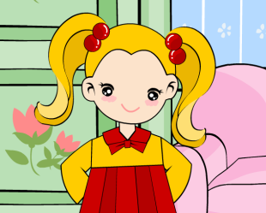
>>Lead-in
Listen and enjoy
Are you happy?
If you are happy,
please clap you hands.
If you are happy,
please stomp your feet.
If you are happy,
please shout “hurray”.
（单击电视屏幕可播放动画）

Slide 3
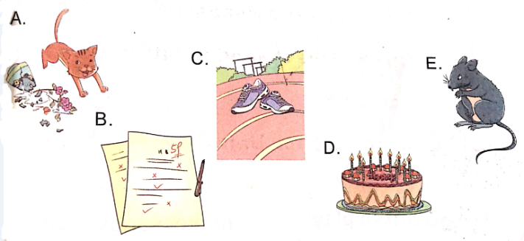
>>Lead-in
Think and match
How is she/he feeling now?

Slide 4
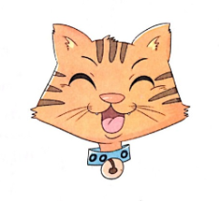
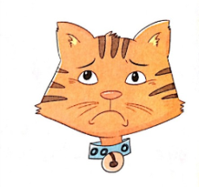
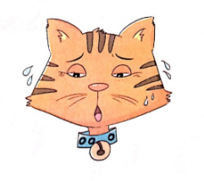
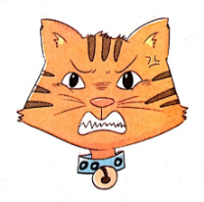
>>Practice
Read and match
Is she/he feeling happy now?

Slide 5
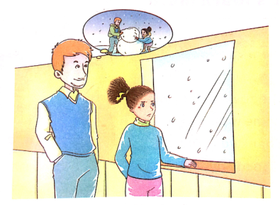
>>Presentation
Listen and answer
1. Is kitty happy? Why?
No, she isn’t. Because it’s snowing again. She can’t go out to play.
2. What can Kitty and her dad do?
They can make
a snowman.

Slide 6
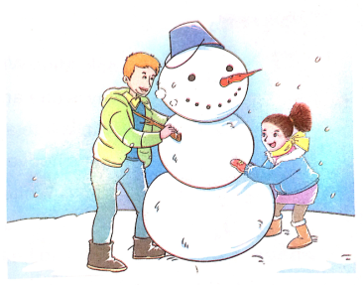
>>Presentation
Listen and answer
1. What are they doing?
They’re making a big snowman.
2. How are they feeling now?
Are they happy?
They’re very happy.

Slide 7
>>Practice
Listen and follow
Dad: You look sad, dear. Why?
Kitty: Because it’s snowing again.
I can’t go out to play.
Dad: Why not? Come on.
We can make a snowman.
Kitty: A snowman! It’s a good idea.

Slide 8
>>Practice
Listen and follow
Kitty: Oh, it’s OK. A big snowman!
Dad: How are they feeling now?
Are you happy?
Kitty: Yes. I’m very happy.

Slide 9
>>Practice
Role-play

Slide 10
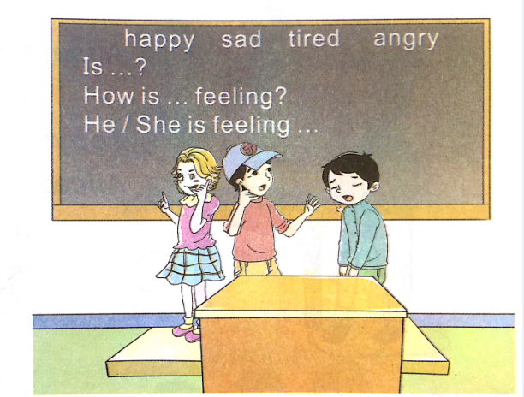
>>Practice
Let’s play

Slide 11
>>Practice
Listen and tick or cross
She looks happy. She is feeling happy.
√
×
×
×

Slide 12
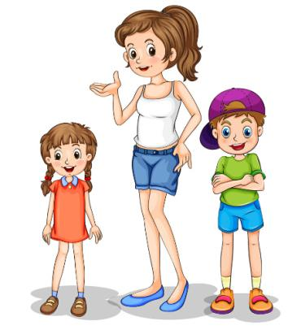
>>Practice
小小指挥家
I’m feeling happy now. What about you?
I’m tired.
What about you?

Slide 13
>>Summary
表述情感的句型：
You look sad.
---How are you feeling now?
---I’m feeling very…
---Are you happy/…
---Yes. I am very happy.

Slide 14
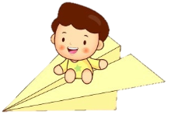
>>Homework
1.观看课文动画，按照正确的语音、语调朗读课文对话。
2.仿照Let’s play部分做练习。
3.预习“Let’s learn more”。
close

