Slide 1
Module
Time off
8
Unit 3 Language in use.
WWW.PPT818.COM

Slide 2
Teaching aims
To summarise and practise the use of the object clause with that
To consolidate new vocabulary

Slide 3
Language practice
I can hardly believe we’re in the city centre.
I don't think they allow people to swim in the
lake.
We thought somebody was moving about.
Lingling’s uncle said that it was wrong to pull
leaves off plants and that we should protect
everything here.

Slide 4
Grammar
that引导的宾语从句
定义：在句子中起宾语作用的从句叫做宾语从句。

Slide 5
宾语从句分为三类：
(1) that引导的宾语从句
I hope (that) it will snow this winter.
(2) whether/if引导的宾语从句
I’m not sure if he will come.
(3) 疑问词引导的宾语从句
I want to know what he will do next.

Slide 6
当谓语动词表示肯定的概念，如“希望、相信、知道、说”时，其后面的句子一般用that引导。that没有任何词汇含义，只有语法功能，目的是使读者清楚后面的句子是宾语从句。多数情况下that可以省略。例如：
I hope (that) it will snow this winter.
Betty thinks (that) trees can improve the air.
I know (that) he is friendly.

Slide 7
注意：并非所有的动词后面都可接that引导的宾语从句，常接 that 宾语从句的谓语动词有：believe, expect, explain, feel，hear，hope, imagine, prefer, promise, report，say, see, tell, think, under, stand，warn, wish 等。

Slide 8
宾语从句的语序：
宾语从句的语序应为陈述句的语序。
例如：
I hear (that) physics isn’t easy.
I think (that) you will like this school soon.
Can you tell me how I can get to zoo。

Slide 9
宾语从句的时态受主句的限制
1.主句是一般现在时态，从句根据实际情况而定。
2.主句是一般过去时态，从句用相应的过去的时态。如果从句的动作发生在主句之前则从句要用过去完成时态。例:
1 ) She says that she is a student.
She said that she was a student.
2) She says that she will fly to Japan in a week.
She said that she would fly to Japan in a week.

Slide 10
3) She says that she has finished her homework
already:
She said that she had finished her homework already:
如果宾语从句说的是客观真理、自然现象或亊实时，这时宾语从句要用一般 现在时态。
例：
The teacher said that the earth goes round the sun.
He told me that Japan is an island country。

Slide 11
宾语从句的否定转移
当主句谓语动词是think, believe, suppose，expect等词，而宾语从句的意思是否定时，常把否定转移至主句表示。
I don’t think it is right for him to treat you like that.

Slide 12
主句的谓语动同 think, believe, imagine, suppose, consider, expect, fancy, guess等，并且主句的主语是第一人称而且为一般现在时，从句的否定词一般 要转移到主句上来，其反义疑问句一般与宾语从句一致。
I don’t believe that man is killed by Jim, is he?
I expect our English teacher will be back this weekend, won't she/he?
We suppose you have finished the project, haven't you?

Slide 13
如果宾语从句中有某个含有否定意义的形容间或副词不包含带有否定前 缀的词,如：unhappy, unfair, dislike等)，其反义疑问句要用肯定形式.
We find that he never listens to the teacher carefully, does he?

Slide 14
当主句的主语是第二、三人称时，其反义疑问句一般与主句保持一致。
Your sister supposes she needs no help, doesn’t she?
You thought they could have completed the project, didn't you?
They don't believe she's an engineer, do they?
She doesn't expect that we are coming so soon, does she?

Slide 15
宾语从句小口诀：
宾语从句三注意，时态语序引导词；
主句一般现在时，从句不需受限制；
主句一般过去时，从句须用相应时；
陈述句转化that引，一般疑问句用if/whether,
特殊问句疑问词，引导词后陈述式。

Slide 16
1. Match the two parts of the sentences.
There may be more than one possibility.
1. I think (that)…
2. He says (that)...
3. She is sure (that)...
4. They do not believe (that)...
5. We know (that)…
a) …we can go out alone at night.
b) …he almost got lost in the forest.
c) ... we should stay together.
d) …the park is over 500 years old.
e) ... we will see better from up there.

Slide 17
2. Complete the passage with the correct
form of the words and expressions in
the brackets.
I want to go on a trip with my family in the summer holiday, but I do not think we (1) __________ (agree) on where to go. I think that we should (2)_____ (go) to the beach but Mum and Dad say they (3)_____
want to go to the countryside. Danny is sure that the beach and the countryside
will agree
go
want

Slide 18
(4)_____(be) boring. He wants to go to a big city and do sightseeing. Milly doesn’t think that sightseeing (5)_____(be) interesting. She wants to stay at home and watch TV or go swimming. I tell my family that we (6)_________ (have to) decide soon because the holiday starts next week!
are
is
have to

Slide 19
3. Complete the sentences with the correct
form of the expressions in the box.
famous for not…any more point out wake up
pointed out
1. My uncle____________ the monkey in the
tree next to us.
2. We ate some cakes and I was _____ hungry
__________.
3. I ________ in the middle of the night and
could not fell asleep again
4. The town is ___________its cheese.
not
any more
woke up
famous for

Slide 20
4. Complete the passage with the correct form of the words in the box.
air along bird clear climb cross quiet shout
It was early in the morning. The park was very (1)_______ and the only sound was the (2) _______ singing. There was no one (3) _________ nor
quiet
birds
shouting

Slide 21
were any dogs barking. The sun was
very bright and the (4)_____ was very
(5)_______ and fresh. We walked
(6) _______ the lake，(7)_______ the small bridge and (8)__________ up the hill. We felt very happy at the top.
air
clear
along
crossed
climbed

Slide 22
5. Listen and complete the notes.
Holiday plan:________________________
____________________
Number of people:__________
Things to take: ____________________
_______________
Where to sleep:___________
What to eat:______________
go climbing in the mountains,
camp out cook food
fifteen
mobile phone, lots of
warm clothing
camp out
cook food

Slide 23
Tapescript
Girl: Mum, can I go on a holiday with my
friends?
Mum: Where are you going?
Girl: We're going climbing in the mountains.
Mum: Who are you going with?
Girl: Well, Susan and Dave suggested that we
join a group. There will be fifteen people
altogether.
Mum: It sounds dangerous. Where are you
going to sleep? What are you going to do

Slide 24
about food? Will you be able to call me?
Girl: Don't worry! We're going to camp out.
We'll cook our own food, and I'll take my
mobile phone.
Mum: What about clothes? It's going to be cold
in the mountains.
Girl: I'll take lots of warm clothing.
Mum: I'm worried that you'll fall and break
your leg! Then what will you do?
Girl: Oh, stop worrying, Mum! Everything will
be fine. Please can I go?
Mum: Well... all right. But do be careful!

Slide 25
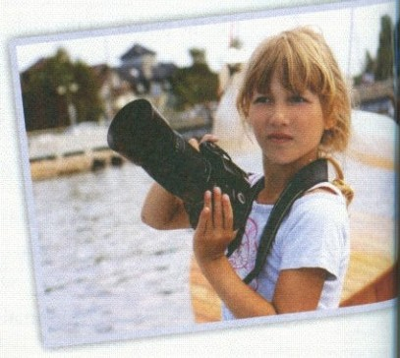
6. Read and match the people with the best clubs for them.
_{1. Welcome to our photo club!}
Do you like taking photos? Would you like to learn more about how to take good photos? Or how to make them better? Come to our photo club on Thursday evening and find out.

Slide 26
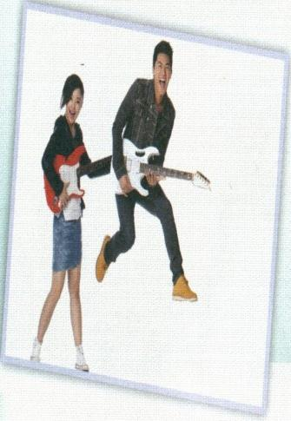
2. Dance to the music of the world!
Have you ever listened to music from America or South America? Do you like American pop or rock? And do you like to dance? If you love listening to music from countries all around the world, come along every Wednesday evening — listen to new songs and learn how to dance.

Slide 27
_{3. Film night}
Tuesday night is film night! Come and watch the latest films, enjoy them with your friends, talk about them... all without going to a cinema in the city centre.
A
Jack plays the guitar really well, but he would like lo play with some other people. He also likes dancing, bui has no one to dance with.

Slide 28
Annie has just received a new camera for her birthday, but she does not know how to use it, and would like lo learn more.
B
Dan usually spends his evening watching films on television and DVDs. He lives a long way from the city centre, and his parents would like him to make some new friends.
C
Paragraph 1
Paragraph 2
Paragraph 3
A Jack
B Annie
C Dan

Slide 29
Lake District national Park
Lake District National Park is in the north of England. It is England’s biggest national park. It is very beautiful, with hills, lakes and forests. Most visitors enjoy walking around the lakes or climbing up the mountains.

Slide 30
The highest mountain in England is in Lake District National Park. On a clear day，you can see a long way from the top of the mountain. Walkers have to be careful because the weather can change suddenly, especially in the mountains. The Lake District is popular with artists who like to paint the beautiful countryside. Many English

Slide 31
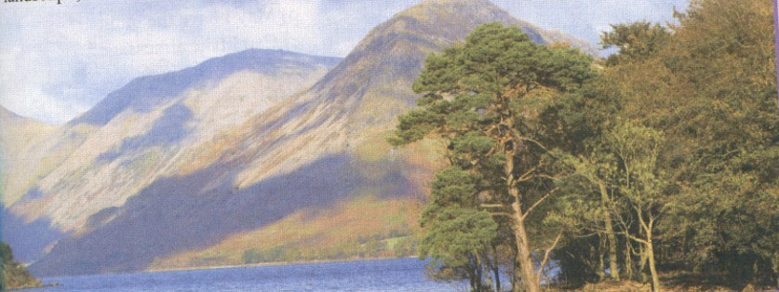
poets have written poems about the beautiful landscape, and these poems have made the Lake District even more famous.

Slide 32
Module task :
Writing a leaflet for a trip
7. Work in pairs. Think about a holiday trip to a place of interest and answer the following questions.
Where is it?
What can you do there?
When can you go?
How many people are there in each group?
How long do they stay?
What have people said about their trip to
the place?

Slide 33
8. Write a leaflet for the trip. Use your
answers to the questions in Activity 7 and
the language points below to help you.
Come to … for your holiday.
You can …
You’ll be in a group of…people.
You’ll stay for …days.
Many people have said that the trip is very enjoyable.

Slide 34
Exercise
一、单项选择题。
1. It’s ten ____ from my home. The children must take bus to school.
A. metre B. metres
C. kilometre D. kilometres
2. -- What’s the ___ of the rock?
--It’s a square.
A. path B. leaf C. top D. shape
D
D

Slide 35
3. The child is sleeping, don’t wake him
_____.
A. up B. down C. off D. in
4. _____ called you just now. I heard the
ring.
A. Somebody B. anybody
C. Nobody D. some body
A
A

Slide 36
中考链接
David was so excited at the good news that he could _____ say a word.
【2013 山东临沂】
A. nearly B. hard C. ever D. hardly
2. — Excuse me, sir, smoking _____ in the gas station.
—Oh, I’m really sorry.
【2013 福建福州】
A. doesn’t allow B. isn’t allowed
C. aren’t allowed D. don’t allowed
D
B

Slide 37
3. He felt ____ curious that he asked ____
many questions about it.
【2013山东盐城】
A. such, such B. so, so
C. such, so D. so, such
4. She always does very well in the English exams. But she can _____ understand English radio programs. 【2013 江西】
A. always B. hardly
C. already D. easily
B
B

Slide 38
5. Jason likes the ____ of the cake. It is a heart. 【2013 河北】
A. color B. size
C. smell D. shape
6. As volunteers, they should do ____ to help the children in trouble. 【2012 山东济南】
A. nothing B. anybody
C. something D. somebody
D
C

Slide 39
7. Jason likes the ____ of the cake. It is a heart.
【2013 河北】
A. color B. size
C. smell D. shape
8. Sanya is famous _____ its beautiful beaches.
【2013 黑龙江绥化】
A. of B. for C. as D. to
D
B

Slide 40
二、根据中文提示完成句子。
1.我认为他不会来参加这个聚会。
__ _______ _______ he will come to the party.
2.这个公园以这座漂亮的塔而闻名。
This park _______________ its beautiful tower
I don’t think
is famous for

Slide 41
3.这条河太深，孩子们不能独自过河。
The river is ___________. The children can't _________ by themselves.
4.虎口拔牙很危险。
It is dangerous to _________________ a tiger’s mouth.
too deep
cross it
pull a tooth out

Slide 42
Homework
To summarise and practise the use of the object clause with that.
Try your best to master what you have learned in this module and preview the next module.

