Slide 1
Unit3 A healthy diet
第3课时
WWW.PPT818.COM

Slide 2
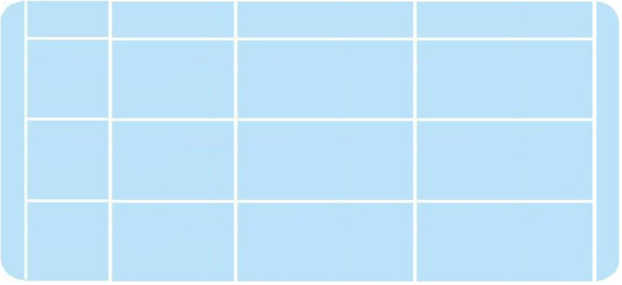








Let's talk
Let’s review.
Name
Breakfast
Lunch
Dinner
a lot of rice
some fish
some meat
some bread
and milk
a lot of
noodles
an egg
some meat
some vegetables
a little rice
What does Mike have for breakfast/lunch/dinner?
Does he have a healthy diet? Give some suggestions.What about YangLing?

Slide 3

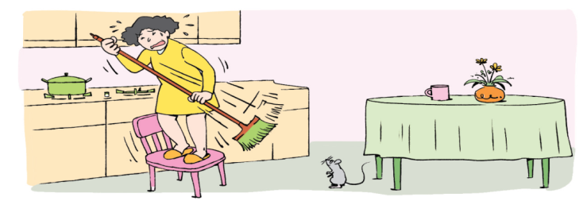

Mrs Li’s house
Let’s find
？
Get out!
Get out!
/au/
What's in her house?
What does Mrs Li shout?

Slide 4

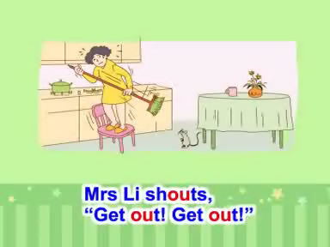
Watch and learn
Sound time

Slide 5


about
mouth
house
/ aʊ/
out
…
shout

Slide 6
touch
cousin
country
/ ʌ /
young

Slide 7



young
cousin
cloud
loudly
sound
blouse
touch
country
/aʊ /
/ʌ /

Slide 8
看一看字母组合ou的其他发音
you
/ u: /
cough
/ ɔ /
cousin
/ ʌ /
should
/ u /

Slide 9


Ticking time

Slide 10


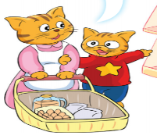
Mrs Li is afraid of the mouse.
What is the mouse afraid of?

Slide 11
Cartoon time
Watch and answer.
Where do they go ?
Why do they go there?
What do they do there?

Slide 12
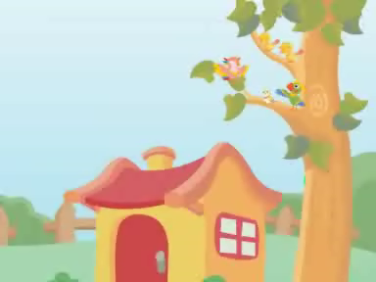
Cartoon time

Slide 13

Cartoon time
Where do they go ?
They go to the supermarket.
Why do they go there?
There is not much food in the fridge.
They have to go to the supermarket.
What do they do there?
They buy some food.

Slide 14



`
Read and answer
Cartoon time
What do they buy?
How much do they buy?
cola
take
a small bottle
拿
a little

Slide 15
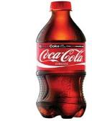
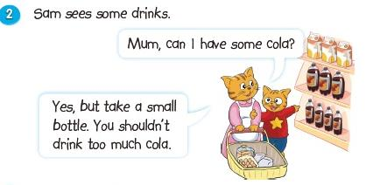
Can Sam drink too much cola?

Slide 16
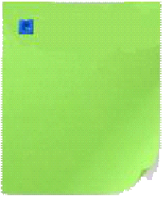
Cartoon time
Read and answer.
How much do they buy?
They buy so
many things.
Is Sam happy
at last?
cola
a small bottle
a big bag of rice
a big fish
a lot of
a little

Slide 17
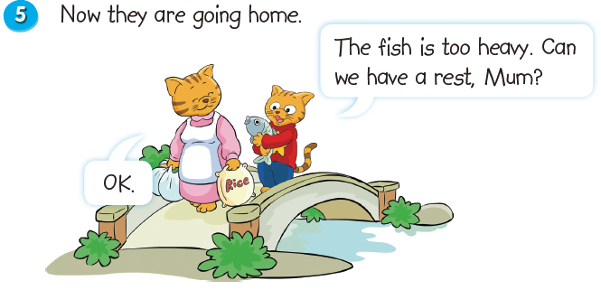
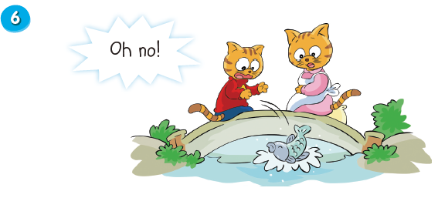
重的
休息一下
sad
The fish falls in to the river.

Slide 18
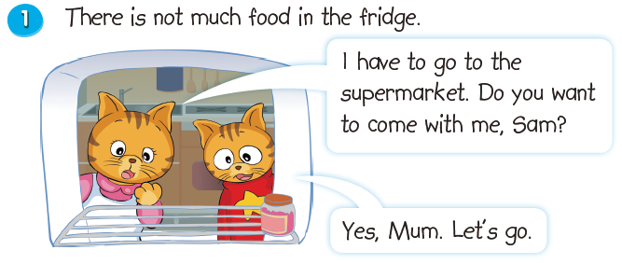
Cartoon time
Read and imitate.

Slide 19
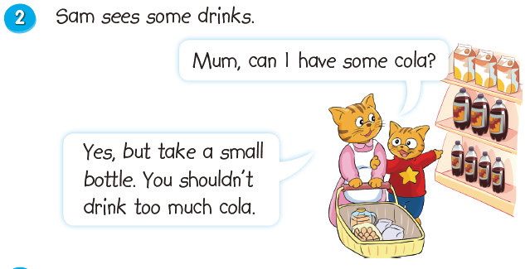
Cartoon time
Read and imitate.

Slide 20
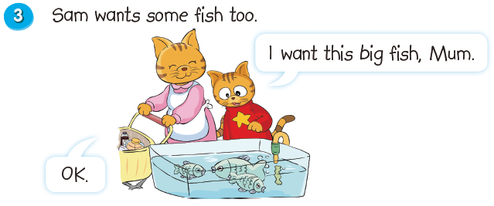
Cartoon time
Read and imitate.

Slide 21
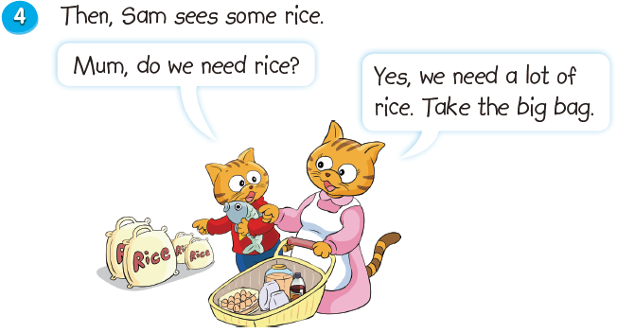
Cartoon time
Read and imitate.

Slide 22
Cartoon time
Read and imitate.

Slide 23
Cartoon time
Read and imitate.

Slide 24

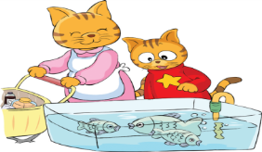


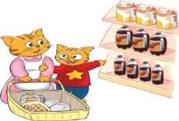
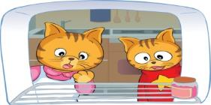

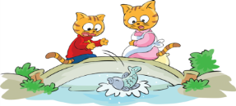


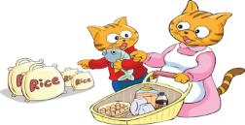
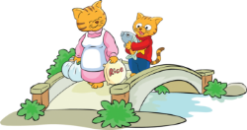
Role play!

Slide 25


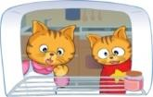
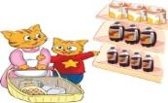





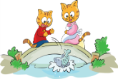
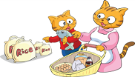
Let'retell!
fridge
supermarket
There is not much food in Sam’s ______. He goes to the__________
with his mother. First, he _____ some cola, but his mother lets him
____a small bottle, and he shouldn’t drink ______ ______ cola.
Next, he _______ a big fish. Then, Sam ____ the big bag of rice.
Finally, they go home , but the fish is ________, Sam wants to
_____ ____ ____. But when they walk onto the bridge,
the fish _____ into the river.
wants
take
too much
needs
wants
heavy
have a rest
falls

Slide 26

Ticking time
I know the story of the cartoon.

Slide 27
Homework
1、Make a healthy eating table for your family.
为家人制定一份健康饮食表。
2、Read Cartoon time.
朗读卡通故事。

