Slide 1
Unit 5
Why do you like pandas?
Section B 第2课时
WWW.PPT818.COM

Slide 2
相邻的两个颜色相同的单词可以消掉，
学生读单词，老师点击。
注意一定要看好再点，否则无法返回。
当出现没有相邻的同色椭圆时，
游戏失败。

Slide 3
flag
cut
over
lion
forget
down
made of
giraffe
get lost
cut down
Thailand
elephant
place
tree
Thai
panda
water
kill
save
tiger
danger
ivory
symbol
koala

Slide 4
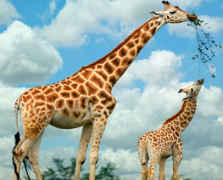
Lead-in
— What animals do you like?
— I like ________.
— Why?
— Because ______________________________.
giraffes
giraffes are beautiful and friendly

Slide 5
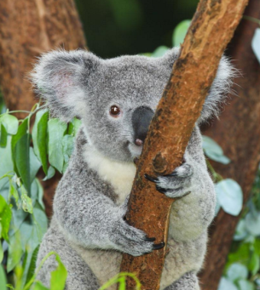
— What animals do you like?
— I like _______.
— Why?
— Because ______________________.
koalas
koalas are cute and shy

Slide 6
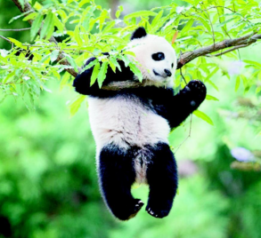
— _______________________?
— ____________.
— _____?
— _______________________________.
What animals do you like
I like pandas
Why
Because pandas are and
smart
cute

Slide 7
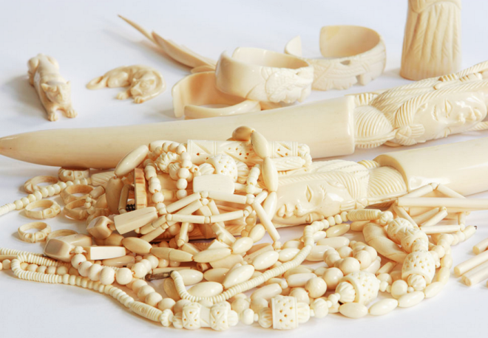
Do you know the elephants are in great danger?
Here are some things that are made of ivory.

Slide 8
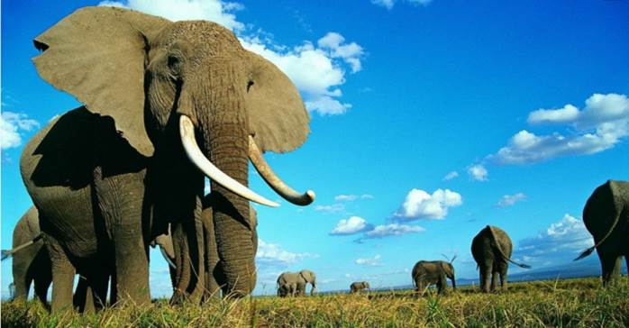
Let’s watch a video.

Slide 9
2a
Check (√) the animals that you think are in great danger.
√
___ lions ___ elephants ___ pandas
___ giraffes ___ koalas ___ tigers
√
√

Slide 10
Read this website article and check (√) the best title for it.
2b
_______ What Is an Elephant?
_______ Come to Thailand
_______ Let’s Save the Elephants
_______ Elephants Are Good Pets
√

Slide 11
Read the article quickly and find out the topic sentence in each paragraph.
Para. 1
The elephant is one of Thailand’s symbols.
Para. 2
Elephants are smart animals.
Para. 3
Elephants are in great danger.

Slide 12
Read paragraph 1 and answer the questions.
1. Where are the students from?
2. What do they want to do?
3. Why are elephants important in Thailand?
Thailand.
Save the elephants.
symbols
it is one of Thailand’s _________.
a white elephant
Because
the first flag had ______________ on it.
good luck
it is a symbol of __________.

Slide 13
Read paragraph 2 and answer the questions.
Are elephants smart animals?
What can they do?
Yes, they are.
can play ______ or ______.
soccer
music
can also ______ very well.
draw
They
walk
get lost
can ____ for a long time and never _______.
remember
can also _________ places with food and water.

Slide 14
Read paragraph 3 and answer the questions.
1.Are elephants in great danger? And why?
in great danger
Elephants are ______________.
cut down
people _________ many trees.
their homes
Because
elephants are losing ___________.
their ivory
people kill elephants for _________.

Slide 15
2. How can they save elephants?
Don’t cut down so many _____.
Don’t ____ things made of ivory.
Remember that March 13th is _________________.
trees
buy
Thai Elephant Day

Slide 16
Hello. We are students from Thailand, and we want to save the elephants. The elephant is one of Thailand’s symbols. Our first flag had a white elephant on it. This is a symbol of good luck.
Elephants are smart animals. They can play soccer or music. They can also draw very well. People say that “an elephant never forgets”. Elephants can walk for a long time and never get lost. They can also remember places with food and water. This helps them to live.
……的标志
迷路

Slide 17
处于（极大）危险之中
But elephants are in great danger. People cut down many trees so elephants are losing their homes. People also kill elephants for their ivory. Today there are only about 3,000 elephants (over 100,000 before). We must save the trees and not buy things made of ivory. Remember that March 13th is Thai Elephant Day.
由……制成

Slide 18
Read the article again and fill in the blanks.
Our first flag had a white elephant on it.
“our” refers to _________
“it” refers to ___________________
Thailand’s
Thailand’s first flag
This is a symbol of good luck.
a white elephant
“this” refers to _______________
They can play soccer or music.
elephants
“they” refers to ___________

Slide 19
This helps them to live.
“this” refers to ______________________
________________________.
elephants can remember
places with food and water
People cut down many trees so elephants are losing their homes.
elephants’
“their” refers to __________

Slide 20
2c
Read the article again and complete the mind map.
Importance in Thailand
first flag had _____
symbol of _______
Facts and figures
people ____ many trees
people kill them for ___
today there are___(over ___ before)
Abilities
can play _____
can also _____ well
can ___ places with
food and water
How to save them
don’t cut down so many __
don’t ___ things made of ivory.
___ is Thai Elephant Day.

Slide 21
Importance in Thailand
first flag had _____________________
symbol of ___________
a white elephant on it
good luck
Abilities
can play ______________
can also ______ well
can _________ places with food and water
soccer or music
draw
remember

Slide 22
Facts and figures
people ________ many trees
people kill them for __________
today there are_______________________
(over ________ before)
cut down
their ivory
only about 3,000 elephants
100,000
How to save them
don’t cut down so many _____
don’t _____ things made of ivory.
___________ is Thai Elephant Day.
trees
buy
March 13th

Slide 23
Language points
1. People say that “an elephant never forgets”.
人们说“大象从不遗忘东西”。
forget作动词, 意为“忘记”, forget+名词/代词意为“忘记某物/某人”。例如:
很抱歉, 我忘记了你的名字。
I am sorry but I forget your name.

Slide 24
【用法辨析】forget的不同搭配
词 条 | 用法及例句
forget to do sth.
forget doing sth.
“忘记去做某事(未做)”。
“忘记做过某事(做过但是忘了)”。

Slide 25
【活学活用】
①别忘了关窗户。
Don’t forget the door.
②汤姆忘记已经把教室的灯关了。
Tom forgot the lights in the classroom.
to close
turning off

Slide 26
2. We must save the trees and not buy things made of
ivory. 我们必须拯救树木, 不买由象牙制成的东西。
(1)made of ivory “由象牙制成”, 此处为过去分词短
语作后置定语, 修饰前面的名词things。
(2)be made of “由……制成”, 可以看出原材料。

Slide 27
【辨析】be made of, be made from与be made into
(1)成品+be made
of+材料（可以看出原材料）
from+材料（看不出原材料）

Slide 28
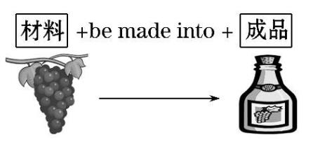
(2)材料+be made into +成品。

Slide 29
【活学活用】
①毛衣常由羊毛制成。
Sweaters are often wool.
②尼龙是由空气、煤和水加工制成的。
Nylon is air, coal and water.
③这些橙皮可以加工成药材出售。
These orange peels can medicine
for sale.
made of
made from
be made into

Slide 30
3. But elephants are in great danger.
但是大象正处在很大的危险中。
danger为名词意为“危险”, in great danger意为“处于极大危险之中”,其反义词组为out of danger “脱离危险”。
现在很多物种都处于危险之中。
Many species are now in danger.

Slide 31
Exercise
一、用所给词的适当形式填空。
1．We must be _________(friend) to our classmates.
2．We mustn't buy things _______ (make) of ivory.
3．One of the students ____(be) Lily's sister.
4．Lin Tao often helps me _____(do) my homework.
5．Some animals are in great _________ (dangerous)．
friendly
made
is
do
danger

Slide 32
二、根据汉语意思完成句子。
1．每年人们砍倒许多树。
Every year people _____ ______ many trees.
2．大象能走很长一段时间。
Elephants can walk ____ ___ ______ ____.
cut down
for a long time

Slide 33
3.大象处于失去家园的危险中。
Elephants are ___ ______of _______ their homes.
4.他们为了象牙而杀大象。
They ____ the elephants ____ their ______．
5.不要忘记那一百个有趣的地点。
Don't _______ that one hundred interesting places．
in danger
losing
kill
for
ivory
forget

