Slide 1

BUSINESS YEAR IN EUROPE AND THE REPORT TEMPALATE
学校运动会摄影ppt模板
CREATIVE BUSINESS ELEMENTS
Conveniently procrastinate client-centric technology via highly efficient manufactured products. Seamlessly productivate go forward benefits without interdependentinfrastructures. Conveniently procrastinate client-centric technology via

Slide 2
目 录
Assertively fabricate competitive manufactured products vis-a-vis equity invested catalysts
for change.

此处添加标题

此处添加标题
Conveniently procrastinate client-centric technology via highly efficient manufactured products. Seamlessly productivate go forward benefits without interdependentinfrastructures.
Conveniently procrastinate client-centric technology via highly efficient manufactured products. Seamlessly productivate go forward benefits without interdependentinfrastructures.
●
此处添加标题

此处添加标题
Conveniently procrastinate client-centric technology via highly efficient manufactured products. Seamlessly productivate go forward benefits without interdependentinfrastructures.
Conveniently procrastinate client-centric technology via highly efficient manufactured products. Seamlessly productivate go forward benefits without interdependentinfrastructures.

此处添加标题

此处添加标题
Conveniently procrastinate client-centric technology via highly efficient manufactured products. Seamlessly productivate go forward benefits without interdependentinfrastructures.
Conveniently procrastinate client-centric technology via highly efficient manufactured products. Seamlessly productivate go forward benefits without interdependentinfrastructures.

Slide 3

SECTION 01
Conveniently procrastinate client-centric technology via highly efficient manufactured products. Seamlessly productivate go forward benefits
SECTION 02
Conveniently procrastinate client-centric technology via highly efficient manufactured products. Seamlessly productivate go forward benefits
此处添加标题
Conveniently procrastinate client-centric technology via highly efficient manufactured
Conveniently procrastinate client-centric technology via highly efficient manufactured products. Seamlessly productivate go forward benefits

Slide 4
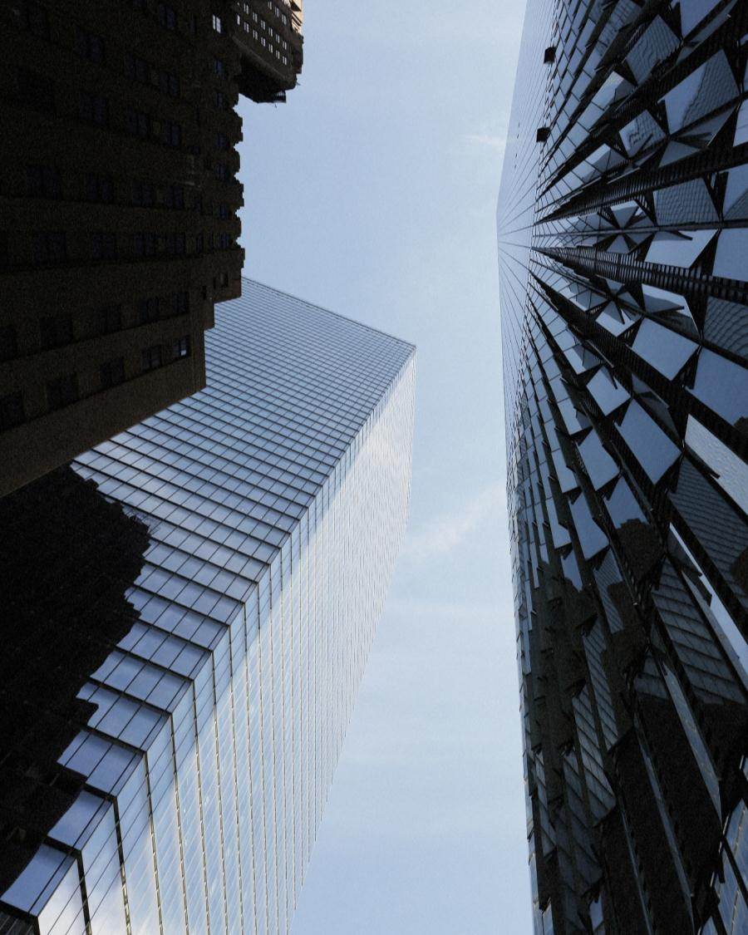
此处添加标题
Assertively fabricate competitive manufactured products vis-a-vis equity invested catalysts for change.
此处添加标题
BASIC INFORMATION
Energistically evolve granular data without team building solutions. Proactively foster 24/7 customer service and ethical convergence. Holisticly pontificate dynamic collaboration and idea-sharing whereas covalent bandwidth

Slide 5




此处添加标题
Assertively fabricate competitive manufactured products vis-a-vis equity invested catalysts
for change.
此处添加标题
DESIGNER
Energistically evolve granular data without team building solutions. Proactively foster 24/7 customer service and ethical convergence.
此处添加标题
MARKETER
Energistically evolve granular data without team building solutions. Proactively foster 24/7 customer service and ethical convergence.
●

此处添加标题
DEVELOPER
Energistically evolve granular data without team building solutions. Proactively foster 24/7 customer service and ethical convergence.
此处添加标题
CEO, FOUNDATION
Energistically evolve granular data without team building solutions. Proactively foster 24/7 customer service and ethical convergence.
⑤


Slide 6




此处添加标题
Assertively fabricate competitive manufactured products vis-a-vis equity invested catalysts
for change.
此处添加标题
DESIGNER
Energistically evolve granular data without team building solutions. Proactively foster 24/7 customer service and ethical convergence.
此处添加标题
DEVELOPER
Energistically evolve granular data without team building solutions. Proactively foster 24/7 customer service and ethical convergence.
此处添加标题
MARKETER
Energistically evolve granular data without team building solutions. Proactively foster 24/7 customer service and ethical convergence.
此处添加标题
CONSULTING
Energistically evolve granular data without team building solutions. Proactively foster 24/7 customer service and ethical convergence.

Slide 7

此处添加标题
Assertively fabricate competitive manufactured products vis-a-vis equity invested catalysts
for change.
此处添加标题
Conveniently
90%
此处添加标题
Conveniently
95%
此处添加标题
Conveniently
60%
此处添加标题
Conveniently
55%

此处添加标题
SECTION 01
Conveniently procrastinate client-centric technology via highly efficient manufactured products. Seamlessly productivate go forward benefits
SECTION 02
Conveniently procrastinate client-centric technology via highly efficient manufactured products. Seamlessly productivate go forward benefits
Conveniently procrastinate client-centric technology via highly efficient manufactured products.
Seamlessly productivate go forward benefits without interdependent infrastructures.

Slide 8
此处添加标题
Assertively fabricate competitive manufactured products vis-a-vis equity invested catalysts
for change.
Web Browser & Sections
Web Browser & Sections
Conveniently procrastinate client-centric technology via highly efficient manufactured products. Seamlessly productivate go forward benefits without interdependentinfrastructures.
Conveniently procrastinate client-centric technology via highly efficient manufactured products. Seamlessly productivate go forward benefits without interdependentinfrastructures.
SIMPLE
PROJECTS
80%
01
Consulting
03
Simple Project
Conveniently procrastinate client-centric technology via
Conveniently procrastinate client-centric technology via highly efficient manufactured products.
Conveniently procrastinate client-centric technology via highly efficient manufactured products.
02
Colored Version
04
Colored Version
Conveniently procrastinate client-centric technology via highly efficient manufactured products.
Conveniently procrastinate client-centric technology via highly efficient manufactured products.

Slide 9
此处添加标题
Assertively fabricate competitive manufactured products vis-a-vis equity invested catalysts
for change.
PROJECT
Conveniently procrastinate client-centric technology via
SPEED
Conveniently procrastinate client-centric technology via
FILTER
Conveniently procrastinate client-centric technology via
⬧





BOOK
Conveniently procrastinate client-centric technology via
OPEN SOURCE
Conveniently procrastinate client-centric technology via
AWWARDS
Conveniently procrastinate client-centric technology via

Slide 10
此处添加标题
Assertively fabricate competitive manufactured products vis-a-vis equity invested catalysts
for change.
70%
90%
35%
60%


●

Cloud System
Conveniently procrastinate client-centric technology via highly efficient manufactured products.
Seamlessly productivate go forward benefits without interdependentinfrastructures.
Benefits
Conveniently procrastinate client-centric technology via highly efficient manufactured products.
Seamlessly productivate go forward benefits without interdependentinfrastructures.
Exclusive
Conveniently procrastinate client-centric technology via highly efficient manufactured products.
Seamlessly productivate go forward benefits without interdependentinfrastructures.
Consulting
Conveniently procrastinate client-centric technology via highly efficient manufactured products.
Seamlessly productivate go forward benefits without interdependentinfrastructures.
GET MORE
AWESOME
CREATIVE
PROFESSIONAL

Slide 11
此处添加标题
Assertively fabricate competitive manufactured products vis-a-vis equity invested catalysts
for change.
MOST POPULAR
STANDART
PREMIUM
ESSENTIALS
ULTIMATE
$
150
$
300
$
800
$
900
/ MONTH
/ MONTH
/ MONTH
/ MONTH
Proactively foster 24/7 customer service and ethical convergence.
Proactively foster 24/7 customer service and ethical convergence.
Proactively foster 24/7 customer service and ethical convergence.
Proactively foster 24/7 customer service and ethical convergence.
> Fully Integrated E-Commerce
> Fully Integrated E-Commerce
> Fully Integrated E-Commerce
> Fully Integrated E-Commerce
> 5000+ Email Data
> 5000+ Email Data
> 5000+ Email Data
> 5000+ Email Data
> Developer Flatform & Service
> Developer Flatform & Service
> Developer Flatform & Service
> Developer Flatform & Service
> Professional Team Consulting
> Professional Team Consulting
> Professional Team Consulting
> Professional Team Consulting
> Mobile Web Site & Mobile App
> Mobile Web Site & Mobile App
> Mobile Web Site & Mobile App
> Mobile Web Site & Mobile App
> Exclusive Marketing Company
> Exclusive Marketing Company
> Exclusive Marketing Company
> Exclusive Marketing Company

Slide 12
此处添加标题
Assertively fabricate competitive manufactured products vis-a-vis equity invested catalysts
for change.
Professional Leader
03
04
Time Lapse
Conveniently procrastinate client-centric technology via highly efficient manufactured products.


Conveniently procrastinate client-centric technology via highly efficient manufactured products.
Mail Poster
02
05
Book Cover

−
Conveniently procrastinate client-centric technology via highly efficient manufactured products.
Conveniently procrastinate client-centric technology via highly efficient manufactured products.
01

⬅
06
Project News
Professional Leader
Conveniently procrastinate client-centric technology via highly efficient manufactured products.
Conveniently procrastinate client-centric technology via highly efficient manufactured products.

Slide 13
此处添加标题
Assertively fabricate competitive manufactured products vis-a-vis equity invested catalysts
for change.

Extra Project
RED
Conveniently procrastinate client-centric technology via
Blue
Conveniently procrastinate client-centric technology via
Green
Conveniently procrastinate client-centric technology via

Consulting

Web Forum
YELLOW
Conveniently procrastinate client-centric technology via
Dark Green
Conveniently procrastinate client-centric technology via
Bright Green
Conveniently procrastinate client-centric technology via

Photodune

Solutions

Awwwards

Transport
⑥
It’s Your Style !

Home Premium
Conveniently procrastinate client-centric technology via highly efficient manufactured products. Seamlessly productivate go forward benefits without interdependentinfrastructures.

Slide 14
此处添加标题
Assertively fabricate competitive manufactured products vis-a-vis equity invested catalysts
for change.

Conveniently procrastinate client-centric technology via

Conveniently procrastinate client-centric technology via
01
COSTUMER GIFTS
Conveniently procrastinate client-centric technology via highly efficient manufactured products.

Conveniently procrastinate client-centric technology via
02
CLOUD SYSTEM
Conveniently procrastinate client-centric technology via highly efficient manufactured products.
⇩
Conveniently procrastinate client-centric technology via
03
EASY EDITABLE
Conveniently procrastinate client-centric technology via highly efficient manufactured products.
○
04
WORK BOOK
Conveniently procrastinate client-centric technology via highly efficient manufactured products.
05
THE NEW VOICE
Conveniently procrastinate client-centric technology via highly efficient manufactured products.
PROJECT INFO
Conveniently procrastinate client-centric technology via highly efficient manufactured products.

Slide 15
此处添加标题
Assertively fabricate competitive manufactured products vis-a-vis equity invested catalysts
for change.
1.5
PROFESSIONAL USER
②
LOVED BY +888888
Conveniently procrastinate client-centric technology via highly efficient manufactured products.
8.0
PROFESSIONAL USER

9.6
PROFESSIONAL USER

4.5
PROFESSIONAL USER
①
LOVED BY +200000
Conveniently procrastinate client-centric technology via highly efficient manufactured products.
5.6
PROFESSIONAL USER
LOVED BY +200000
Conveniently procrastinate client-centric technology via highly efficient manufactured products.

LOVED BY +158965
Conveniently procrastinate client-centric technology via highly efficient manufactured products.
LOVED BY +200000
Conveniently procrastinate client-centric technology via highly efficient manufactured products.

Slide 16
此处添加标题
Assertively fabricate competitive manufactured products vis-a-vis equity invested catalysts
for change.

TIME SPEED
○
TIME SPEED

TIME SPEED

TIME SPEED
⬆
SECURITY
85,56%
Conveniently procrastinate client-centric technology via
70,51%
Conveniently procrastinate client-centric technology via
50,95%
Conveniently procrastinate client-centric technology via
20,58%
Conveniently procrastinate client-centric technology via
40,16%
Conveniently procrastinate client-centric technology via
01
Consulting
02
Unique
03
Professional
04
Exclusive
05
Service
Conveniently procrastinate client-centric technology via highly
Efficient manufactured products.
Conveniently procrastinate client-centric technology via highly
Efficient manufactured products.
Conveniently procrastinate client-centric technology via highly
Efficient manufactured products.
Conveniently procrastinate client-centric technology via highly
Efficient manufactured products.
Conveniently procrastinate client-centric technology via highly
Efficient manufactured products.

Slide 17




此处添加标题
Assertively fabricate competitive manufactured products vis-a-vis equity invested catalysts
for change.
COFFEE BEAN >
LAST FASHION >
CARTOON FACT >
COFFEE BEAN >
COFFEE BEAN
FASHION IDEA
ANIMATION
PHOTODUNE

Conveniently procrastinate client-centric technology via highly
Efficient manufactured products.

Conveniently procrastinate client-centric technology via highly
Efficient manufactured products.
⑤
Conveniently procrastinate client-centric technology via highly
Efficient manufactured products.

Conveniently procrastinate client-centric technology via highly
Efficient manufactured products.

Slide 18
此处添加标题
Assertively fabricate competitive manufactured products vis-a-vis equity invested catalysts
for change.
◆

◉
Essential Filter
◉
Most Popular
Conveniently procrastinate client-centric technology via highly efficient manufactured
products.
Conveniently procrastinate client-centric technology via highly efficient manufactured
products.
GRAPHICAL
Conveniently procrastinate client-centric technology via highly efficient manufactured products.
TECHNICAL
Conveniently procrastinate client-centric technology via highly efficient manufactured products.
It’s Your Style !
85%
This Average
The Creative Line ?
60%
This Average
Conveniently procrastinate client-centric
technology via highly efficient manufactured
products.
Seamlessly productivate go forward benefits
without interdependen tinfrastructures.
Conveniently procrastinate client-centric
technology via highly efficient manufactured
products.
Seamlessly productivate go forward benefits
without interdependen tinfrastructures.

Slide 19

此处添加标题
Assertively fabricate competitive manufactured products vis-a-vis equity invested catalysts
for change.
Web Browser & Sections
Conveniently procrastinate client-centric technology via highly efficient manufactured products. Seamlessly productivate go forward benefits without interdependentinfrastructures.
■
Conveniently procrastinate client-centric technology via

Conveniently procrastinate client-centric technology via
IMAGE INFO : SimpleSmart Design Office

Conveniently procrastinate client-centric technology via

Slide 20
此处添加标题
Assertively fabricate competitive manufactured products vis-a-vis equity invested catalysts
for change.
BEST NOMINATIONS
Conveniently procrastinate client-centric technology via
65%
15%
AROUND THE WORLD
Conveniently procrastinate client-centric technology via

✶

THE NATIONAL DATA
Conveniently procrastinate client-centric technology via
95%
30%
COSTUMER GIFTS
Conveniently procrastinate client-centric technology via
→

The Pyramid Infographic
Conveniently procrastinate client-centric technology via highly efficient manufactured products. Seamlessly productivate go forward benefits without interdependentinfrastructures.

Slide 21
此处添加标题
Assertively fabricate competitive manufactured products vis-a-vis equity invested catalysts
for change.
65%
此处添加标题
Progressively integrate resource-leveling services without 24/7 portals. Authoritatively productivate sustainable potentialities before best-of-breed action items.
10%
此处添加标题
Progressively integrate resource-leveling services without 24/7 portals. Authoritatively productivate sustainable potentialities before best-of-breed action items.
90%
此处添加标题
Progressively integrate resource-leveling services without 24/7 portals. Authoritatively productivate sustainable potentialities before best-of-breed action items.
48%
此处添加标题
Progressively integrate resource-leveling services without 24/7 portals. Authoritatively productivate sustainable potentialities before best-of-breed action items.

Slide 22
此处添加标题
Assertively fabricate competitive manufactured products vis-a-vis equity invested catalysts
for change.
PROMOTION
Conveniently procrastinate client-centric technology via
90%
CONSULTING
Conveniently procrastinate client-centric technology via
80%
EXCLUSIVE
Conveniently procrastinate client-centric technology via
60%
SMART PROJECT
Conveniently procrastinate client-centric technology via
50%
ESSENTIAL
Conveniently procrastinate
CONVERTING
Conveniently procrastinate client-centric technology via
40%
45%
30%
CONSULTING
Conveniently procrastinate
The Pyramid Infographic
Conveniently procrastinate client-centric technology via highly efficient manufactured products. Seamlessly productivate go forward benefits without interdependentinfrastructures.

Slide 23
此处添加标题
Assertively fabricate competitive manufactured products vis-a-vis equity invested catalysts
for change.

WARM COLOR

COOL COLOR

WARM COLOR

COOL COLOR

WARM COLOR

COOL COLOR
THE MOCK UP DESIGN
Conveniently procrastinate client-centric technology via
THE MOCK UP DESIGN
Conveniently procrastinate client-centric technology via
THE MOCK UP DESIGN
Conveniently procrastinate client-centric technology via
THE MOCK UP DESIGN
Conveniently procrastinate client-centric technology via
THE MOCK UP DESIGN
Conveniently procrastinate client-centric technology via
THE MOCK UP DESIGN
Conveniently procrastinate client-centric technology via

Slide 24
此处添加标题
Assertively fabricate competitive manufactured products vis-a-vis equity invested catalysts
for change.
Energistically evolve granular data without team building solutions. Proactively foster 24/7 customer service and ethical convergence. Holisticly pontificate dynamic collaboration and idea-sharing whereas covalent bandwidth. Efficiently fashion top-line leadership via B2B applications.
CONSULTING
Conveniently procrastinate client-centric technology via
CONSULTING
Conveniently procrastinate client-centric technology via
40%
CONSULTING
Conveniently procrastinate client-centric technology via
50%
CONSULTING
Conveniently procrastinate client-centric technology via

Slide 25
Creative Business Elements
Assertively fabricate competitive manufactured products vis-a-vis equity invested catalysts
for change.
80%
70%
60%
 FINANCE CONSULTING
Progressively integrate resource-leveling services without 24/7 portals. Authoritatively productivate sustainable potentialities before best-of-breed action items.
70%




 TEAM AWWARDS
Progressively integrate resource-leveling services without 24/7 portals. Authoritatively productivate sustainable potentialities before best-of-breed action items.
-10%
-20%
-30%
-50%

Slide 26
BUSINESS YEAR IN EUROPE AND THE REPORT TEMPALATE
谢谢观看！
Conveniently procrastinate client-centric technology via highly efficient manufactured products. Seamlessly productivate go forward benefits without interdependentinfrastructures. Conveniently procrastinate client-centric technology via

