Slide 1
Unit1 He’s the boy who won the photo competition last year!
MODULE 11
WWW.PPT818.COM

Slide 2
01
能听懂包含定语从句的句子
学习目标
02
能运用定语从句谈论照片
03
能与他人合作组织语言介绍摄影作品
04
增强审美意识和对家乡的热爱之情

Slide 3
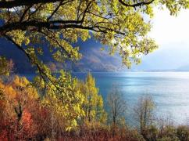
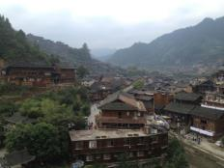
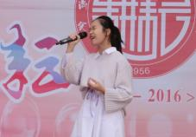
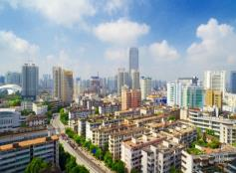
Revision
I have some nice photos.
The photos were taken last year.
I have some nice photos _____ were taken last year.
that

Slide 4
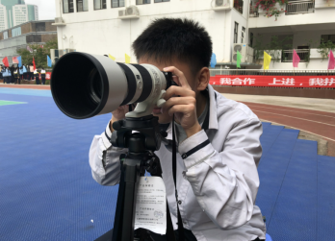
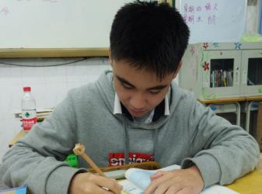
Lead in
Who took the nice photos ?
He’s the boy.
The boy won the photo competition last year!
He’s the boy_____won the photo competition last year!
who

Slide 5
Lead in
It is a beautiful girl.
The beautiful girl is wearing a blouse and skirt.
It is a beautiful girl_____is wearing a blouse and skirt.
who

Slide 6
Listen and complete the sentences.
right
The boy on the _____ is the guitar player.
2. The boy in the ______ is the singer.
3. The boy at the ______is the drummer.
centre
back

Slide 7
Listen and answer the questions.
Tip: Before listening, we should do a prediction. 听前预测
1.What are they talking about?
A.Singing competition. B. Photo competition.
C.School dance.
2.How many subjects are there in the competition?
Four.

Slide 8
PART1: Listen and complete the table.
Tip: Before listening, we should do a prediction. 听前预测
He Zhong | 1. He’s the boy _____ won the photo competition last year. 2. The one ______ took photos at the school dance. 3. _____________, he’s really good.
who
who
The thing is

Slide 9
Retelling.
Tony will enter the photo competition, he wants to beat He Zhong.
He Zhong is the boy...
He Zhong | 1. He’s the boy _____ won the photo competition last year. 2. The one ______ took photos at the school dance. 3. _____________, he’s really good.

Slide 10
Listen and answer the questions.
1. What are the subjects that they' ve chosen for this year' s competition?
Nature, ___________ and Away, City and ___________, and Music.
2. Where is Tony from?
A. Beijing. B. London. C.Cambridge.
Home
People

Slide 11
Find out the sentences which include attributive clause in the dialogue. 找出文中包含定语从句的句子
1. He is the boy who won the photo competition last year.
2. The one who took photos at the school dance.
3. I have a feeling that we can solve these little difficulties.
4. What are the subjects that they' ve chosen for this year' s competition?
5.Take some photos of Beijing and add some photos of Cambridge that you took recently.

Slide 12
Our task:
Find some good ways to win the photo competition.

Slide 13
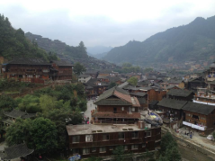
获胜第一步：选照片主题
What subject do you want to choose?
Nature
Home and Away
Music
City and People

Slide 14
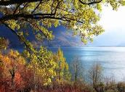
获胜第二步：学会描述照片
Where / when did you take it ?
Who / what is in it?
The photo shows a lake______ is in Jiuzhaigou.
that
Nature
that
The photo shows a village _____ has many traditional buildings.
Home and Away

Slide 15
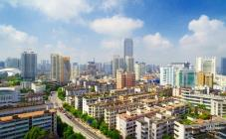
获胜第二步：学会描述照片
Where / when did you take it ?
Who / what is in it?
City and People
The photo shows a city ______ I like most.
that
that
The photo shows a girl _______ is singing at the school party .
who
Music

Slide 16
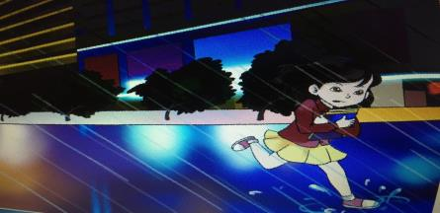
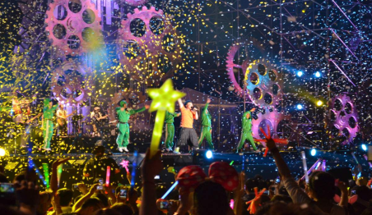
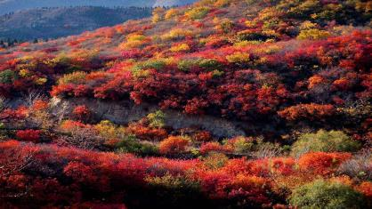
blouse,skirt,rush,protect...against...
What subject do you want to choose?
What does the photo show?
City and People
Music
singer, band, concert, fans
Xiangshan Park, different colors
Nature

Slide 17
Home and Away
Weifang is the city that I like best.
Love country
Love life
Love yourself

Slide 18
当堂达标
用所给单词的适当形式填空
（that , who）
1.The meeting______you missed yesterday was very important.
2.The girl______is talking happily is our monitor.
3.The little dog that_____ three legs is very poor. ( have )
4.The girl who is planting trees______Nana. ( be )
5.I don't like the_________that are painted white. ( house )
（2020青海中考）
We'll never forget those______lost their lives for our country.
A.who B. which C. whom
that
who
has
is
houses

Slide 19
Homework
Describe a photo which was taken by yourself.

Slide 20
Thanks.

