Slide 1
Unit 2
What time do you go to school?
Section B
WWW.PPT818.COM

Slide 2
Period 1

Slide 3
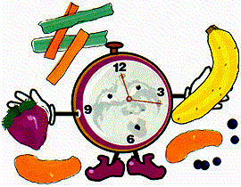
创设情境
T：What time is it now?
Ss：It’s…

Slide 4
It’s 7 :15
seven-fifteen
a quarter past seven

Slide 5
创设情境
It’s 7 :30
seven-thirty

Slide 6
It’s 7 :45
a quarter to eight

Slide 7
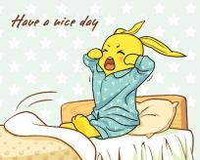
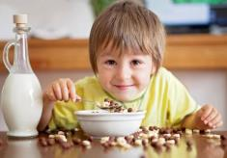
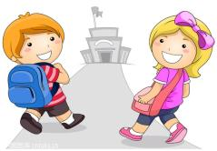
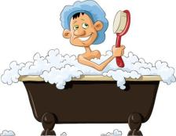
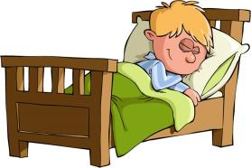
When do you usually ...?

Slide 8
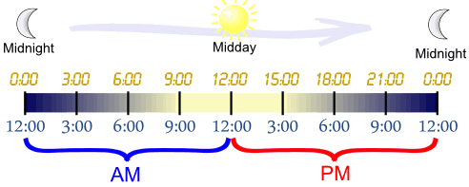
a.m.
p.m.

Slide 9
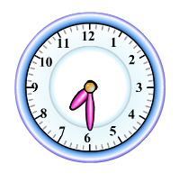
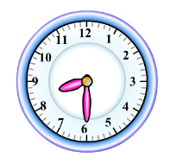
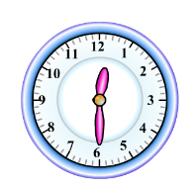
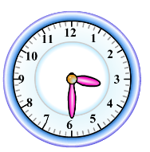
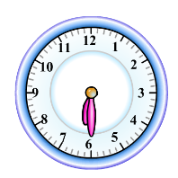
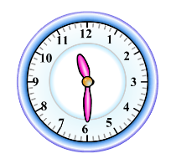
a.m.
Beijing
Tokyo
Paris
p.m.
Los Angeles
New York
London

Slide 10
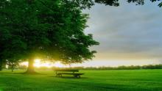
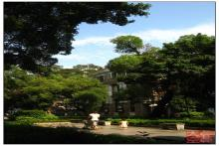
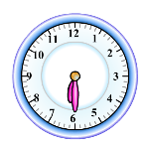
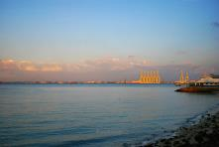
in the morning
in the afternoon
in the evening
Beijing
Los Angeles
New York

Slide 11
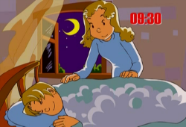
a.m.
p.m.
in the
afternoon
in the
morning
p.m.
in the
evening

Slide 12
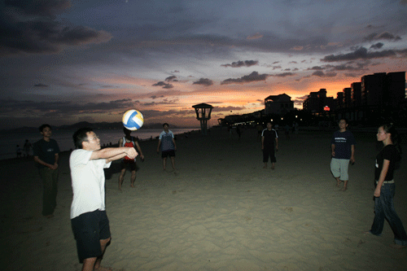
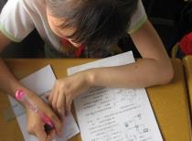
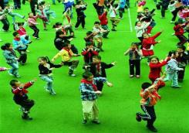
in the evening
in the afternoon
in the morning
morning?
What do you usually do in the
afternoon?
evening?

Slide 13
When do people usually …? People usually …?
启发思考
in the morning
in the afternoon
in the evening
do homework
eat dinner
eat breakfast
go to bed

Slide 14
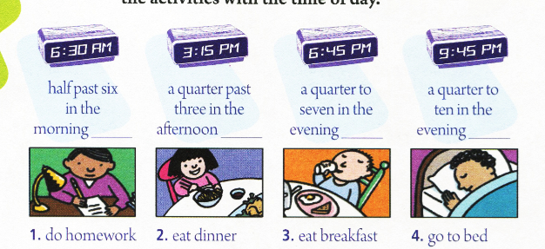
1a Match the activities with the time of day.
3
1
2
4

Slide 15
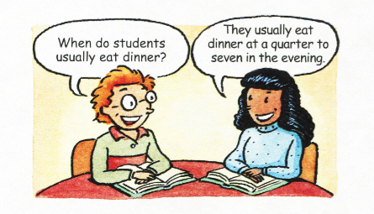
自主或小组探究
Pair work
1b Check your answers with your partner.

Slide 16
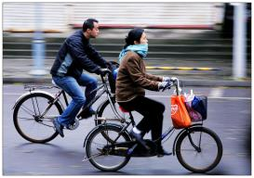
自主或小组探究
Pair work
Talk with your partner
A: When do people …?
B: They …
go to work

Slide 17
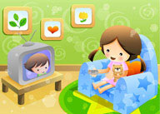
A: When do people …?
B: They …
watch TV

Slide 18
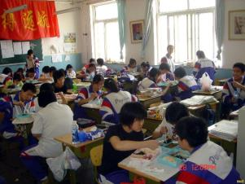
A: When do students …?
B: They …
have lunch

Slide 19
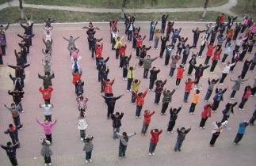
A: When do students …?
B: They …
do exercise

Slide 20
1c Listen and circle the activities you hear.
get up _____ 6. do my homework ____
2. run ____ 7. clean my room ____
3. eat breakfast ____ 8. eat dinner ____
4. go to school ____ 9. take a walk ___
5. go home _____ 10. go to bed ____
5:30

Slide 21
1d Listen again. Write the times next to the activities you circled in 1c.
get up _____ 6. do my homework ______
2. run ________ 7. clean my room ____
3. eat breakfast _______ 8. eat dinner ____
4. go to school _______ 9. take a walk ___
5. go home __________ 10. go to bed ________
5:30
5:30 p.m
6:00 a.m
7:00 a.m
7:15 p.m
7:45 a.m
4:15 p.m
9:00 p.m

Slide 22
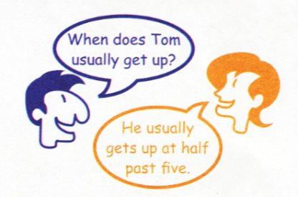
Pair work
1e Ask and answer questions about Tom.

Slide 23
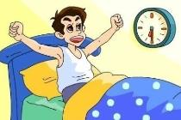
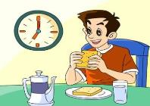
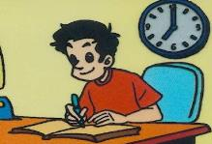
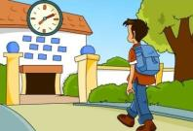
协作交流
—When does Tom usually …?
— He usually …

Slide 24
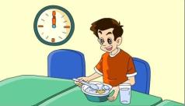
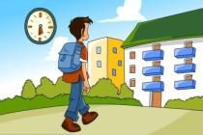
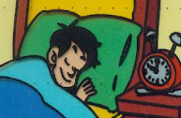
—When does Tom usually …?
— He usually …

Slide 25
总结提高
when 和 what time 的区别
what time: 问时间，一般指具体时刻。
when: 问时间，既指具体时刻，也指大的时间。
---What time do you go to school?
---I go to school at 7:00.
---When do you go to school?
---I go to school at 7:00.
---I go to school in the evening.

Slide 26
翻译：
1.你通常几点睡觉?
2.你的父亲七点钟上班吗？
3.他十二点吃午饭。
4.人们通常在晚上看电视。
What time / When do you usually go to bed?
Does your father go to work at 7:00?
He has / eats lunch at 12:00.
People usually watch TV in the evening.

Slide 27
Homework
Copy and recite the conversation in 1c.

Slide 28
Period 2

Slide 29
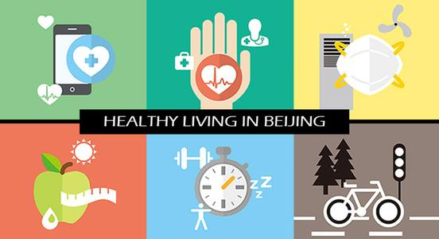
创设情境
How to be healthy?

Slide 30
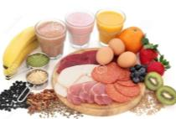
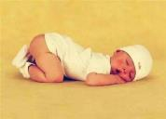
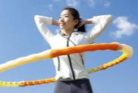
How to be healthy?
To be healthy = eat healthy food + exercise + sleep well

Slide 31
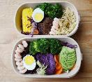
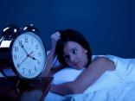
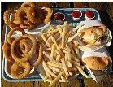
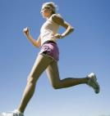
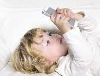
healthy
unhealthy

Slide 32
启发思考
2a Check (√) the activities you think are healthy.
_____ go to bed early _____ eat ice-cream
_____ eat quickly _____ eat vegetables
_____ play sports _____ take a walk
√
√
√
√

Slide 33
自主或小组探究
2b Who is healthier? Circle the healthy activities.
Hi! I’m Tony. I don’t like to get up early. In the morning, I get up eight. Then I go to school at eight thirty. I don’t have much time for breakfast, so I usually eat hamburgers. After school, I sometimes play basketball for half an hour. When I get home, I always do my homework first.

Slide 34
In the evening, I either watch TV or play computer games. At ten thirty, I brush my teeth and then I go to bed.
Mary is my sister. She usually gets up at six thirty. Then she always takes a shower and eats a good breakfast. After that, she goes to school at eight thirty.

Slide 35
At twelve, she eats lots of fruit and vegetables for lunch. After lunch, she sometimes plays volleyball. She always eats ice-cream after dinner. She knows it’s not good for her, but it tastes good! In the evening, she does her homework and usually swims or takes a walk. At nine thirty, she goes to bed.

Slide 36
2c Write down the unhealthy habits of each person. Then think of healthy activities for them.
Unhealthy habits Healthy activities
Tony ______________ ______________
______________ ______________
Mary ______________ ______________
______________ ______________

Slide 37
 | Unhealthy habits | Healthy activities
Tony
…don’t like to get up early
… usually eat very quickly
… for lunch, I usually eat hamburgers
…watch TV or play computer games
… at ten thirty… I go to bed
…play basketball for half an hour
… brush my teeth

Slide 38
 | Unhealthy habits | Healthy activities
Mary
… always eats ice-cream after dinner
…usually gets up at six thirty
…always takes a shower and eats a good breakfast
… eats lots of fruit and vegetables for lunch
… sometimes plays volleyball
… usually swims or takes a walk
… at nine thirty, she goes to bed

Slide 39
协作交流
Pair work
Do you have any healthy habits?
Do you have any unhealthy habits?

Slide 40
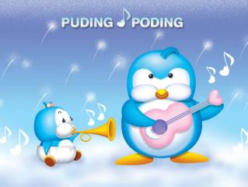
3a Number these sentences in order to make a story about a daily routine.

Slide 41
3
___ I usually exercise from six fifteen to seven.
___ I always get up early at six.
___ After that, I always brush my teeth and go to school at eight.
___ Then I quickly have a shower and eat breakfast.
___ I have lunch at quarter to twelve.
___ I get home from school at half past four and do my homework.
___ I have a very healthy life.
___ I have dinner at seven thirty.
___ I go to bed at ten.
2
5
4
6
7
1
8
9

Slide 42
总结提高
Language points
1. In the evening, I either watch TV or play computer games.
晚上我要么看电视要么玩电脑游戏。
either … or … 表示“要么……要么……；不是……就是……;或……或……”。这个结构可用来连接两个独立的词、短语、甚至独立的句子。例如：
You can come either today or tomorrow.
你可以今天或明天来。

Slide 43
either…or和or的区别和用法
来看两个例子：
She will come either today or tomorrow.
她不是今天来就是明天来。
She will come today or tomorrow.
她今天或明天来。

Slide 44
小结：
either … or和or的区别，主要在于语气强弱。前者强调“非此及彼”，后者仅有“或者”的意思。此外，either … or之后的语句应对称，也就是说，either之后用名词，or后面也用名词，either之后是从句，or后面也一样。所以，“他不是醉了，就是疯了”一句，就应说成： He is either drunk or mad.

Slide 45
完成句子。
1. 你可以在那里呆两天或三天。
You may spend two __________ three days
there.
2. Sorry, there is only one ticket. ________
you ________ she can have it.
A. Not; but B. Either; not
C. Both; and D. Either; or
or
D

Slide 46
【2012四川自贡】“You can’t have them all. You can choose _____the kite ______ the toy car,” said the mother.
A. either; or B. not only; but also
C. both; and
【答案】A

Slide 47
2. At twelve, she eats lots of fruit and vegetables for lunch.
lot pron. 许多；大量
lots of (= a lot of) 许多，大量
The boy has a lot of / lots of pocket money.
这男孩有许多零用钱。
There are a lot of / lots of famous movie stars in the USA.
美国有许多著名的电影明星。

Slide 48
lots of、 a lot of 既可以修饰不可数名词也可以修饰可数名词的复数形式，相当于many或much。a lot of, lots of 通常用于肯定句，否定句中一般用many或much。

Slide 49
3. She knows it’s not good for her, but it tastes good!
她知道这对她(健康)不利，但它(指冰激凌)却很好吃。
1) be good for… 表示“对……有益”；
be bad for… 表示“对……有害”。例如：
It’s good for our health to go to bed early and get up early.
早睡早起对我们的健康有好处。

Slide 50
It’s good for… 对……有益
It’s bad for…对……有害
完成句子
1. Smoking is ________ your health. (吸烟无益健康。)
2. We hope you can give up , will ____________ your health. (我们希望你戒烟，这对你的健康有利。)
bad for
be good for

Slide 51
2) taste表示“吃上去；品尝”，之后要用形容词。
表示感觉的系动词还有smell(闻起来)和feel(摸上去)。
例如：
This fish smells bad.
这鱼闻着坏了。
This sofa feels nice and soft.
这沙发摸上去舒服、柔软。

Slide 52
Homework
(1) Finish Self Check.
(2) Write about your own daily routine.

Slide 53
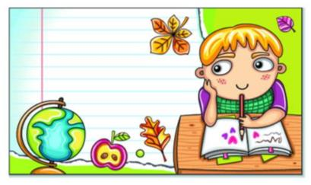
Write about your own daily routine.

Slide 54
I always get up at 6:00 and take a shower at 6:05. I get dressed at 6:20 and eat breakfast at 6:25. I brush my teeth at 6:50 and go to school at 7:00. I have lunch with my classmates at 12:00. I usually go home at 4:00 and do my homework from 4:15 to 6:45. I always have dinner at 7:00 and take a walk with my family at 7:45. I usually watch TV at 9:00 and go to bed at 10:00.

