Slide 1
Unit 4 Topic 1 When was it invented?
Section B
WWW.PPT818.COM

Slide 2
Review
I. Choose the right answer. You can do it.
( )1.He ___play computer games unless he finished his
homework.
A. was allowed to B. was not allowed to C. allow to
( )2.We all know that paper ___wood.
A. is made of B. is made into C. is made from
( )3.This kind of machine ___in 2006.
A. is invented B. is made C. was invented
( )4.A(An)___is used for taking photos.
A .Camera B. Lift C. MP3 player
( )5 .We should spend more time ___because it’s too
important.
A .to learn English B. learning English C. in English
B
C
C
A
B

Slide 3
Review
II. Fill in the blanks with the right preposition.
1.The desk is made _____ wood.
2.The red wine is made _____ grapes.
3.This delicious cake was made ___my mother.
4.Glasses are made ___ glass.
5.Our group is made up ___ four students.
6.That kind of machine is made _____Japan.
of
from
by
of
of
in

Slide 4
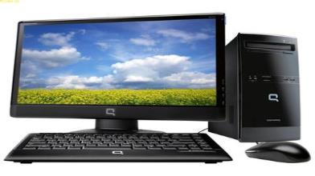
Look and talk about the picture.
A: Where were computers invented?
B: They were invented in America.
A: When were computers invented?
B: They were invented in 1946.
invent /America/in 1946

Slide 5
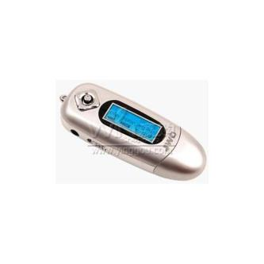
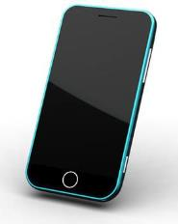
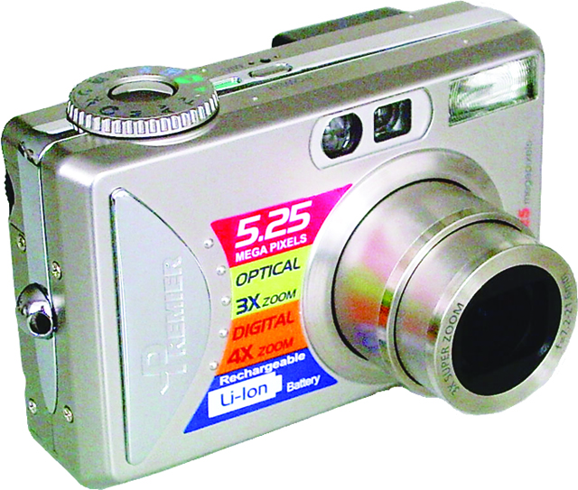
MP3 player
1998
Korea
listen to music
mobile phone
1973
America
communicate easily
digital camera
1975
America
take photos
Please choose one to talk about.

Slide 6
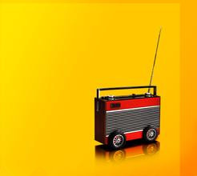
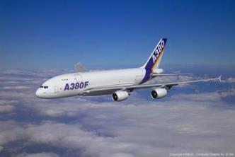
A:What’s this ?
B:It’s …
A:When was it invented ?
B: It was invented in …
A: Who invented it ?
B:…

Slide 7
1b Listen to 1a and choose the correct answers.
A
( ) 1. Where are Michael and Jane?
A. In the science museum.
B. At the school library.
C. In the zoo.
D. In the park.
( ) 2. Which object is not mentioned in
the conversation ?
A. Light bulb. B. Airplane.
C. Television. D. Radio.
C

Slide 8
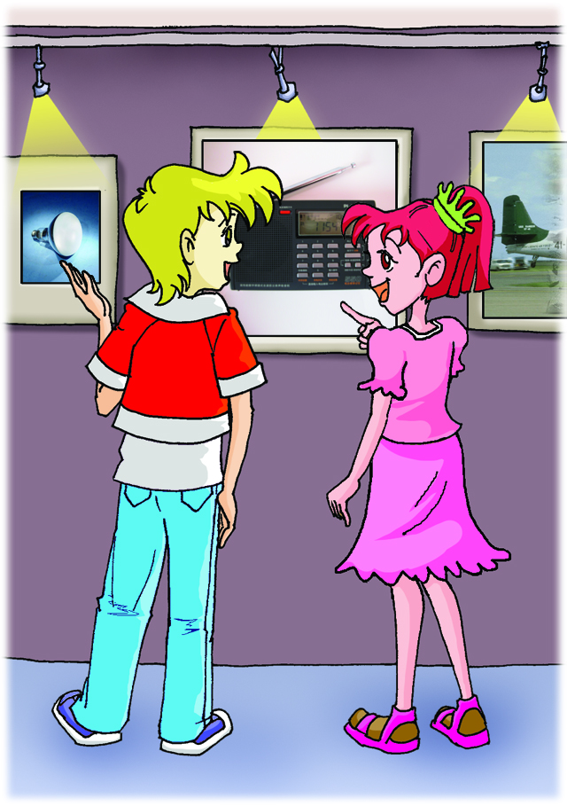
1a Look, listen and say.
When was it invented?
Who invented it?
Look, a light bulb!
In 1897,
Thomas Edison.

Slide 9
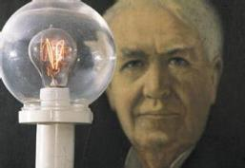
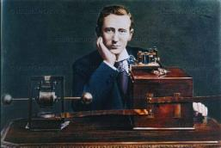
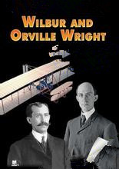
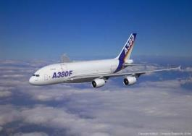
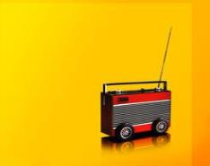
Can you match them?
In 1895 in 1903 in 1879

Slide 10
1c Read 1a and complete the table.
Invention | Inventor | Year
light bulb
 | Guglielmo Marconi
 |  | 1903
Thomas
Edison
1879
radio
1895
airplane
Wilbur and
Orville Wright

Slide 11
1d Discuss with your classmates the inventions listed in 1c. Let them guess which invention you are describing.
You may begin like this:
It is widely used by people everywhere. It was invented in 1879 by Thomas Edison. It’s said that…

Slide 12
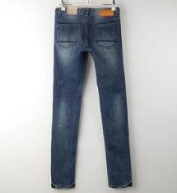
Do you know?
A: What are these ?
B:…
A: When were they produced first ?
B:…
A: What were they made of ?
B:…

Slide 13
2 Fill in the blanks with the proper forms of the given words.
The first jeans were produced in 1855. At that time, they ___________(not call ) jeans and they were just hard-wearing pants designed for workers. The pants _____________ (make ) of the brown cloth. This kind of cloth ______ usually ________(use) for making tents. Nowadays, their materials have been changed so that it feels more comfortable. And many different jeans styles _______ also ________(create). They ___________( design) not only for workers but also for teenagers and women. Later jeans are popular all over the world.
were not called
were made
was
used
are
created
are designed

Slide 14
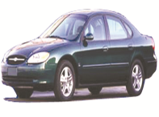
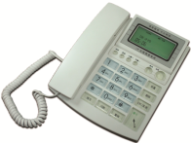
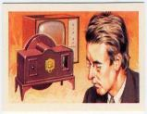
3 Listen to the three passages. Match the pictures with the following information.
Invention
Inventor
Year
a.1926
A. Karl Benz
b.1876
B. John Baird
c.1885
C. Alexander Graham Bell

Slide 15
4a Read the following words. Listen and check the vowels.
rocket cotton hospital model
satellite camera laptop plastic

Slide 16
4b Listen and read the following sentences aloud, paying attention to the stress and intonation. Then use the words in 4a to make up similar conversations.
A: `When was the `digital camera `developed?
B: It was `developed in the `1970s.
A: Is the `digital camera `developed in `Korea?
B: `No.
A: `Where was it `developed?
B: It was `developed in `Japan.

Slide 17
Exercises
idely
The light bulb is w______ used by people everywhere.
Thomas Edison i_______ the light bulb in 1879.
It’s s______ that he invented more than two thousand things during his life.
The airplane was invented by Wilbur and Orville Wright in 1903. It’s d______ from today’s.
nvented
aid
ifferent

Slide 18
Summary
We learn: 1.Some words: bulb, airplane, hard-wearing,
Korea
2. Some phrases: be used by, more
than, be different from
3. Some sentences:
It’s said that he invented more than two
thousand things during his life.
We can: 1.Use the simple past passive voice:
Do you know when it was invented?
It was invented in 1879.
2.Talk about the inventors of some great inventions.

Slide 19
Assignment
Read 1a.
Memorize the useful expressions and key sentences that we learn today.
Finish Section B in your workbook.
Preview Section C.

