Slide 1
Unit3 This is my father.
人教精通版三年级下册
WWW.PPT818.COM

Slide 2
Review
Let’s chant

Slide 3
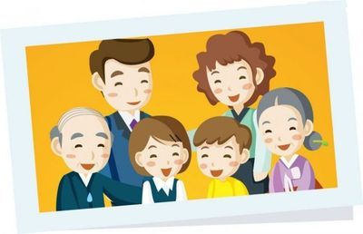
Lead-in
This is a photo of Li Ming’s family.
father
mother
Who’s this?
Who’s that?
sister

Slide 4
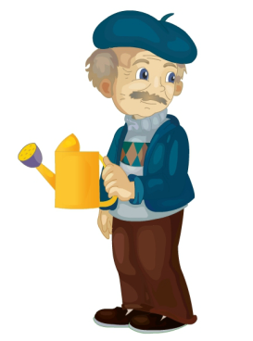
Presentation
Who’s this?
grandfather
(grandpa)
This is Li Ming’s father’s father.

Slide 5
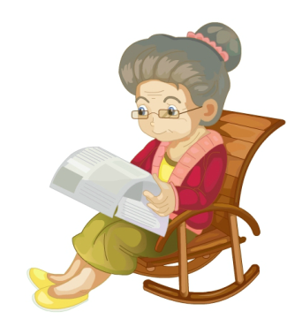
Presentation
Who’s that?
grandmother
(grandma)
That’s Li Ming’s father’s mother.

Slide 6
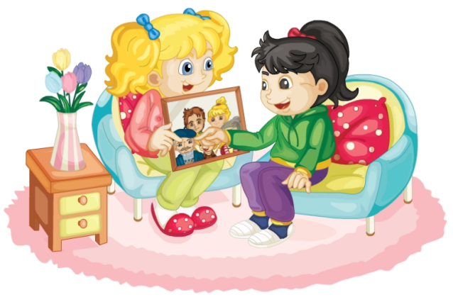
Presentation
Who are they?
What are they talking about?

Slide 7
Presentation
Look! This is my father and this is my mother.
Who’s this?
This is my grandmother.
And who’s that?
That’s my grandfather.

Slide 8
Presentation
Just talk
 | Look! This is my father and this is my mother.
 | Who’s this?
 | This is my grandmother.
 | And who’s that?
 | That’s my grandfather.

Slide 9
Practice
Read it by yourselves for one minute .
小组读对话一分钟。
一分钟倒计时
60
Learning tip :
50
10
10
当你自己朗读时，遇到不会读或不明白意思的单词或句子，可以把它圈起来，请教同学或老师！
20
20
40
30
30
开始

Slide 10
Practice
Who’s this?
This is my father.

Slide 11
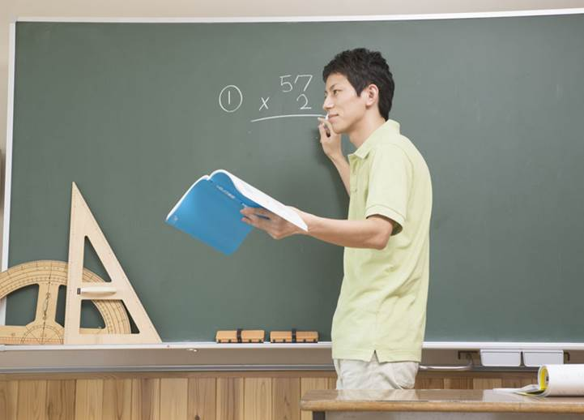
Practice
Who’s that?
That’s my teacher.

Slide 12
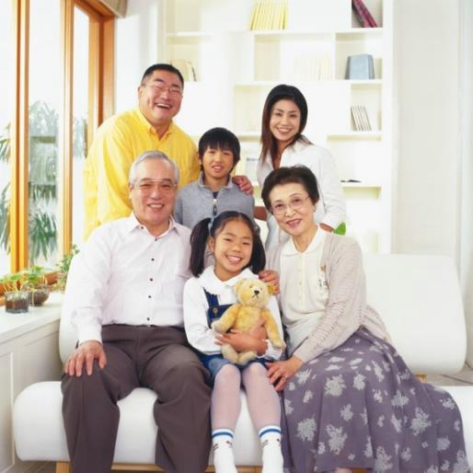
Practice
猜谜游戏
This is my mother’s father. Who’s this?
This is my mother’s mother. Who’s this?

Slide 13
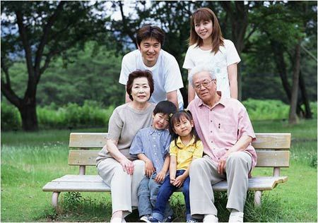
Practice
猜谜游戏
This is my father’s mother. Who’s this?
This is my father’s father. Who’s this?

Slide 14
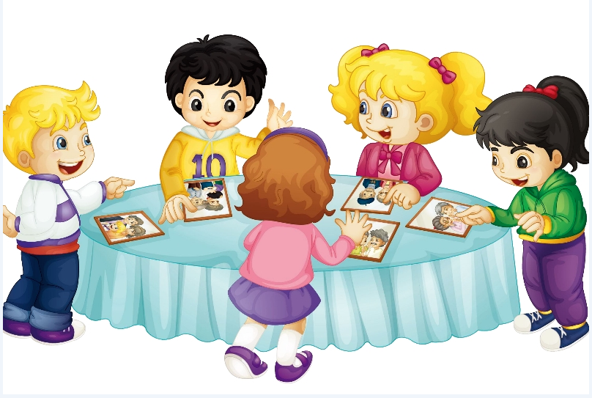
Practice
Let’s play
This is my grandmother.
Who’s that?

Slide 15
Summary
本课学到的新单词：
爷爷（外公）
奶奶（外婆）
本课学到新句型：
询问这是谁或那是谁？怎么回答？
grandfather (grandpa)
grandmother (grandma)
Who’s this/that?
This is/That’s …

Slide 16
Homework
1. Listen the dialogue three times.
听Just talk录音三遍。
2. Recite the dialogue.背诵对话。
3. With the help of the sentence parttens, make a new dialogue .在学过的主句型的帮助下，再创编一个新对话。
Close

