Slide 1
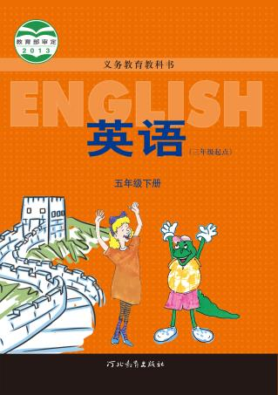
河北教育出版社 五年级 | 下册
Unit 4 Lesson24
A Gift for Little Zeke
WWW.PPT818.COM

Slide 2
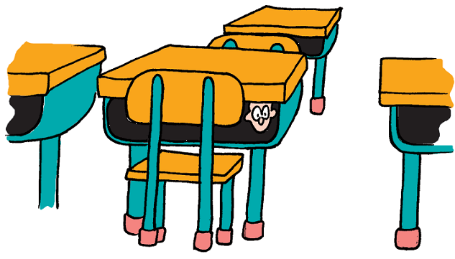
河北教育出版社 五年级 | 下册
Look and ask

Slide 3
河北教育出版社 五年级 | 下册
Read P1-2 and answer
1.Where does Little Zeke live?
Little Zeke lives in Emma’s desk.
2.Where does Little Zeke sleep?
Little Zeke sleeps in the sock.
3.What does Tess put for Little Zeke in the morning?
A hamburger and some milk.

Slide 4
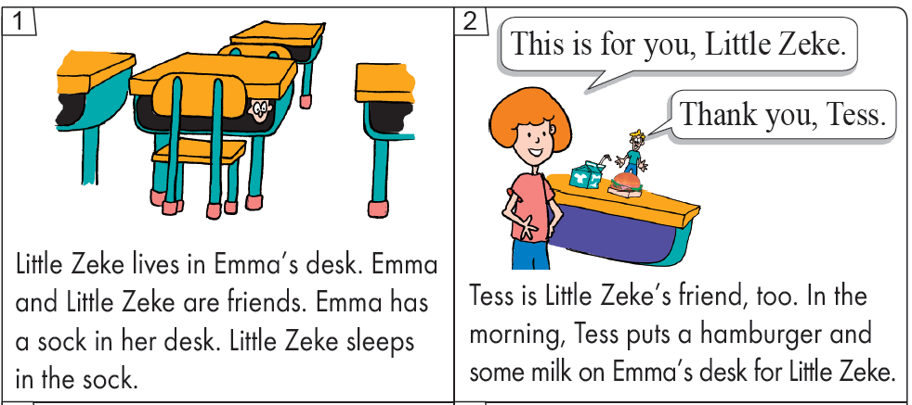
河北教育出版社 五年级 | 下册
Listen to P1-2 and follow it

Slide 5
河北教育出版社 五年级 | 下册
Read P3 and underline the answer
This evening, Little Zeke feels sad. Why?
Emma’s class had a party. Mrs. Jones had gifts for everyone. Was there a gift for Little Zeke? No.

Slide 6
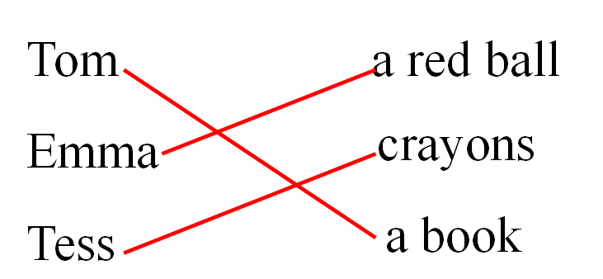
河北教育出版社 五年级 | 下册
Read P3-5 and match
What’s Mrs. Jones’ gifts?

Slide 7
河北教育出版社 五年级 | 下册
Listen and repeat.
This evening, Little Zeke feels sad. Why?
Emma’s class had a party. Mrs. Jones
had gifts for everyone. Was there a gift
for Little Zeke? No. Mrs. Jones had a
book for Tom. Tom liked it.
This book is for you.
Thanks, Mrs. Jones.

Slide 8
河北教育出版社 五年级 | 下册
Mrs. Jones had a red ball for Emma.
Emma played with her ball.
This ball is for you.
Thank you, Mrs. Jones.

Slide 9
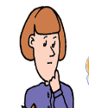
河北教育出版社 五年级 | 下册
Mrs. Jones had some new crayons for Tess.
Tess went to her desk. She worked on a
picture with her new crayons.
These crayons are for you.
Thank you, Mrs. Jones.

Slide 10
河北教育出版社 五年级 | 下册
Watch P6-8 and answer
1.What does Little Zeke write to Mrs. Jones?
2.What gift does Mrs. Jones give to Little Zeke?

Slide 11
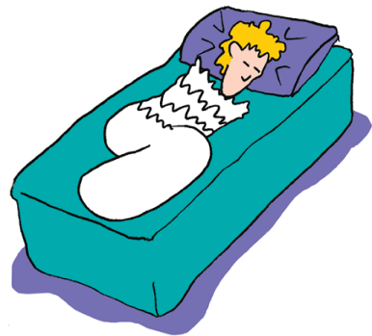
河北教育出版社 五年级 | 下册
Read P9 and answer
How does Little Zeke feel?

Slide 12
河北教育出版社 五年级 | 下册
Homework
Retell the story with your classmates.
和同学复述这个故事。

