Slide 1
Unit 7 A picture of my family
WWW.PPT818.COM

Slide 2
What's that?
A picture of my family.
一张我的家庭照片。

Slide 3
A picture of my family.
一张我的家庭照片。
a picture of...
一张 ...… 图画/相片

Slide 4
Xiaohuihui say:
It's me.
是我。
He is my father.
他是我的父亲。
She is my mother.
她是我的妈妈。

Slide 5
A picture of my family.
Angella say:
一张我的家庭照

Slide 6
Angella say:
It's me.
是我。
He is my father.
他是我的父亲。
She is my mother.
她是我的妈妈。

Slide 7
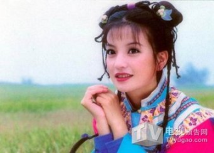
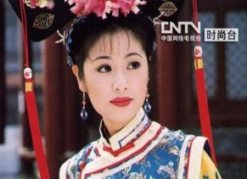
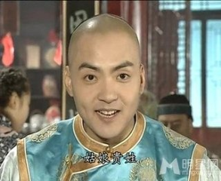
Xiaoyanzi say:
It's me.
She is my sister.
她是我的妹妹。
He is my brother.
他是我的哥哥。

Slide 8
Let's read
}
father
爸爸
mother
妈妈
家庭
成员
brother
兄弟
sister
姐妹

Slide 9
家庭成员
爸爸 妈妈 哥哥 姐姐 我
爷爷 奶奶

Slide 10
家庭成员
爸爸 妈妈 哥哥 姐姐 我
father mother brother sister me
爷爷 奶奶
grandpa grandma

Slide 11
Bomb game
grandpa grandma man
lady mother father
boy girl
dad mum

Slide 12
Bomb game
grandpa grandma man
lady mother father
boy girl
dad mum

Slide 13
Bomb game
grandpa grandma man
lady mother father
boy girl
dad mum

Slide 14
Group the words
grandpa grandma man lady
mother father boy girl
dad mum
.......
............
.........
.........
.........
...............

Slide 15
Divide the words
grandpa grandma man lady
mother father boy girl
dad mum
grandpa man father
1. 男性：__________________________
__________________________
boy dad
grandma lady mother
2. 女性：__________________________
__________________________
girl mum

Slide 16
Choose the words
（ ） 1. A boy B teacher C girl
B
（ ） 2. A family B father C sister
C
（ ） 3. A grandma B grandma C boy
C
（ ） 4. A how B she C he
A
（ ） 5. A man B lady C boy
B

Slide 17
大小声
家庭成员
mother father
grandpa grandma
brother sister me

Slide 18
Summary
家庭成员
mother father
grandpa grandma
brother sister me

