Slide 1
Module
10
On the radio
Unit 1 I hope that you can join us one day.
WWW.PPT818.COM

Slide 2
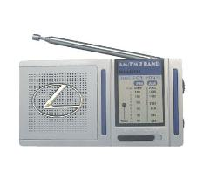
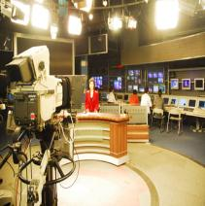
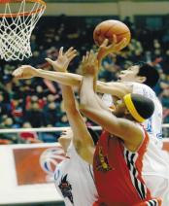
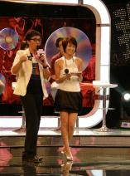
Warming-up
radio
Do you like listening to the radio programmes?
What kind of programs do you like?
I like listening …

Slide 3
I like watching/listening to…
I don’t like/hate watching/listening to…
动画城
Cartoon City
Lecture Room
FM 101.7

Slide 4
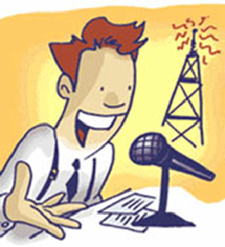
Dec. 4th
latest
news
microphone
newsreader

Slide 5
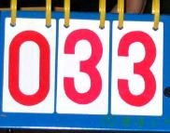
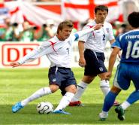
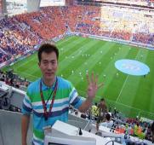
score
result
sport
We won!
reporter
Huang Jianxiang

Slide 6
sunny
weather
rain
report

Slide 7
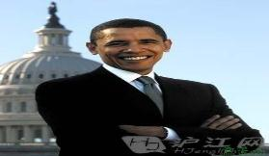
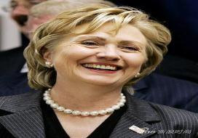
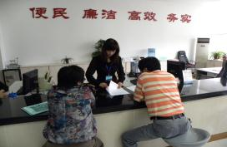
president
politician
government
service

Slide 8
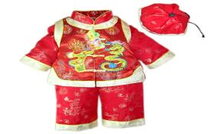
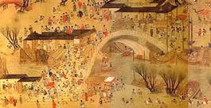
history
tradition
culture
book
art

Slide 9
Teaching aims
1. Teaching aims:
To be able to give advice and warnings,
and get specific information from the conversation
To be able to talk about radio programmes

Slide 10
2. Main contents:
Key vocabulary
director, show, around, show sb. around,
on air, avoid, national, international, interview
Key structures
And we should avoid making any noise in the background!
Remember what I said: we need to keep quiet if the red light is on.
I think you need to speak English really well.

Slide 11
Words and expressions
/də'rektə;daI'rektə/
/ʃəʊ/
/ə'raʊnd/
/ə'vɔId/
导演；主管；经理 n.
director
引领；带领 v.
show
around
到处；向各处 adv.
带某人参观；给某人做向导
show sb. around
on air
（广播或电视）播出
避免；防止 v.
avoid

Slide 12
Words and expressions
/'bækgraʊnd/
/'næʃnəl/
/'Intə'næʃnəl /
/prI'zentə/
/'Intə'vju:/
背景；后景 n.
background
national
国家的；国内的 adj.
国际的；世界的 adj.
international
主持人 n.
presenter
采访；访谈 n.
采访；访问 v.
interview

Slide 13
Focus on
Words:
director show around avoid
background national
international interview
Phrases:
show sb. around
on air
Patterns:
Come this way.
It gets crazy in here…
That’s great news!

Slide 14
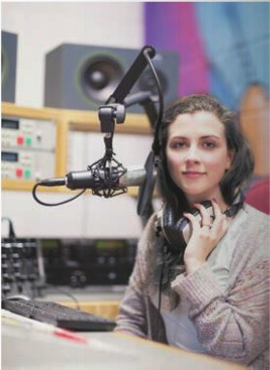
Listening and vocabulary
Listen and check (√ ) the types of news you hear.
culture
government
sports
weather
√
√

Slide 15
2. Listen again and complete the
sentences.
1. Zhang Li reads ________________________
____________________ on Radio Beijing.
2. The president of Russia will stay in China
for __________.
3. The match is between ______ and _________.
the latest news from China
and around the world
three days
China England

Slide 16
Listen and answer.
Where are Lingling and Tony?
They are at Radio Beijing.
2. What are they doing?
They are visiting the radio station.
3. Who is Chen Huan?
She/He is the news director at Radio Beijing.
4. What is the news while they are at the radio station?
Germany has won the football match,2-1
against England.

Slide 17
Tapescript
Zhang Li: Good afternoon. It's three o'clock,
and you're listening to Radio Beijing,
with the latest news from China and
around the world. I'm Zhang Li. The
president of Russia arrived in Beijing
today for a three-day visit to China...
Now for sports, and we're going over
to Wang Lin for the latest report on

Slide 18
the football match between China
and England. Wang Lin, can you
tell us what the score is?
Wang Lin: Yes, at the moment, the score is
China 2, England 1. China is
winning, but there is still half
an hour to go. Back to you,
Zhang Li!
Zhang Li: Thank you. We are looking
forward to the result.

Slide 19
Watch and read
Everyday English
_{• Come this way.}
_{• It gets crazy in here…}
_{• That’s great news.}

Slide 20
3. Listen and read.
Chen Huan: Hi, everybody. I’m the new
director at Radio Beijing.
Lingling: Thank you for showing us around.
Chen Huan: No problem! Now, come this way.
Look at the red light. When it's on,
it means we're on air. And we
should avoid making any noise in
the background.
Tony: OK.

Slide 21
Chen Huan: This is the newsroom. We collect
the latest national and international
news and write reports here. It gets
crazy in here just before the
programme begins.
Lingling: How can I become a presenter?
Chen Huan: I think you need to speak English
well. So keep studying, and I hope
you can join us one day.
Tony: What about the sports news?
Chen Huan: That’s over there. And it is where

Slide 22
we do interviews with big stars of
sports. Let’s watch the presenter.
Remember, I said you need to
keep quite if the red light is on.
Presenter: Finally, we've just heard that
Germany has won the football
match,2–1 against England.
Lingling: Hey! That's great news!
Tony: No, it's awful news!
All: Ssh!
Presenter: ... And that’s the end of the six
o’clock news.

Slide 23
Now complete the notes.
1. When the red light is on, it means
____________.
2. We collect _________________________
________________ and write reports in
the newsroom.
3. You should _______________________
if you want to be a presenter.
4. This is also where we _____________
with the big sports stars
we’re on air
the latest national and
international news
speak English really well
do interviews

Slide 24
Language points
I’m the news director at Radio Beijing.
我是北京广播电台新闻部的主任。
director “导演，主管，经理”。是名词。
动词为direct, 意 为“指导，导演，管理”。
We went back and reported our findings to director.
我们回去把调查的结果向经理汇报了.
The film was directed by Howard Hawks.
该影片是由霍华德·霍克斯导演的。

Slide 25
2. Now, come this way.
没关系，现在请走这边。
come this way 这边走
Come this way , if you please .
如果您愿意，请这边走。
Please come this way. We'll go in by that door.
请这边走，我们从那扇门进去。
Practise
请从这里的入口进入博物馆。
Please come this way into the museum.

Slide 26
3. Thank you for showing us around.
谢谢您带我们参观。
show sb. around + 地点, “带某人参观，给某人做向导”。e.g.
Shall I show you around the factory?
我带你去参观工厂, 好吗?
thank you for doing sth
= thanks for doing sth.
感谢某人做某事
e.g. Thank you for helping me.
= Thanks for helping me.

Slide 27
4. When it’s on, it means we’re on air.
当它（红灯）亮时，我们正在广播。
on air, “（广播或电视）播出，正在广播”。
例如：
We will be on air in about five minutes. 我们将在大约五分钟后开始广播。
The radio station is on air from 6.00 a.m.
这个电台早晨6点开播.

Slide 28
5. And we should avoid making any noise
in the background!
要避免背景中的任何杂音。
avoid“避免，防止”
avoid + doing sth. “避免做某事” e.g.
Please try to avoid making the same mistake next time.
下次请尽量避免犯同样的错误。

Slide 29
6. It gets crazy in here just before the programme
begins.
在节目开始前，这里都要忙疯了。
It gets crazy… …变得疯狂
It really gets crazy around Thanksgiving and Christmas and Easter.
在感恩节，圣诞节以及复活节时事情就会变得疯狂有趣。
Practise
考试前，教室里忙疯了。
It gets crazy in classroom before the test comes.

Slide 30
So keep studying, and I hope that you can
join us one day.
所以继续学习吧，我希望有朝一日你能加入我们。
keep (on) doing sth. 表示“坚持做某事”。例如：
Keep climbing until you get to the top of the mountain.
继续攀升，直到你到达山顶。

Slide 31
8. And it is where we do interviews with the
big sports stars.
where we do interviews with the big sports stars 是一个由where引导的表语从句。
interview 采访，访谈”。是可数名词。
do an interview with sb. “采访某人”
give an interview to… “接受……的采访”
I want to do interviews with the headmaster at school next month.
我想下个月采访校长。

Slide 32
9. We need to keep quite if the red light is on.
红灯亮的时候我们需要保持安静。
keep quite 保持安静
We should keep quite in the class.
我们应在课堂上保持安静。
Practise
请在开会时保持安静并关闭你的手机。
Please keep quite in the meeting and close your phone.

Slide 33
10. That’s great news! 那是好消息！
That’s great news. “真是好消息”，较口语的说法，表达看到好消息的喜悦之情。
That’s great news for developers.
对于开发人员，这是个特棒的消息。
Practise
这是一个超级好消息因为思考积极面能够改变生活！
That’s great news because thinking positively changes lives!

Slide 34
11. It’s awful news! 这是坏消息！
It’s awful news. 非正式的说法，相对应的表达是“It’s great news!”。
It’s awful news for me.
对我来说是个坏消息。
Practise
他不能接受这个坏消息。
It’s awful news for him to accept.

Slide 35
4. Complete the sentences with the words
in the box.
avoid background international
interviews national
1. Newspapers and television programmes
often have ___________ with famous people.
2. More and more _____________ students are
coming to China to learn Chinese.
interviews
international

Slide 36
3. Every country has its own ________
hero — a person who did something very
important for the country and its people.
4. Try to _______ drinking too much tea or
coffee, or you will not be able to sleep well.
5. Could you speak a little bit louder，please?
It is very noisy in the ____________. .
national
avoid
background

Slide 37
Pronunciation and speaking
5. Read and predict how the speaker is likely to pronounce the .
1. the red light 2. the interview
3. the programme 4. the football match
5. the end 6. the reports
7. the sports news
/ðə/ —— 1，3，4，6，7
/ði:/ —— 2，5
Now listen and check.

Slide 38
Pronounciation and speaking
分析: 英语中the有两种读音：一是在以辅音音素开头的单词前读作/ðə/ ,如the day, the key; 二是在以元音音素开头的单词前读作
/ði:/ ，如 the hour, the inside。

Slide 39
6. Say the expressions in Activity 5 aloud.
Work in pairs to take turns saying the expressions and listening to your partner. You can say “That’s great!” if your partner pronounces the expressions correctly or “Try again” if not.

Slide 40
7. Work in pairs. Ask and answer questions
about the radio.
1. What do you like listening to?
2. What do you not like listening to?
3. What programme did you listen to the last
time you turned on the radio?
4. What do you need to do if you want to be a
presenter?
Now work with other pairs. Find out who has the same answers.

Slide 41
For example:
A: What do you like listening to?
B: I like listening to my father’s record
collection.
A: Why?
B: Because the music is very different
from modern music.
A: What’s it like?
B: The songs tell stories.

Slide 42
Exercise
一、单项选择题。
He is the famous ______ of Harry Potter.
A. direct B. director C. act D. reporter
2. The radio is _____, and we can hear the news now.
A. in air B. on air C. to air D. by air
B
B

Slide 43
3. Which of the following is not right? ____ A. Is there any need for you to go there? B. Does he need any help? C. The house needs repairing. D. The garden needs to tidy.
4. No matter how hard it is, we’ll Keep
____until we make it.
A. failed B. failing C. tried D. trying
D
D

Slide 44
5. We should _______ eating too much meat in our daily life.
A. speak B. show C. hear D. avoid
6. — Could I do an ______ with you tomorrow?
— Yes, of course.
A. interview B. interviews
C. director D. directors
D
A

Slide 45
7. We'd like to thank you for _____ us around
the Great Wall
A. show B. showing
C. showed D. shown
8. — What are you doing, Laura?
— I'm reading the _____ news in the newspaper.
A. latest B. newest
C. nearest D. closest
B
A

Slide 46
9. We must keep listening to English programmes _______ the radio
A. in B. of C. for D. on
10. —I'm waiting for the mail. Do you know ______ it will arrive?
—Usually it conies by 4: 00.
A. how B. where C. when D. what
D
C

Slide 47
二、根据句意和汉语提示写单词。
1. He is a famous _________ (导演).
2. I want to be a __________ (主持人) in the
future.
3. There will be an _____________ ( 国际的)
meeting next week.
4. He has a strong political ___________(背景).
5. He has an ____________ (访谈) next
Thursday for a job.
director
presenter
international
background
interview

Slide 48
三、 完成下列英语句子。
1. 她有礼貌地带我们参观她家。
She was gracious enough to ______ ___
________her home.
2. 我最喜欢的节目正在直播。
My favorite programme is ____ _____.
3. 他们把电影院当成聊天的场所了，不知道
在电影院要保持安静吗？
They thought cinema is a chatting place,
don’t they know to ______ ______ (保持安静)
in cinema?
show us
around
on air
keep quite

Slide 49
4. 没事儿，酒喝多了的时候，每个人都有点疯狂的。
Don’t worry about it. Everyone gets a little ______ when they have too much to drink.
5. 把重复的任务交给员工去做，而不是你自己去做。
Give repetitive assignments to your
employees; avoid ______them yourself.
crazy
doing

Slide 50
Homework
用英语或汉语介绍你知道的著名主持人。
例如：
何炅，中国知名主持人，北京外国语大学教师。自1998年起，主持湖南卫视的《快乐大本营》栏目长达十余年。此外，曾主演《正德演义》等影视剧尤其2004年发行的歌曲《栀子花开》深受好评.

