Slide 1
Unit 9
Have you ever been to a museum?
Section A 3a—4c
WWW.PPT818.COM

Slide 2
A report
 | Have you ever been to...? | Where do you want to go? | How do you get there?
Grandfather
Grandmother
Father
Mother
Uncle
...

Slide 3
Brainstorm
Museums | Feelings

Slide 4
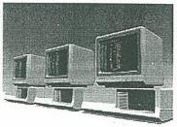
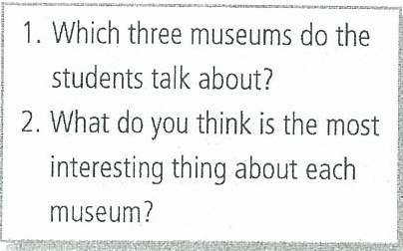
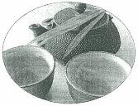
Read the magazine article and
answer the questions.
3a
参考答案：
The American Computer Museum, the International Museum of Toilets and the Hangzhou National Tea Museum.
They have information about different computers and who invented them at the American Computer Museum.
They have so many different kinds of toilets at the International Museum of Toilets.
The tea art performances are the most interesting at the Hangzhou National Tea Museum.

Slide 5
What kind | Where | How | What to see/learn

Slide 6
3b
Read the article aganin and
answer the following questions.
[参考答案]
1.He says it’s the most interesting museum.
2.We can learn about the history and development of toilets.
3.Because you can watch the tea art performances.

Slide 7
Language points
·even +比较级 更……
—How are you feeling now? 你现在感觉怎么样？
—Even worse. 更糟了。
·It’s unbelievable that…… 令人难以置信
It’s unbelievable that she has finished the work in a short time.
真是令人难以置信，她用很短的时间完成了那项工作。
·be able to 与 can
be able to 强调通过努力而获得的能力。如：
She can sing the song in English. 她能用英语唱这首歌。
can 则强调自身已具有的能力。如：
He will be able to sing this song in English in a few minutes, too.
几小时之后，他也能用英语唱这首歌。
·encourage... to... 鼓励……做……
My mother always encourages me to try me best. 我妈妈总是鼓励我尽最大努力。

Slide 8
3c
Which of the underlined words in the
passage have the following meanings?
improve peaceful
progressed invented
unusual rapid

Slide 9
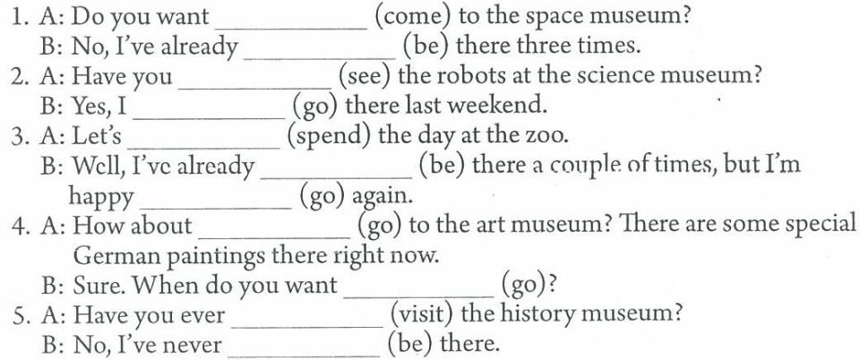
4a
Put the correct forms of the verbs
in the blanks.
to come
been
seen
went
spend
been
to go
going
to go
visited
been

Slide 10
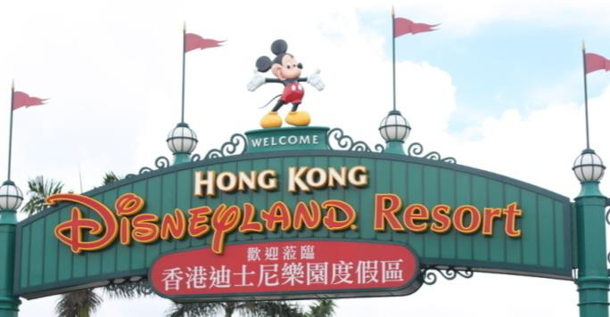
A fun place
Clue 1 Cartoon
Clue 2 Walt Disney
Clue 3 Mickey Mouse

Slide 11
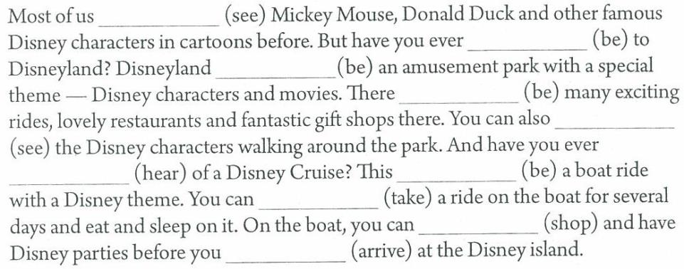
Fill in the blanks with the correct
forms of the verbs in brackets.
4b
have seen
been
is
are
see
heard
is
take
shop
arrive

Slide 12
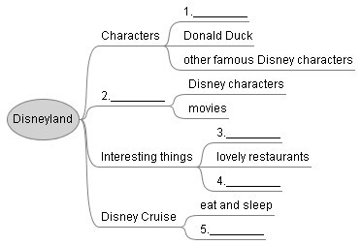
Read the passage and fill in the blanks of the mind-map.
Answers: 1. Mickey Mouse 2. Theme 3. exciting rides
4. fantastic gift shops 5. shop and have Disney parties

Slide 13
A survey
Answer the survey questions and then
ask your partner.

Slide 14
Grammar Focus

Slide 15
Homework
展开充分的想象，设计一个有趣、有创意的博物馆，写一篇短文介绍它。
What kind
Where
How
What to see/learn

