Slide 1
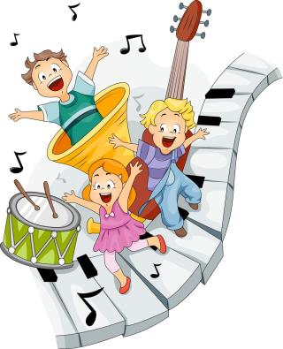
6
Music
第一课时
WWW.PPT818.COM

Slide 2
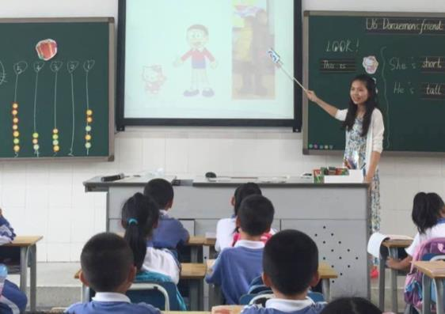
Free talk1
in the classroom
classroom
Miss Chen
Chen
basketball
playing basketball
white dress
white
music

Slide 3
Free talk1
I am Miss Chen.
I am wearing a white dress.
I am in the classroom.
I like playing basketball.
I like music too.

Slide 4
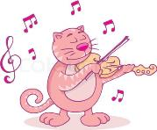
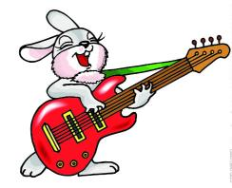
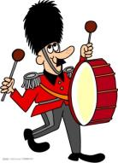
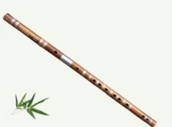
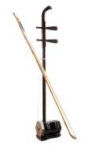
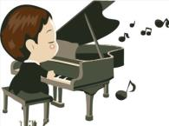
Free talk2
What can the music man play?

Slide 5
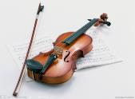
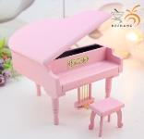
Let's guess.
What can Miss Chen play?
Can you play the _______?
guitar
violin
instruments
Erhu
piano
????

Slide 6
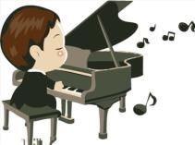
Let's sing.
I am the music man.
I come from down your way.
And I can play!
What can you play?
I (can) play the piano
Pi-a pi-a pi-a-no pi-a-no pi-a-no
Pi-a pi-a pi-a-no pi-a pi-a-no

Slide 7
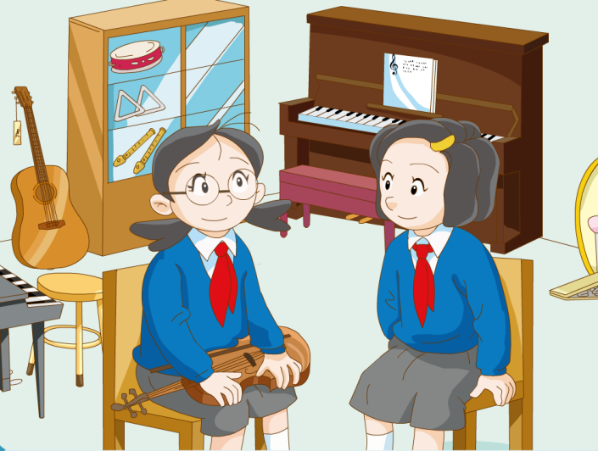
music room

Slide 8
Watch and answer
Do they like music?
What can they play?

Slide 9
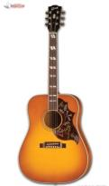
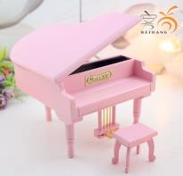
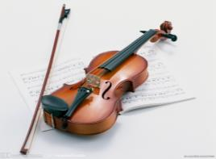
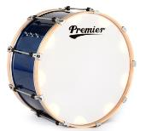
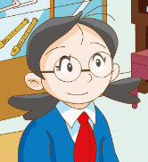
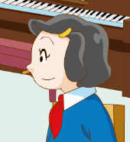
Learn and say.
Yes,Ido.
I like music.
It's wonderful.
like?

Slide 10
Read and answer
Jill's
Joe's

Slide 11
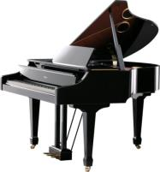
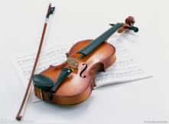
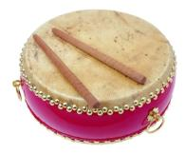
Let's enjoy
I like ______ music.
big drum
long flute

Slide 12
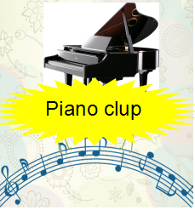
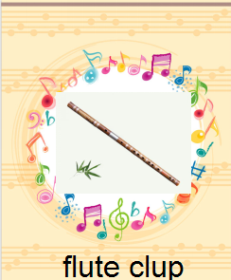
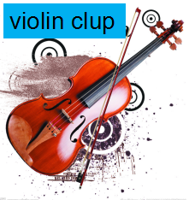
Violin club
Piano club
Guitar club
Flute club
There will be some music clubs in our school.
I like music. It's nice. I can play the piano. So I want to join the piano club.
What about you?
What club do you want to join?

Slide 13
Let's talk
I like music.
It's _____.
I can play the _____. So I want to join the _____ club.
I like _____music.
It's _____.
So I want to join the _____ club.
What about you?
What club do you want to join?

Slide 14
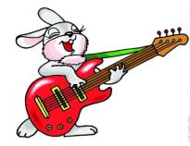
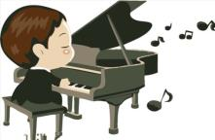
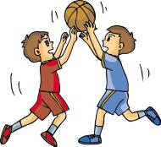
Difference
区别
play the piano
play the violin
play the guitar
play basketball

Slide 15
Homework
1.listen and read after the tape P26
2.Write down which club you want to join and why.
3.Sing the song I am the music man .(选做)

