Slide 1
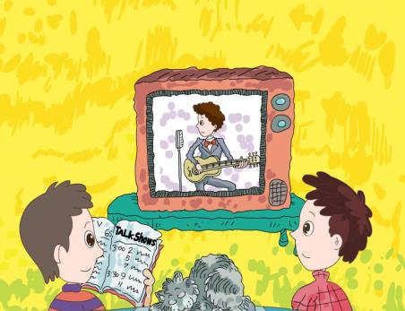
人教版八年级上册
Unit5
Do you want to watch a game show?
Section B（第1课时）
WWW.PPT818.COM
0

Slide 2
1. 掌握以下单词：educational, meaningless, famous, rich, successful等。 2.掌握以下句型： I like to watch talk shows. They’re more enjoyable. I don’t really like those kinds of TV shows. I think they’re boring. 3.能听懂有关表述喜好或不喜欢某种电视节目和电影的原因的英文表达，独立完成相关的听力任务。 4.通过具体情境下的语言学习，能够自由的进行相关话题的口语输出。
学习目标

Slide 3
自学互研
学习目标
根据句意及汉语提示完成句子
1. Our teacher asked the syudents not to do such meaning-
less (毫无意义的) things.
2. The favorite thing for my son is to watch the cartoons (
卡通片).

Slide 4
情景导入
Quickly eyes
Say the words and phrases quickly.
talk show
sports show
soap opera
sitcom
game show
news
educational
talent show
comedy

Slide 5
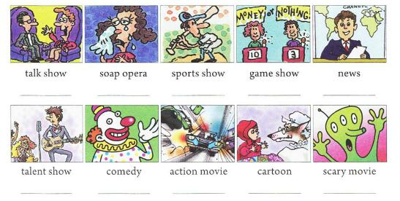
1a What do you think of these TV shows and movies? Choose words from the box and write them under the pictures.
educational serious wonderful relaxing meaningless enjoyable exciting boring
boring
enjoyable
educational
exciting
serious
relaxing
enjoyable
educational
exciting
meaningless

Slide 6
Pair work Choose words from the box and make conversations with your partner.
educational serious wonderful relaxing meaningless enjoyable exciting boring
A: What do you think of the game show?
B: I think it is very exciting. What do you think of the game show?
A: I think it’s a bit boring.

Slide 7
1b Listen and circle the description words you
hear in the box in 1a.
educational serious wonderful
relaxing meaningless enjoyable
exciting boring

Slide 8
1c Listen again. Write down the words John and Mary use to describe the TV shows or movies.
 | John | Mary
Action movies | exciting
Scary movies
Game shows
Sitcoms
Talk shows
meaningless
exciting
meaningless
boring
relaxing
boring
relaxing
enjoyable
wonderful

Slide 9
Group work
1d Tell your partner what John and Mary like to watch and why. Then tell your partner what you like to watch and why.
John wants to watch talk shows because they’re enjoyable. I like to watch action movies because they’re exciting.

Slide 10
问题探究
正确区分下列单词的用法
surprise 使惊奇的
surprised对….感到惊奇
surprising令人惊奇的
与之类似的词还有： relax:作动词意为“放松”，后面直接接宾语。relax oneself
relaxed：做形容词意为“感到轻松的”，主语为人
relaxing：做形容词意为“令人放松的”，修饰物

Slide 11
课堂评价
用括号内所给单词的适当形式填空。
Alice likes to see_______(comedy) best.
The news in yesterday’s newspaper was ________(wonder).
His classmates doesn’t like _______(act)movies at all.
It’s________(enjoy) to listen to music when I am free.
We were all happy when we heard the ______(excite) news
comedies
wonderful
action
enjoyable
exciting

Slide 12
Words and phrases
talk show, soap opera, sports show, game show, comedy, action movie, cartoon, scary movie
Description words
educational, serious, wonderful, relaxing, meaningless enjoyable, exciting, boring
Sentences：
I like to watch talk shows. They’re more enjoyable.
I don’t really like those kinds of TV shows. I think
they’re boring.

Slide 13
Homework
Make a survey about what your friends and parents like to watch and why, and write them down to make some paragraphs.

