Slide 1
Unit 9
Have you ever been to a museum?
R 八年级下册
第2课时
WWW.PPT818.COM

Slide 2
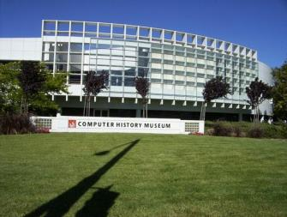
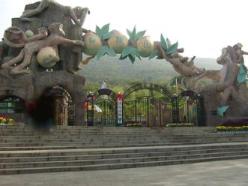
Lead-in
Where is the most interesting place you have been to? Share your experience with others.
computer museum
zoo

Slide 3
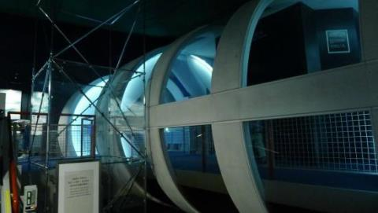
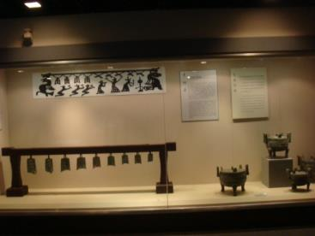
space museum
history museum

Slide 4
Three students talk about the most interesting
museums they have ever been to. Read the
magazine article and answer the questions.
3a
1. Which three museums do the students talk about?
They talk about the American Computer Museum,
the International Museum of Toilets, and the
Hangzhou National Tea Museum.

Slide 5
2. What do you think is the most interesting thing about
each museum?
1) the American Computer Museum— the special
computer that can play chess even better than humans.
2) the International Museum of Toilets— many different
kinds of toilets.
3) the Hangzhou National Tea Museum—the tea art
performances.

Slide 6
Ken：The most interesting museum
I’ve ever been to is the American
Computer Museum. They have
information about different computers
and who invented them. The old
computers were much bigger. It’s
unbelievable that technology has progressed in such a rapid way! I’ve also learned that there was a special computer. It could play chess even better than humans. I wonder how much more computers will be able to do in the future.
information与介词about连用，表示“关于……的信息”
information (uc.n.) 意为“信息”，指通过各种途径获得的任何关于某人或某物的信息。
一条信息：a piece of information
以如此快的方式
定语从句修饰more

Slide 7
Language points
1. It’s unbelievable that technology has progressed in such a rapid way!
（1）unbelievable: (adj.) 难以置信的；不真实的。
反义词：believable（可信的）
拓展：believe （v.）相信；认为。
I / We believe 后接that 引导的从句需注意否定转移。

Slide 8
（2）progress: ( v.& n.) 进步；进展。
固定搭配： make progress 取得进步，取得进展
例: 如果你想进步，你就得更加努力学习。
If you want to make progress, you must work hard.
make progress in … 在……方面取得进步 。
例: 老师希望我能在科学方面取得进步。
The teacher hopes that I can make progress in
science.

Slide 9
（3）such : (adj.) 这样的，这种，用来修饰名词（名词前可带形容词，也可不带）。
如果修饰可数名词单数，其后面需加不定冠词 a / an。
例：我们对这样的事情感兴趣。
We are interested in such things.

Slide 10
辨析：such 与 so
such | 形容词，用来修饰名词； 常用搭配: such + a /an +adj. + 可数名词单数 such + adj. + 不可数名词 such + adj. + 可数名词复数
so | 副词，用来修饰形容词或副词； 常用搭配：so + adj. + a/an + 可数名词单数 so + many/few/much/little + 可数名词复数或不可数名词

Slide 11
（4）rapid : (adj.) ，迅速的；快速的。副词形式为rapidly。
辨析 rapid、quick 与 fast
fast
quick
rapid
快的，一般指物体的运动速度快，常用来形容交通工具跑得快，钟表走得快，人的速度快等。
迅速的，快的；强调行动敏捷，反应迅速。
快的，指动作本身，意义比quick强。表速度之快往往可与fast通用，但它多指运动本身。

Slide 12
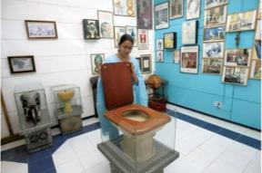
Amy：I’ve recently been to a very
unusual museum in India，the
International Museum of Toilets. I
just couldn’t believe my eyes when I
saw so many different kinds of toilets
there. The museum teaches people about the history and development of toilets. It also encourages governments and social groups to think about ways to improve toilets in the future.
encourage 及物动词，鼓励。
encourage sb. to do sth.
鼓励某人去做某事

Slide 13
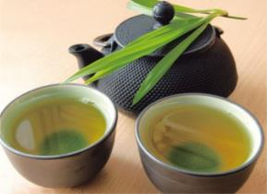
Linlin：Last year I went to the
Hangzhou National Tea Museum.
It’s a relaxing and peaceful place
near a lake. The tea art perfor-
mances show how to make a perfect cup of tea with beautiful tea sets. Watching the tea preparation is just as enjoyable as drinking the tea itself.
I’ve finally realized why my grandpa loves drinking tea and collecting tea sets.

Slide 14
Language points
1. The tea art performances show how to make a perfect cup of tea with beautiful tea sets.
茶艺表演展示了如何用漂亮的茶具沏出一杯完美的茶。
how to make a perfect cup of tea是“疑问词+动词不定式”结构，作动词show的宾语。

Slide 15
疑问代词what，who，which
接动词不定式
疑问副词where，when，how
此结构的动词不定式短语可在句中作主语、宾语、表语等成分。
例：如何拯救我们的家园对我们来说是一个重大的问题。
How to save our homeland is a big problem for us.

Slide 16
2. Watching the tea preparation is just as enjoyable as drinking the tea itself. 观看沏茶的过程就和喝茶本身一样令人愉快。
动名词短语watching the tea preparation在句中作主语。
动名词（短语）作主语时，谓语动词常用第三人称单数形式。（由and连接的两个或两个以上的动名词（短语）作主语时，谓语动词则用复数形式。）

Slide 17
Read the article again and answer the following questions.
3b
1. What does Ken say about the American Computer
Museum?
2. What can we learn at the International Museum of
Toilets?
3. Why is the Hangzhou National Tea Museum a nice
place to enjoy tea?

Slide 18
1. What does Ken say about the American Computer
Museum?
Key says that : (a) it is the most interesting museum he has ever been to; (b) it has information about different computers and who invented them, and (c) he learned that there was a special computer that plays chess better than humans.

Slide 19
2. What can we learn at the International Museum of
Toilets?
We can learn about the history and development of
toilets.
3. Why is the Hangzhou National Tea Museum a nice
place to enjoy tea?
It is a nice place to enjoy tea because it is located in a
relaxing and peaceful place near a lake. Watching tea
art performances is also enjoyable.

Slide 20
Which of the underlined words in the passage have the following meanings?
3c
make (something) better
improve
quite
peaceful
become better
progressed
made
invented
uncommon
unusual
quick
rapid

Slide 21
Grammar Focus
Have you ever been to a science museum? | Yes, I’ve been to a science museum. / No, I’ve never been to a science museum.
Have you ever visited the space museum? | Yes, I have. I went there last year. / No, I haven’t.
I’ve been to the art museum many times. | Me, too. And I’ve also visited the nature museum.
I’ve never been to a water park. | Me neither.

Slide 22
现在完成时（Ⅱ）
1.现在完成时表示经历的用法
现在完成时常用have been to（去过），ever（曾经），never（从没）等表示经历。
have / has been to：表示去过某地，可以与never, ever, just, once等连用。
例：Mr. Smith has ever been to China three times.
史密斯先生曾去过中国三次。

Slide 23
ever：常用于现在完成时的一般疑问句中，放在主语之后，过去分词之前。
例：Have you ever visited the Palace Museum?
你曾参观过故宫博物馆吗？
never：表示否定，用在助动词have / has之后，过去分词之前。表示否定的简短回答可以用neither。
例：I have never been to Hong Kong.
我从来没去过香港。

Slide 24
2.have/ has been to与have / has gone to的用法区别
have/ has been to
have / has gone to
意为“去过某地”，表示去过某地，现在已经回来了，通常与表示次数的状语连用，如twice，several times，ever，never等
意为“去了某地”，表示到某地去了，强调说话时去某地的人不在场（可能在途中，也可能已到达）。

Slide 25
She __________ Europe twice.
He __________ England.
has been to
（已经回来了）
has gone to
（现在不在这里）
注意：若have/ has been to或have / has gone to后接副词，则省略to。
He has been abroad many times.他多次出国。
He has gone home.他回家去了。

Slide 26
4a
Put the correct forms of the verbs in the blanks.
1. A: Do you want _________ (come) to the space museum?
B: No, I’ve already ______ (be) there three times.
2. A: Have you ______ (see) the robots at the science
museum?
B: Yes, I ______ (go) there last weekend.
to come
been
seen
went

Slide 27
spend
3. A: Let’s ______ (spend) the day at the zoo.
B: Well, I’ve already _____ (be) there a couple of times, but I’m happy ______ (go) again.
4. A: How about _______ (go) to the art museum? There are some special German paintings there right now.
B: Sure. When do you want ______ (go)?
5. A: Have you ever ________ (visit) the history museum?
B: No, I’ve never _____ (be) there.
been
to go
going
to go
visited
been

Slide 28
Fill in the blanks with the correct forms of the verbs in brackets.
4b
Most of us __________ (see) Mickey Mouse, Donald Duck and other famous Disney characters in cartoons before. But have you ever ______ (be) to Disneyland? Disneyland ______ (be) an amusement park with a special theme — Disney characters and movies. There ______ (be) many exciting rides, lovely restaurants and
have seen
been
is
are

Slide 29
fantastic gift shops there. You can also ______ (see) the Disney characters walking around the park. And have you ever _______ (hear) of a Disney Cruise? This _____ (be) a boat ride with a Disney theme. You can ______ (take) a ride on the boat for several days and eat and sleep on it. On the boat, you can ______ (shop) and have Disney parties before you ______ (arrive) at the Disney island.
see
heard
is
take
shop
arrive

Slide 30
4c
Answer the survey questions and then ask your partner.
Have you ever... | You | Your partner
been to another province in China?
lost something important?

Slide 31
Exercise
1.— I’m sorry to keep you waiting.
—Oh, not at all. I just ____ here.
A. have been B. had been C. was D. am
2. She encouraged him ____ to her.
A. talk B. talks C. talking D. to talk
3. My mother often encourages me ____ English as much
as possible.
A. speak B. speaks C. speaking D. to speak
A
D
D

Slide 32
4. The suitcase looks too heavy for the lady to carry. Let’s go to help her, ______?
A. will you B. won’t you C. shall we D. do we
5.As we all have grown up, we should learn to look after _____.
A. ourselves B. us C. myself D. we
6. _____ you ever _____ to Africa?
A. Have; gone B. Have; been C. Do; go D. Were; going
C
A
B

Slide 33
7. The teachers encouraged many students __________
(take) part in the sports meeting.
8. It’s ___________ (believable) that he can finish the
work in such a short time!
9. Few people _______ (know) him, did they?
10. It’s _____ _____ nice day today!
to take
unbelievable
knew
such a

