Slide 1
Unit 6
When was it invented?
Section A 2a-2d
WWW.PPT818.COM

Slide 2
Words and expressions
n. 鞋跟；足跟 /hi:l/
n. 勺；铲子 /sku:p/
n. 电；电能 /,ilek'trisəti/
n. 样式；款式 /stail/
n. 高兴；愉快 /'pleʒə(r)/
n.(=zip) 拉链；拉锁 /'zipə(r)/
adj. 每日的；日常的 /'deili/
heel
scoop
electricity
style
pleasure
zipper
daily

Slide 3
Words and expressions
有道理
n. 网站 /'websait/
n. 先锋；先 /,paiə'niə/,/,paiə'nir/
v. 列表；列清单 /list/
n. 名单；清单
v. 替代；说到 /'menʃn/
have a point
website
pioneer
list
mention

Slide 4


Do you know?
What are the Four Great Inventions
in ancient China?

Slide 5
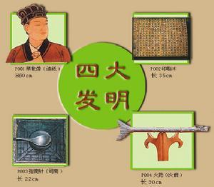
paper-making
造纸术
printing
印刷术
compass
指南针
gunpowder
火 药

Slide 6
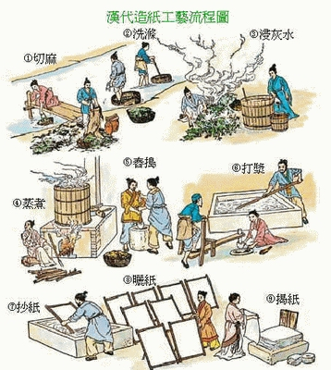
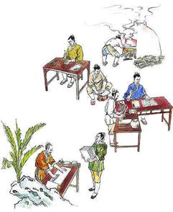
造纸术
印刷术

Slide 7
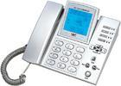
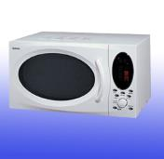

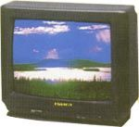
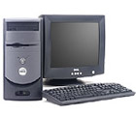
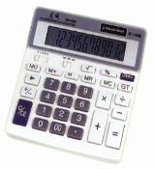


What’re these called in English?
car
television
telephone
microwave
oven
computer
calculator
light bulb
battery

Slide 8
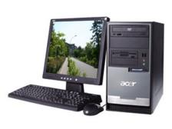
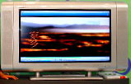
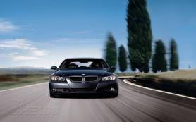
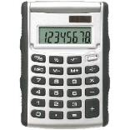
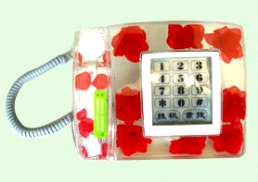
Look at the things. In what order do you
think they were invented?

Slide 9
A: I think the calculator was invented before the computer.
B: Well, I think the calculator was invented after the computer.

Slide 10
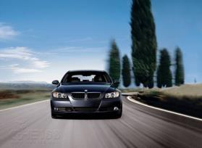
Game
A: I think … was invented before …
B: Well, I think … was invented after ….
The car was invented before the TV set.

Slide 11
A: I think … was invented before …
B: Well, I think … was invented after ….
The telephone was invented
before the TV set.

Slide 12

A: I think … was invented before …
B: Well, I think … was invented after ….
The telephone was invented before
the computer.

Slide 13
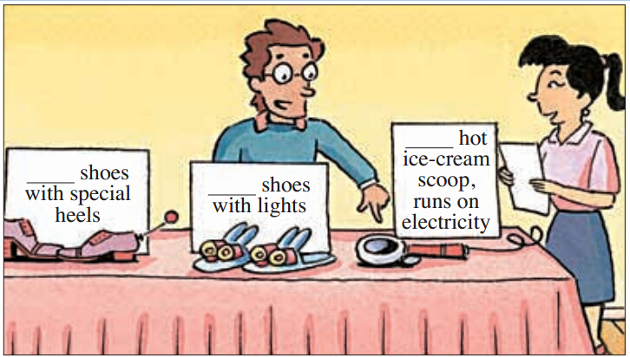
2a Listen and number the inventions
[1–3] in the order you hear them.
2
3
1

Slide 14
2b Listen again and complete the chart below.
Invention | What is it/are they used for?
shoes with special heels | _________ the style of the shoes
shoes with lights | seeing _____________
hot ice-cream scoop | ________ really cold ice-cream
changing
in the dark
serving

Slide 15
Listen again and fill in the blanks.
The first invention is shoes with ________. People always hit their toes on __________ on the way to the bathroom at night. So people can use them for ________ in the ______.
lights
something
seeing
dark

Slide 16
The second invention is a special ice-cream ______. It runs on _________ and becomes hot. It’s _____ for serving really _____ ice-cream.
scoop
electricity
used
cold
The last invention is shoes with special _____. People can move the heels _____ and ______. You can _____ the heels if you are going to a ______ or ______ them if you are just going out for _________.
heels
up
down
raise
party
lower
shopping

Slide 17
2c Make conversations using the
information in 2b.
A: What are they used for?
B: They’re used for ...

Slide 18


What are the shoes with lights used for?
They’re used for seeing in the dark.

Slide 19
What are hot ice-cream scoop used for?
They’re used for serving for really cold ice-cream.
They’re used for changing the style of the shoes.
What are shoes with special heels used for?

Slide 20
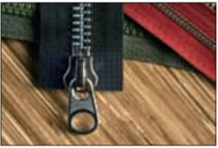
2d Role-play the conversation.
Paul: Hey Roy, the subject for my school
project is “Small inventions that
changed the world.” Can you help me
think of an invention?
Roy: My pleasure! Let me think ... hmm ...
I know! The zipper!
Paul: The zipper? Is it really
such a great invention?
Roy: Think about how often it’s used in our

Slide 21
daily lives. You can see zippers on
dresses, trousers, shoes, bags ... almost
everywhere!
Paul: Well, you do seem to have a point ...
Roy: Of course! I thought about it because I
saw a website last week. The pioneers of
different inventions were listed there.
For example, it mentioned that the
zipper was invented by Whitcomb
Judson in 1893. But at that time, it
wasn’t used widely.
Paul: Really? So when did it become popular?
Roy: Around 1917.

Slide 22
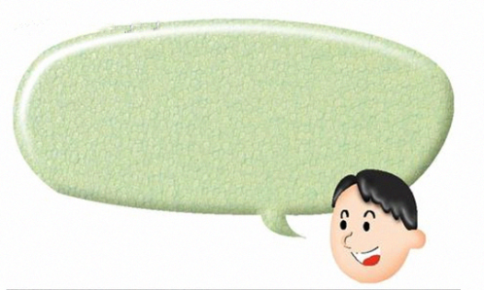
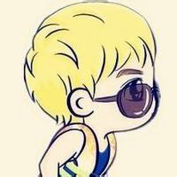
role-play
Hey Roy…

Slide 23
Language points
the style of the shoes 鞋子的款式
style名词，意为“样式；款式”。
其常用短语 in style意为“时髦的”，
其反义短语为out of style, 意为“过时的”。
►This year's style in dresses is different from last year’s.
今年的服装样式与去年的不同。
► Her clothes are always in style.
她的衣服总是很时髦。

Slide 24
(2) style作名词，还可意为“方式”。
► Our children need new learning styles.
我们的孩子需要新的学习方式。
► I like your style.
我喜欢你做事的方式。

Slide 25
2. My pleasure! 非常愿意！
pleasure (a state of feeling or being happy)
名词，意为“高兴;愉快”。
► He takes no pleasure in his work.
他从工作中得不到丝毫的乐趣。
► —Thanks for helping me.
谢谢你帮助了我。
—My pleasure. / It s a pleasure. 别客气。

Slide 26

pleasure,pleased与pleasant
辨析：
pleasure | 名词，“高兴；愉快”。常用短语 My pleasure. / With pleasure. / It’s a pleasure.
pleased | 形容词，“高兴的”，短语 be pleased to do sth.“乐于做某事”；be pleased with “对……满意”，句子的主语通常为人
pleasant | 形容词，“令人愉快的”，可作定 语、表语，修饰物
►I am pleased with the painting.我对这幅画很满意。
►Wish you a pleasant journey! 祝你旅途愉快！

Slide 27
3. Think about how often it’s used in our daily
lives. 想想看,在我们的日常生活中它被使用得
多么频繁。
daily (happening, done or produced every
day) 形容词，意为“每日的；曰常的”。
► Don’t you read the daily news in today’s
newspaper?
你（们）没有读今天报纸上的每日新闻吗?
(2)daily (every day)副词，意为“每日;每天”
► The milkman comes daily to our house.
送奶人每天都到我们家来送奶。

Slide 28
拓展：
daily adj.每日的, 日常的 adv.每日;每天
weekly adj. 每周的 adv. 一周一次
monthly adj.每月的 adv.一月一次
yearly adj.每年的 adv.一年一次

Slide 29
4. Well, you do seem to have a point ...
嗯，看来你说的确实有道理……
have a point固定短语，意为“有道理”
► You have a point — It would be better to
wait till tomorrow.
你说的有道理，还是等到明天比较好。

Slide 30
5. The pioneers of different inventions were
listed there.
各种发明的先驱者们被列到了上面。
(1) pioneer (a person who does something first)
可数名词，意为“先锋；先驱”。
China Young Pioneers意为“中国少年先锋队”。► He is a computer pioneer.
他是计算机方面的先驱。

Slide 31
(2) list动词，意为“列表;列清单”。
► List them and you will never forget.
把它们列出来你就不会忘记了。
list用作名词，意为“名单；清单”。
► I did not see his name on the list.
我在名单上没有看到他的名字。

Slide 32
6. For example, it mentioned that the zipper
was invented by Whitcomb Judson in
1893. 例如, 它提到拉链是在1893年由惠特
科姆.贾德 森发明的。
mention动词，意为“提到，说到”其后可接 that 引导的宾语从句。
► He mentioned that the food was invented by a Chinese.
他提到这种食物是由一个中国人发明的。

Slide 33
拓展：
mention的其他搭配
① mention sb./sth. (to sb.) (向某人)提起某事
► Don't mention it before the children.
在孩子们面前提及此事。
► Nobody mentioned anything to me about it.
没人向我提过这事。
② mention doing sth.提到做某事
►Whenever I mention having dinner together，
he says he’s too busy.
无论何时我一提起 块儿吃顿饭，他就说太忙。

Slide 34
注意：
“Don’t mention it.”主要用来回答感谢，有时也来回答道歉。
► —Thank you very much.多谢你 了。
—Don’t mention it. 不客气。
► — I’m sorry to trouble you.
对不起，打扰你了。
— Don’t mention it.没关系。

Slide 35
Exercise
1．Mo Yan is famous _______ an excellent writer.
And China is famous ______ culture.
A. for; as B. for; for
C. because; as D. as; for
2. --When will A Bite of China II begin tonight?
--It ________ for ten minutes.
A. will begin B. has begun
C. will be on D. has been on
D
C

Slide 36
A
3. Sixteen-year-olds shouldn’t ______ to go to an
Internet bar.
A. be allowed B. be allow
C. allow D. are allowed
4. ---I’m not hungry but thirsty.
---________ .
A. I’m hungry, too.
B. What about some cakes?
C. I’m happy to hear that.
D. How about a glass of water?
D

Slide 37
5. — We can use QQ to talk with each other online.
— Really? Could you please show me
______ it?
A. what to do B. how to do
C. when to do D. why to do
6.As we know, _____of us likes pollution.
A. no one B. none
C. someone D. nothing
7.—Lily, _____ you _____ your ticket?
—Not yet!
A. did; find B. have; found
C. has; found D. do; find
B
B
B

Slide 38
Homework
Recite the conversation in 2d.
Preview the next part.

Slide 39
Thank You!

