Slide 1
Unit 6 Food and lifestyle Comic strip and Welcome to the unit
WWW.PPT818.COM

Slide 2
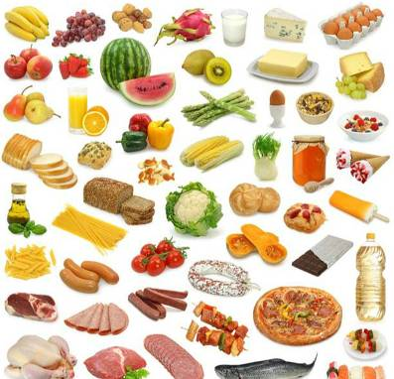
Free talk
What would you like to eat or drink at my
birthday party?
I’d like to eat …
I’d like to drink …

Slide 3
food
vegetables
fruits
meat
drinks
snacks

Slide 4
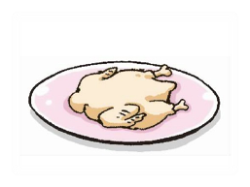
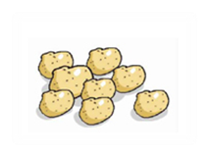
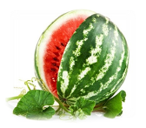
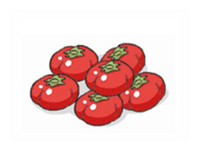
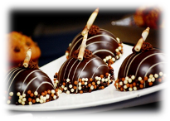
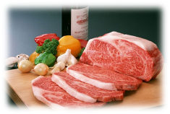
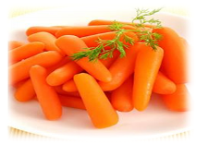
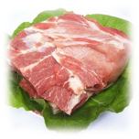
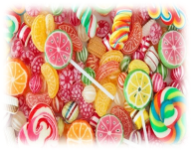
All kinds of food
Help Millie put them into the correct groups.

Slide 5
All kinds of food
vegetables
fruits
meat
potatoes
lemons
chicken
tomatoes
watermelons
beef
carrots
pork
drinks
snacks
milk
chocolate
juice
sweets

Slide 6
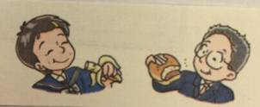
Listen and answer
1. What food does Millie like?
2. What food does Daniel like?
3. What food does Millie dislike?
4. What food does Daniel dislike?
5. Why does Millie like fish?
Bananas, carrots and fish.
Hamburgers and eggs.
Eggs.
Carrots.
It's good for our health.

Slide 7
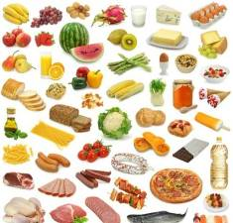
Practice
A: I like … How about you?
B: I like ...
A: Do you like …? They are/It is my favourite.
B: Yes, I like them/it, too./No, I don’t like them/it.
What about…?
A: I like ... It is/They are ...
B: I don’t like ... What about you?
A: …
B: …

Slide 8
Make a survey (调查)
Make a survey about the food you like or dislike in groups of four.
Members | Food you like | Why you like | Food you dislike | Why you dislike
Leader
Member 1
Member 2
Member 3

Slide 9
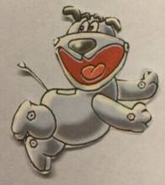
Hobe and Eddie
1. What does Eddie want to eat?
2. Why does Hobo want to have apples?
A hamburger.
An apple a day keeps the doctor away.

Slide 10
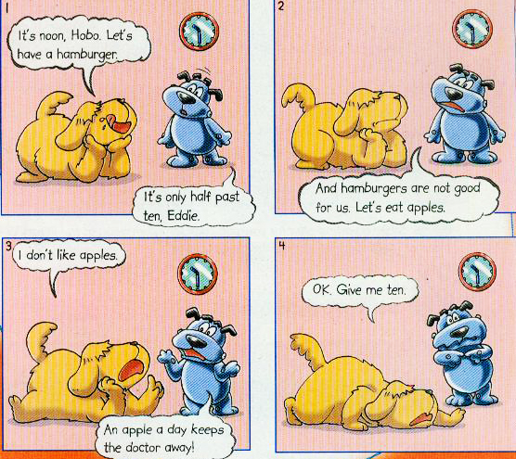
Read

Slide 11
Fill in the blanks
It’s _______. Hobo and Eddie are talking
about what to eat. Eddie would like to have a
___________. But Hobo thinks hamburgers are
not _______ for their health, and that Eddie
should have an _______, because an apple a day
_______ the doctor away. Eddie agrees, but he
needs _______. Do you think he can eat ten
apples for just one meal?
noon
hamburger
good
apple
keeps
ten

Slide 12
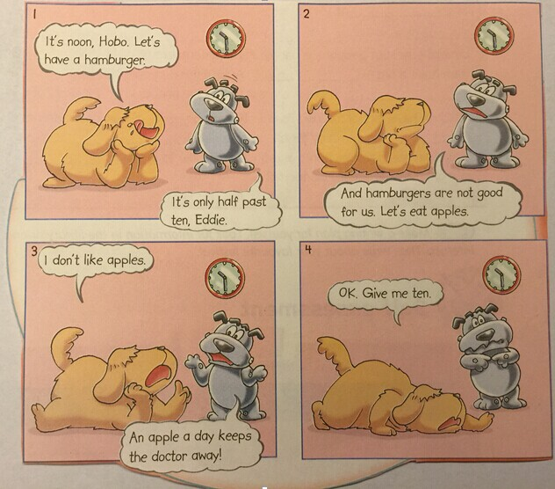
Act out

Slide 13
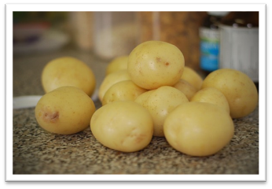
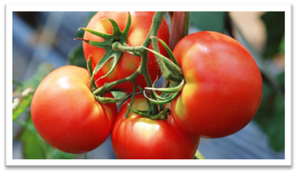
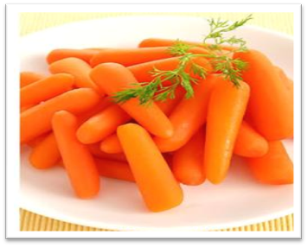
Vegetables
potatoes
tomatoes
carrots

Slide 14
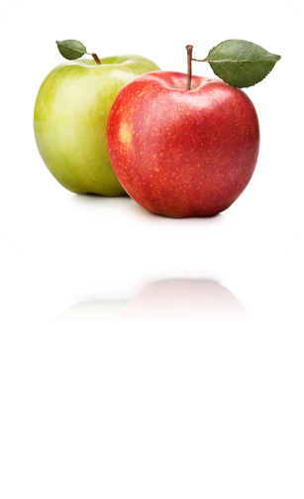
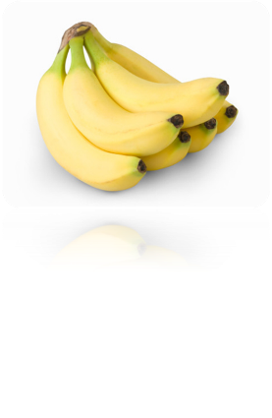
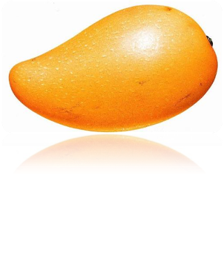
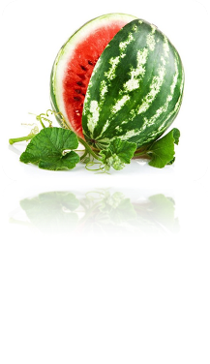
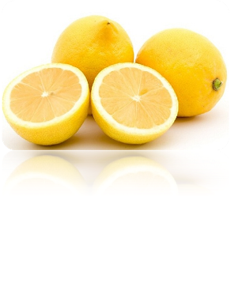
Fruits
oranges
apples
bananas
lemons
mangoes
watermelons

Slide 15
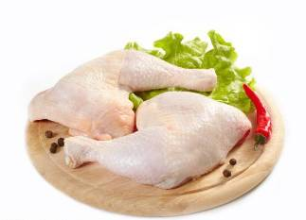
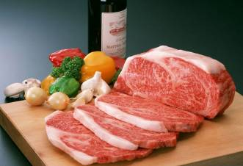
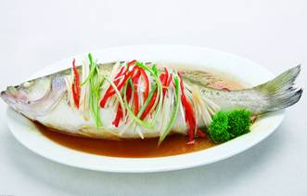
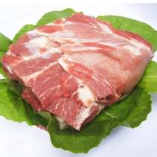
Meat
chicken
beef
fish
pork

Slide 16
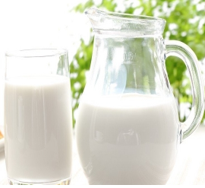
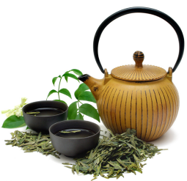
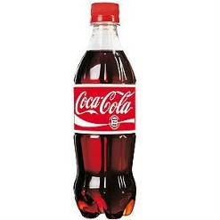
Drinks
coffee
milk
tea
cola
juice

Slide 17
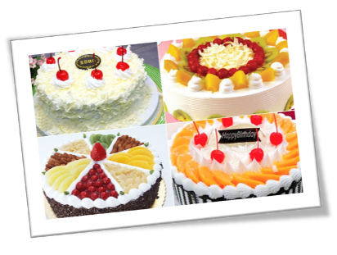
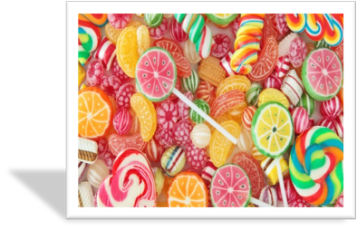
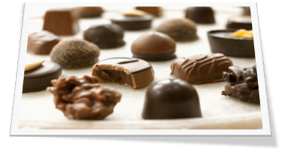
snacks
sweets
cakes
chocolate

Slide 18
Homework
1. Write down the food you like or dislike and
explain your reasons.
2. Preview the new words and expressions in Reading.

