Slide 1
Wash your face
WWW.PPT818.COM

Slide 2
Clap ,Clap,Clap Our Hands Clap,clap,clap our hands! Clap our hands together. Clap,clap,clap our hands! Clap our hands together. Raise,raise,raise our arms! Raise our arms together. Raise,raise,raise our arms! Raise our arms together. Raise,raise,raise our legs! Raise our legs together. Raise,raise,raise our legs! Raise our legs together. Touch,touch,touch our toes! Touch our toes together. Touch,touch,touch our toes! Touch our toes together. Shake,shake,shake our hips! Shake our hips together. Shake,shake,shake our hips! Shake our hips together.

Slide 3
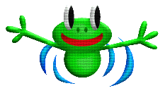
Arms up high. Stand,don’t sit. Let’s exercise, To keep us fit.

Slide 4
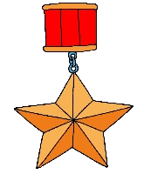
CO LI AH bd pq EF ij mn gy ce AHJK BCDEG

Slide 5
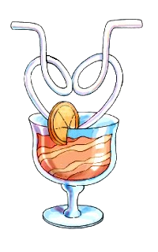
Spell and write
Uu Vv Ww Xx Yy Zz

Slide 6
W M U V X Y W C U K U F O Z O O

Slide 7
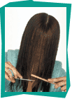
hair

Slide 8
eye

Slide 9
nose

Slide 10
hand

Slide 11
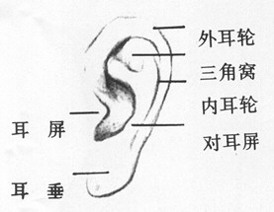
ear

Slide 12
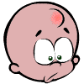
head

Slide 13
face

Slide 14
mouth

Slide 15
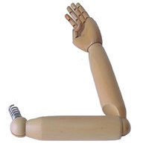
arm

Slide 16
leg

Slide 17
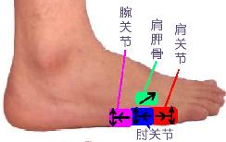
toe

Slide 18
用 Simon Says 的游戏玩
一些指令性的句型。

Slide 19
Brush your hair.
Wipe your eye.
Blow your nose.
Wash your hands.
Clean your ear.
Wash your face.
Touch your head.
Touch your toes.
Raise your arms.
Raise your left arm.
Raise your right arm.
Raise your left leg.
Raise your right leg.

Slide 20
Touch your left foot. Touch your right foot.

Slide 21
foot

Slide 22
介绍自己的身体部位
My 我的
Body 身体
This is my body.

Slide 23
That is your ear.
That is your eye.
That is your arm.
That is your nose.
That is your toe.
That is your leg.

Slide 24
This is …这是。。。。。。
That is …那是。。。。。。

Slide 25
Mr Chen: Touch your toes.
Mr Chen: Raise your arms.
Mr Chen: Raise your right leg.
Mr Chen: Raise your left arm.
Mr Chen: Raise your right arm.
Mr Chen: Raise your left leg.
Mr Chen: Touch your toes.
Jiamin: Ouch!

