Slide 1
Unit 4
Finding your way
Main task
WWW.PPT818.COM

Slide 2
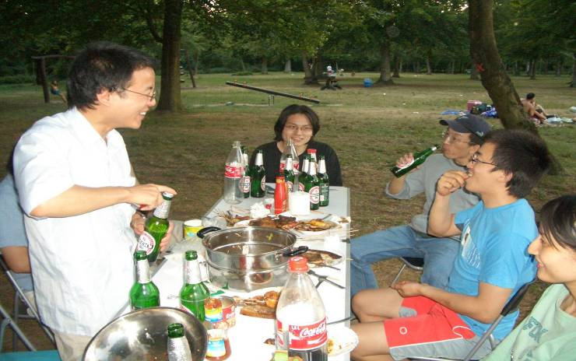
have
a picnic
/ˊpiknik /

Slide 3
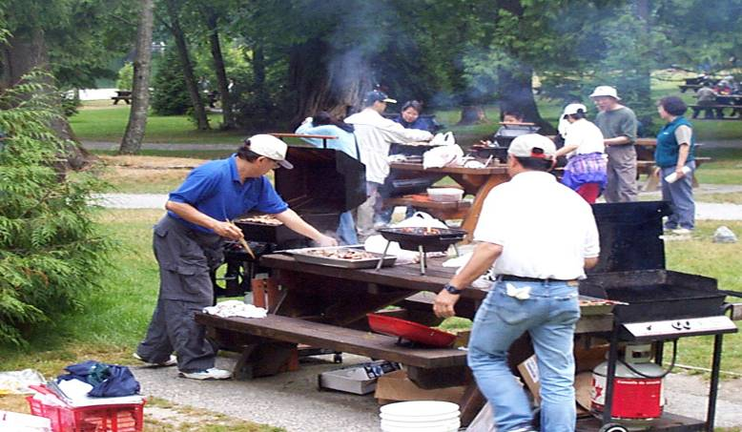
have
a barbecue
/ˊ ba:bikju:/

Slide 4
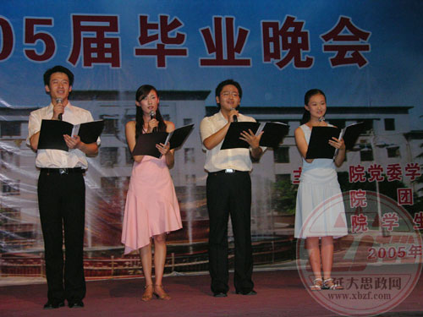
a farewell party
have
to say goodbye
/ f eəˊwel /

Slide 5

Daniel and Simon are also organizing a farewell party for friends from Britain.
Discuss four ‘Wh-’ questions:
1.Where
shall we have the party ?
2.When
shall we have the party ?
3.What
shall we have for food ?
4.Who
shall we invite ?

Slide 6
Details of the questionnaire and your ideas:
1.Where shall we have the party?
2.When shall we have the party?
A. Sunshine Park
A. Saturday afternoon, 1-6 p.m.
B. Chongqing Restaurant
B. Saturday evening, 6-9 p.m.
C. Guangdong Restaurant
C. Sunday afternoon, 2-5 p.m.
D. A teacher’s flat
D. Sunday evening, 6-9 p.m.
3.What shall we have for food?
4. Who shall we invite?
A. Have a barbecue
A. Classmates only
B. Have a picnic
B. Classmates and parents
C. Have some fast food
C. Classmates and teachers
D. Cook some Chinese food
D. Classmates, parents and
teachers

Slide 7
Do you know the results of Daniel’s class?
Results:
1. Most students want to have the party in Sunshine Park.
Most of the students
2. Most students would like to have the party on Saturday afternoon, 26th April, 1-6 p.m.
3. Half of the students want to have a barbecue, half want a picnic.(Mr Wu thinks a picnic will be better.)
Half students
4. Invite students, parents and teachers.

Slide 8

A farewell party
for exchange students from Britain
Where ：___________________________
When ：___________________________
What ：___________________________
Who ：___________________________
Sunshine Park
Saturday afternoon, 1-6 p.m.
Have a picnic
Classmates, parents and teachers

Slide 9
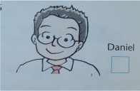
Check final choices:
1.Where shall we have the party?
2.When shall we have the party?
A. Sunshine Park
A. Saturday afternoon, 1-6 p.m.
B. Chongqing Restaurant
B. Saturday evening, 6-9 p.m.
C. Guangdong Restaurant
C. Sunday afternoon, 2-5 p.m.
D. A teacher’s flat
D. Sunday evening, 6-9 p.m.
3.What shall we have for food?
4. Who shall we invite?
A. Have a barbecue
A. Classmates only
B. Have a picnic
B. Classmates and parents
C. Have some fast food
C. Classmates and teachers
D. Cook some Chinese food
D. Classmates, parents and
teachers

Slide 10
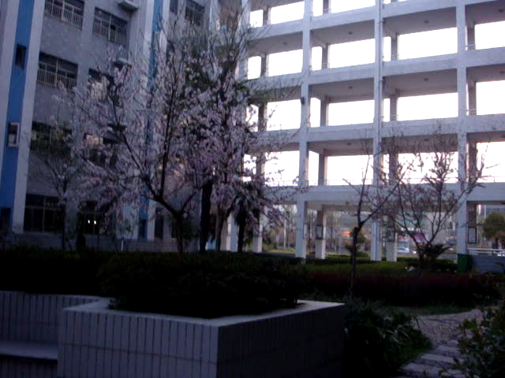
Listen and fill in the missing information
An invitation letter

Slide 11
Class 1, Grade 7
Beijing Sunshine Secondary School
the address of the writer
Sunshine Town
Beijing
20th April
the date
the name of the receiver（收信人）
Dear parents, teachers and classmates
We are happy to invite you to a farewell party for our friends from Britain. We will hold the party in ____________ on Saturday, ________, from _____ to______. We will meet at the park gate. We will have a _____ in the park. We would like everybody to bring their own food and drink. We will also play different ball games.
the main body
(正文）
Sunshine Park
26th April
1 p.m.
6 p.m.
picnic
The map shows you how to get to Sunshine Park. We hope you can come. We look forward to seeing you at our party.
Yours faithfully
closing words
Daniel
signature (签名)
Monitor of Class 1, Grade 7

Slide 12
How to write an invitation letter in English?
………
………
………
写信人详细地址，日期
礼貌用语不可少
Dear ###,
正文表达简洁无误
………………………………………………………………………………………………………………………………………………………………………………………………………………………………………………………………………………………………………………
Yours （faithfully）
不能省
###
署名

Slide 13
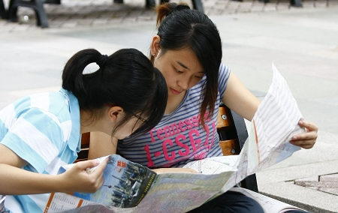
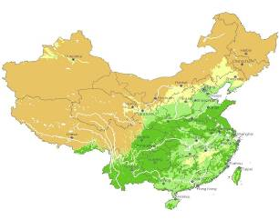
Read the map and know how to get there.
Heilongjiang
Jiangsu
Anhui
Fujian
Taiwan

Slide 14








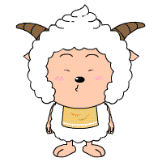
north
north-east
Do you know these directions?
north-west
west
east
south-east
south-west
south

Slide 15
Do you know these signs?
EXIT
traffic lights
turn left
turn right

Slide 16
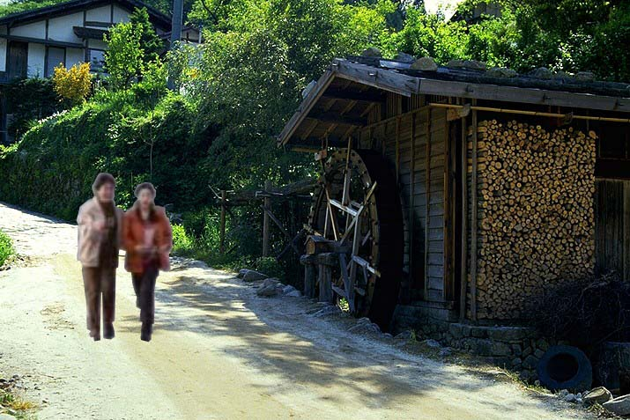
walk a wooden house
past

Slide 17
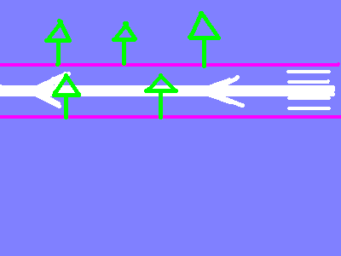

a straight road
go straight on

Slide 18



crossroads
zebra crossing
walk along the zebra crossing
cross/walk across the zebra crossing

Slide 19

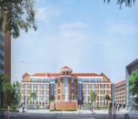
MEMORY
traffic lights
turn right
Jingyuan North Road
crossroads
go straight on
Ganquan West Road
zebra crossing
Doliang Road
turn left

Slide 20
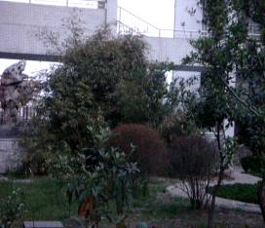
Listen ,fill in the missing information.
Here is the route to Sunshine Park.Take the
.Get out at Exit A.Turn and walk Great Times Street.Walk _______Autumn Street.Then Great Times Street at the corner.Turn ______and walk Great Times Street .Walk past the Bank of China building and______Winter Road.Sunshine Park is right there.
underground
left
along
across
cross
left
along
cross

Slide 21
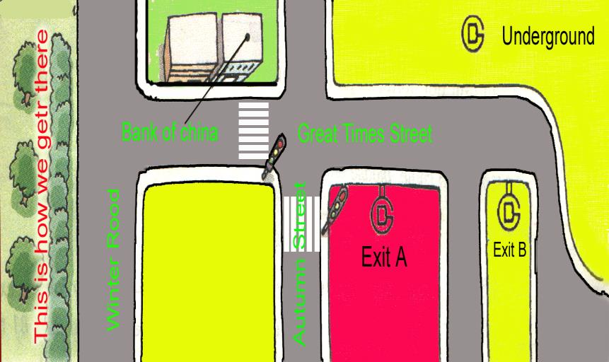

Let’s draw the route together.

Slide 22
Sunshine Park is
right here.
Underground
Turn left and walk along
Bank of China
Walk past
cross
Get out at…
cross
Great Times Street
Turn left and walk along
Walk across
Winter Road
Autumn Street
Exit A
Exit B
corner

Slide 23


How to organize your birthday party ?
1) Write an invitation letter
When /Where /Who to invite to your party ?
What to do and to eat ?
2) Show the map and write the route.

Slide 24

Have a birthday party
Place: Hongmei Park
Time: on Sunday,17th April
2p.m.-4p.m.
Activities:
1) meet at the school gate
2) have a picnic in the park
3) play games and take photos.

Slide 25




Show your invitation letter.

Slide 26
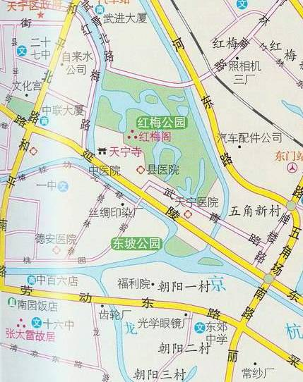
Draw the route to Hongmei Park and give directions
Hongmei Park
罗汉路
] [
Walk along …
Cross/ Walk across…
Turn…and walk along…
Cross/ Walk across…
Let’s meet at the school gate.
Turn…and walk along…
Turn…and walk along…
●
Zhibao Middle School
Turn…and walk past…

Slide 27


Four in groups,fill in the route and stick(粘贴) them on the map.

Slide 28
New Words
monitor
班长
picnic
野餐
烧烤
barbecue
farewell
告别
exit
出口
bank
银行
yours faithfully
你忠实的

Slide 29
How to organize an activity ?
1. Make a questionnaire and get the answers. |  | when
 |  | where
 |  | who
 |  | what activity
2. Write an invitation letter.
Make an invitation card. | draw a map and give directions

Slide 30

Listen ,fill and draw the route.
Here is the route to Sunshine Park.Take the
Get out at Exit A.Turn and walk on.Walk _______Autumn Street.Then Great Times Street at the corner.Turn ______and walk on.Walk past the Bank of China Building and______Winter Road.Sunshine Park is right there.
underground
left
straight
across
cross
left
straight
cross

Slide 31
Homework
May Day holiday is coming.
Write an invitation letter,
draw a map and give directions to the activity you choose.

