Slide 1
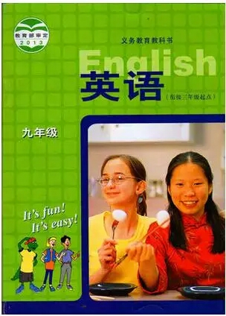
Unit 10 Get Ready for the Future
Look into the Future
WWW.PPT818.COM

Slide 2

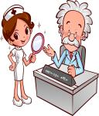



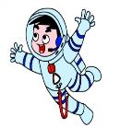


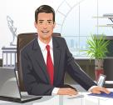
What do you want to be when you grow up?
doctor
cook
singer
painter
dancer
astronaut
worker
boss
football player

Slide 3
Listen to the tape of others' dream.
1.Jenny would like to be a .
2.Brian wants to be a .
3.Steven would things that help improve the environment.
4.Kate would enjoy being a .
5.Danny is going to be an .
pilot
boss
invent
cook
astronaut

Slide 4

boss
老板

Slide 5
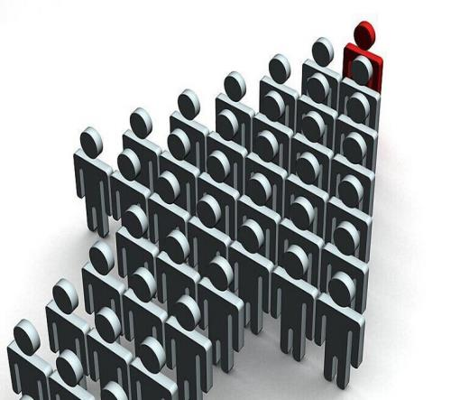
manage
管理，负责

Slide 6
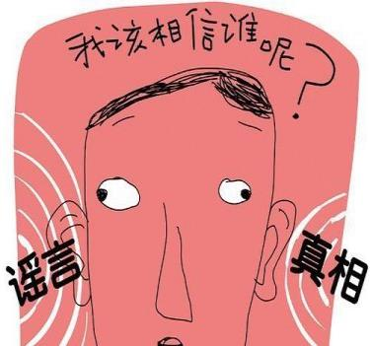
doubt
怀疑

Slide 7

wealth
钱财，财富

Slide 8
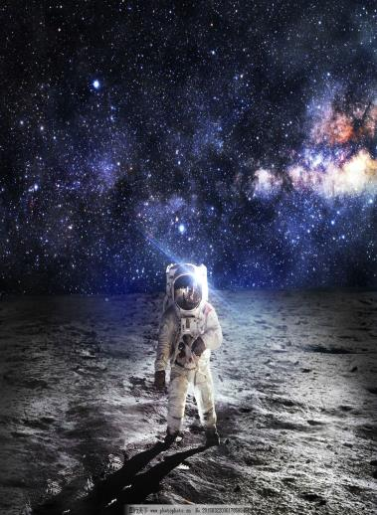
astronaut
宇航员

Slide 9
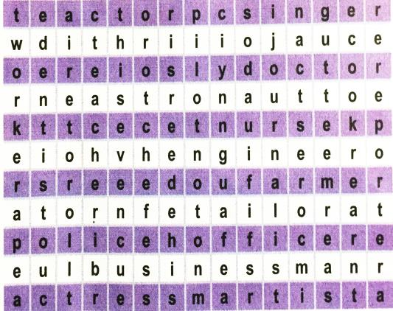
How many job words can you find? Write them down.

Slide 10
Across: actor, singer, doctor, astronaut, nurse, engineer, farmer, tailor, police officer, businessman, actress, artist
Down: worker, dentist, teacher, pilot, journalist, cook, reporter

Slide 11
Language points
Look into the Future 展望未来
look into此处是“观察”。还有“朝里看；调查；浏览（书籍、资料等）” 的意思。
e.g. I noticed Tom looking into a shop window.
我注意到汤姆正往商店橱窗里看。
The police are looking into the accident.
警方正在调查那起事故。
You’d better look into the novel, and get its main idea.
你最好翻阅一下这部小说，了解其主题思想。

Slide 12
grow up长成；成熟；发展
e.g. The little girl has grown up to be a beautiful woman.
那个小女孩已经长成了美丽的女人。
China’s agriculture is growing up quickly.
中国的农业正在快速发展。

Slide 13
could, would都是表推测的情态动词。其所指时间几乎总是“现在”，说话人的主观看法总是以现在时间为基点的。
eg. I love to travel, and it would be fun to fly an airplane.
我喜欢旅行，开飞机旅行会很有趣。
I want to be a boss and manage a big company. I could make a lot of money.
我想当老板管理一家大公司。我会赚很多钱。

Slide 14
可能性大小，一般 might最低，must最高，由低到高的顺序：might (可能) → may (可能) → could (可能) → can (可能) → should (应该会) → ought to (必然) → would (会) → will (会) → must (一定)。
说话人推测的事件所发生的时间，要根据不定式所采取的形式而定，可以是现在时间和过去时间，也可以是将来时间。一般，情态动词之后的不定式若不是完成式，则表示现在时间或将来时间。

Slide 15
e.g. He must be there.
他一定在那里。
Our team might win the race.
我们队可能在赛跑比赛中获胜。
He must be working at the office.
他一定正在办公室里工作。

Slide 16
doubt意为“怀疑；不相信”，既可用作名词，也可用作动词。
doubt用作名词时，常用于句型“There is no doubt + that引导的从句”，意为“毫无疑问……”。
e.g. There is no doubt that we will win the match.
毫无疑问我们会赢得这场比赛。
doubt用作及物动词时，后面可跟名词、代词和从句等。
e.g. —Why do you doubt his words?
—I doubt him because he often cheats us.
—你为什么怀疑他说的话？
—因为他经常骗我们，所以我才怀疑他。

Slide 17
在否定句和疑问句中，doubt后多跟由 that 引导的从句。
e.g. We don’t doubt that he can come on time.
我们毫不怀疑他能准时来。
Do you doubt that he will give up the game?
你怀疑他会放弃这场比赛吗？
在肯定句中，doubt后通常跟由 if / whether 引导的从句。
e.g. I doubt if / whether it will be sunny
tomorrow.
我怀疑明天是否会有阳光。

Slide 18
as for 至于；关于
e.g. As for the thief, he was caught by the police.
至于那个小偷，他被警察抓住了。
As for my achievement, I have much to say.
关于我的成就，我有很多要说的。

Slide 19
a lot of 意为“很多”， a lot意为“很；非常”。= lots of.
a lot of可用来修饰可数名词复数或不可数名词 ；a lot可用来修饰动词。
e.g. There are a lot of books in our school library.
我们学校图书馆有许多书。
We have a lot of time to make our plan.
我们有很多的时间来制定我们的计划。
Do you wear your new watch a lot?
你常戴你的新手表吗?

Slide 20
Read and answer the questions.
1. Who did Li Ming run into?
2. Was Gao Yuan happy to hear from Li Ming?
Gao Yuan.
Of course.

Slide 21
Read the lesson and fill in the blanks.
Some students are having a discussion about their future. Jenny wants to be a pilot. She loves to _____. Brian wants to be a _____, but Jenny thinks Brian should do something that he enjoys. Steven wants to be an _________. He wants to invent something that won’t harm the environment. Kate likes ________ meals and enjoys trying different kinds of food. As for Danny, he is going to choose the most fun and _________ job in the world. He is going to be an astronaut.
travel
boss
engineer
cooking
exciting

Slide 22

Practice the dialogue in groups.

Slide 23
Group work:
1. Make a new dialogue.
2. Act it out.

Slide 24
Across: actor, singer, doctor, astronaut, nurse, engineer, farmer, tailor, police officer, businessman,
actress, artist
Down: worker, dentist, teacher, pilot, journalist, cook, reporter

Slide 25
Discuss: What do you want to be?
Look at the job words you found above in Activity 2. Think about these questions:
● Are some jobs better than other jobs?
● What job do you like best in the list? Why?
● What job do you dislike in the list? Why?
Across: actor, singer, doctor, astronaut, nurse, engineer, farmer, tailor, police officer, businessman,
actress, artist
Down: worker, dentist, teacher, pilot, journalist, cook, reporter

Slide 26
In small groups, organize a list of jobs. Then present your list to the class or to another group of students.
Next, choose a job that you want when you grow up. Choose a job that matches your talents and interests. You can choose any job – it doesn’t have to be on the list.
Now think! What do you need to do to get this job? How can you get ready for it? Make a plan.

Slide 27

Write a short passage to describe your prediction for your future.

Slide 28
Homework
1.Listen and read.
2.Finish exercises of this lesson.

