Slide 1
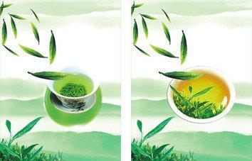
Unit 5 Topic 1
China attracts millions of tourists from all over the world.
Section D
WWW.PPT818.COM

Slide 2
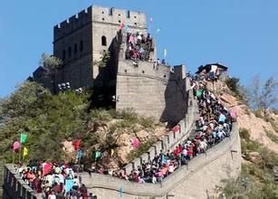
the Great Wall
bring tourists
into China

Slide 3
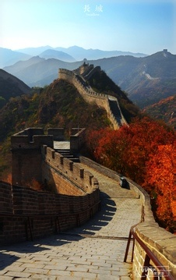
the Great Wall
a treasure of Chinese civilization

Slide 4
S1: What are the material of the Great Wall? S2: The early walls were made of … What’s the length of the Great Wall? S3: It’s about…
to ________their people
Purpose
to ________ them from
their _______
Material——The Great Wall a ________ of Chinese
civilization
Meaning
a ________ of the Chinese
nation
Qin dynasty
____________ ____________
total length
____________
____________
protect
packed earth
and wood
about 8 800
kilometers long
separate
enemies
treasure
Ming dynasty
____________
____________
beginning time
____________
____________
stone and
brick
about 2 500
years ago
symbol

Slide 5
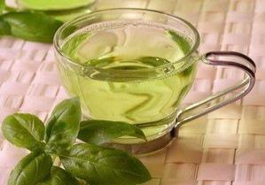
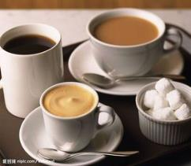
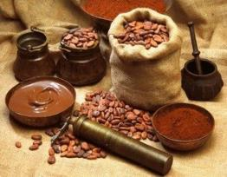
The three major drinks:
adj.主要的
tea
coffee
cocoa
n.可可饮料，可可粉

Slide 6
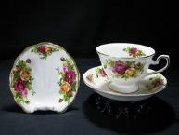
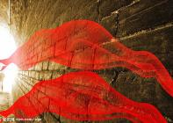
Tea from china, along with silk and porcelain, became an important Chinese export over a thousand years ago.
n.瓷器
n.出口产品

Slide 7
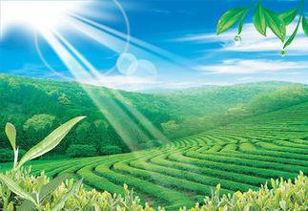
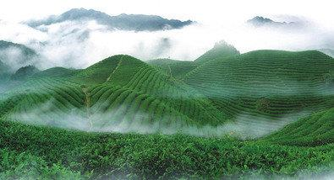
Tea leaves are produced mainly in the south of China because of the mild climate there.
adj.温和的

Slide 8
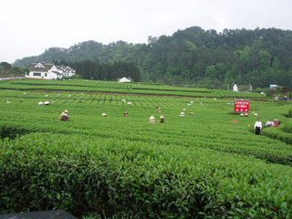
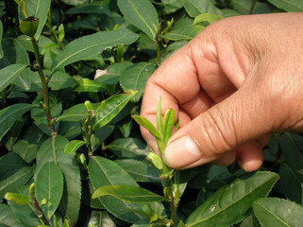
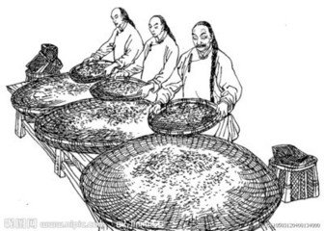
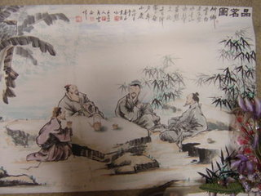
Chinese people have developed their unique tea culture.
adj.独特的
tea planting
tea-leaf picking
tea making
tea drinking

Slide 9
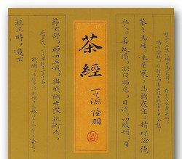
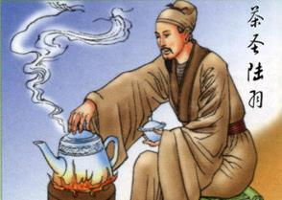
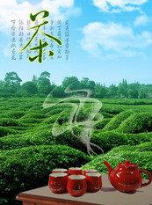
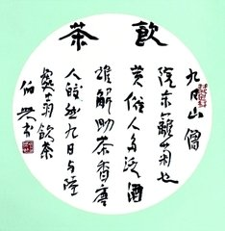
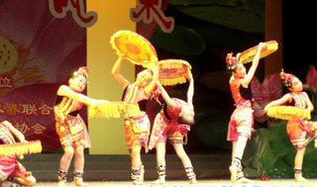
Tea is also a popular topic in dances, songs, poems and novels.
n.话题

Slide 10
Read the following passage and choose the best title for it.
1a
A. China’s Long History of Tea
B. China’s Tea Culture
C. Tea Drinking in China

Slide 11
Read 1a again and mark T (True) or F (False).
1b
1. Chinese tea became world-famous over one thousand years ago. ( )
2. The sound of the English word “tea” is similar to
that of “chaye” in northern China. ( )
3. The written forms of the word “tea” are totally the same in both Chinese and Japanese. ( )
4. Famous tea leaves in China are produced
mainly in the southern part of the country. ( )
5. Tea drinking is the only part of the Chinese tea
culture. ( )
T
F
T
T
F

Slide 12
NOTES:
1. along with… 与……一起
当主语与along with连用时，谓语动词与along with前面的主语在人称和数上保持一致。如：
Joe, along with his family, is leaving for Disneyland.
2. the number of ……的数量
a number of 许多，一些

Slide 13
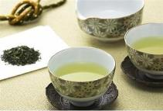
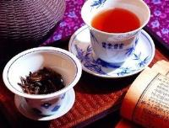
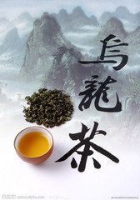
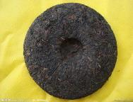
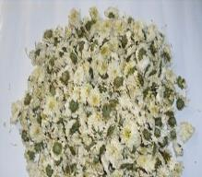
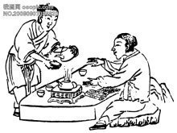
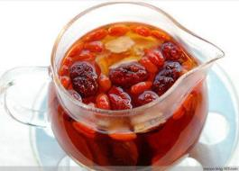
Work in groups to list some unique Chinese tea culture which you know.
2a

Slide 14
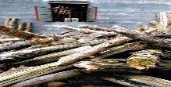
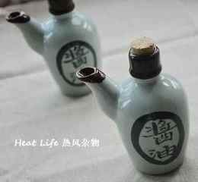
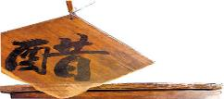
Translate the following sayings about tea into Chinese and discuss your understanding of them with your partner.
2b
1. The friendship between gentlemen is like a cup of
tea.
君子之交淡如水。
2. Firewood, rice, oil, salt, sauce, vinegar and tea
are necessary to begin a day.
开门七件事：柴、米、油、盐、酱、醋、茶。

Slide 15
Sum up
Phrases
1. along with… 与……一起
2. the number of ……的数量
a number of 许多，一些
Sayings
1. The friendship between gentlemen is like a cup of tea.
君子之交淡如水。
2. Firewood, rice, oil, salt, sauce, vinegar and tea are
necessary to begin a day.
开门七件事：柴、米、油、盐、酱、醋、茶。

Slide 16
Sum up
Grammar
China is a great country with about 5 000 years of history.
China is a great country which/that has about 5 000 years of history.
It is a book with details about China.
It is a book which/that introduces China in detail.

Slide 17
Sum up
Functions
1. And some of them are very famous, such as Mount
Tai, Mount Huang, Mount Song and Mount Emei.
2. That’s correct！

Slide 18
Homework
1. Review the main points of this topic.
2. Search for some sayings of Confucius.

