Slide 1
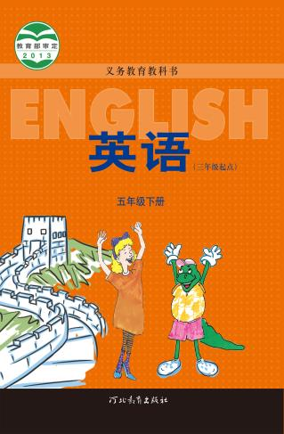
河北教育出版社 五年级 | 下册
Unit 2 Lesson8
Tian’anmen Square
WWW.PPT818.COM

Slide 2
河北教育出版社 五年级 | 下册
Warm-up
Free talk
Have you been to Tian’anmen Square?
What do you see there?
What can you do there?
Would you like to go to Tian’anmen Square?

Slide 3
河北教育出版社 五年级 | 下册
Presentation
Tian’anmen Square is very big!
There are many people here!
Some people are talking pictures on the square.
There are many children.
They are playing.

Slide 4
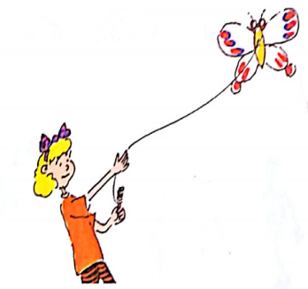
河北教育出版社 五年级 | 下册
“Some men are flying kites!” says Danny.
“Let’s fly a kite.”
“This is easy,” says Jenny.

Slide 5
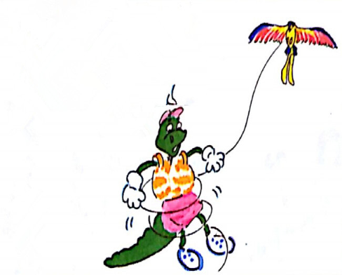
河北教育出版社 五年级 | 下册
Oh, no! This is difficult.

Slide 6
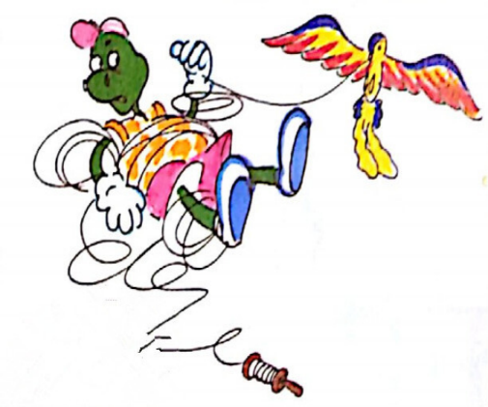
河北教育出版社 五年级 | 下册
Help! Help!

Slide 7
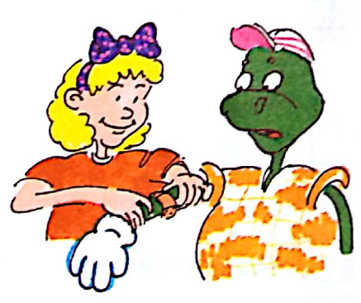
河北教育出版社 五年级 | 下册
“Poor Danny! Are you okay?” asks Jenny.
“No! I hurt my arm!” answers Danny.
“Don’t worry. I can help you,” says Jenny.
“Thanks,” Danny says.

Slide 8
河北教育出版社 五年级 | 下册
Jenny can fly her kite very high.
Danny can’t fly a kite.
He hurts his arm.
He is sad.

Slide 9
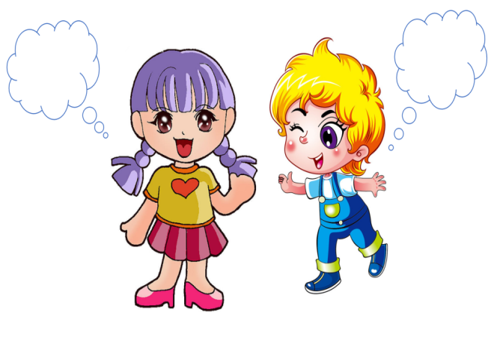
河北教育出版社 五年级 | 下册
Practice
Read and say

Slide 10
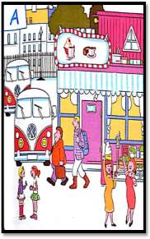
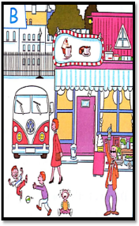
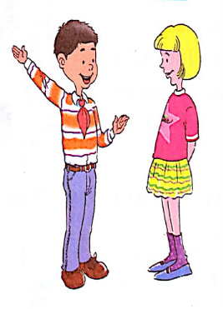
河北教育出版社 五年级 | 下册
Look, talk and write.
In picture A, there are two men. They are walking.
In picture B, there is one man. He issinging.

Slide 11
河北教育出版社 五年级 | 下册
Look, talk and write.
In picture A, _______________
_______________
_______________
_______________
In picture B, ________________________________________________________

Slide 12
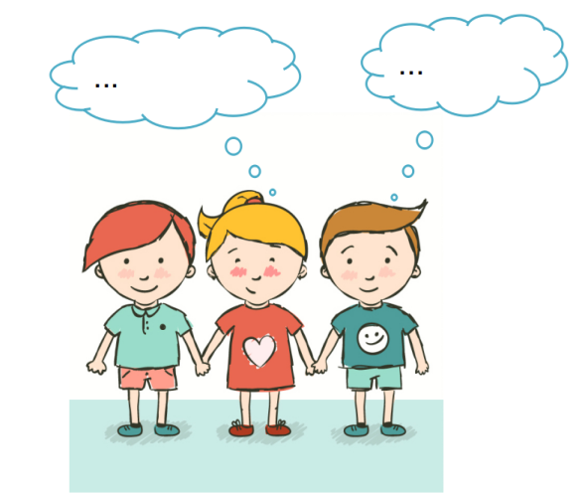
河北教育出版社 五年级 | 下册
Role-play

Slide 13
河北教育出版社 五年级 | 下册
Summary
重点词汇：
say help worry sad
重点句子：
This is difficult.
Don’t worry. I can help you.

Slide 14
河北教育出版社 五年级 | 下册
Homework
Go home and retell the Part1 text to your parents.
回家向父母复述Part1课文内容。

