Slide 1
Unit 1
He looks like a cook
WWW.PPT818.COM

Slide 2
red
yellow
green
blue

Slide 3
black
white
brown

Slide 4
pink
orange
purple

Slide 5
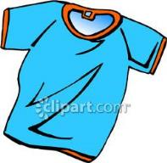
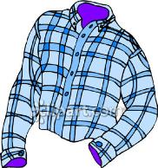
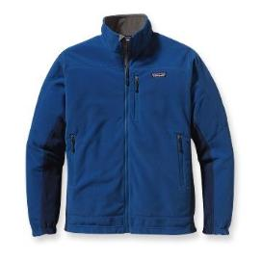
T-shirt
a blue T-shirt
shirt
a blue and white shirt
jacket
a blue jacket

Slide 6
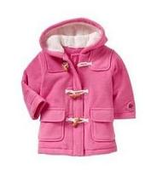
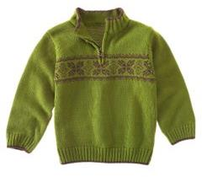
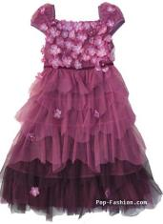
coat
a pink coat
a green sweater
sweater
dress
a purple dress

Slide 7
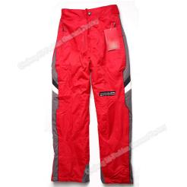
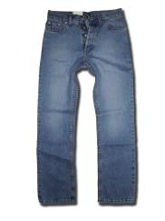
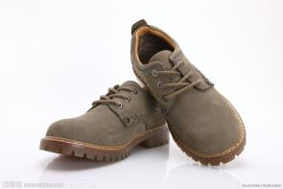
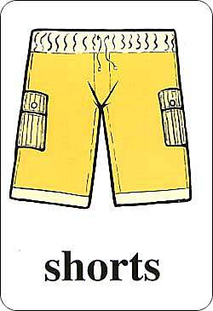
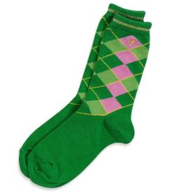
brown shoes
red trousers
blue jeans
yellow
green socks

Slide 8
in 用法
一、方位介词 （在…..里面）
如： in front of 、 in the classroom、 in the box….
二、表示穿戴、带着 。（ in +衣服）
如：in a black jacket / in a white coat/
in a white dress / in brown trousers/
in green shorts

Slide 9
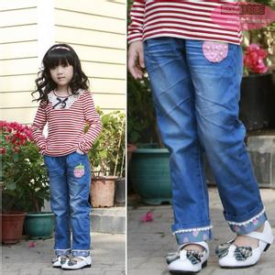
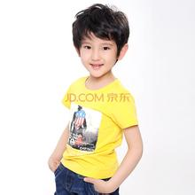
The girl wears a pair of blue jeans.
a girl in a white and black blouse and a pair of blue jeans.
The boy wears a yellow T-shirt.
a boy in a yellow T-shirt.

Slide 10
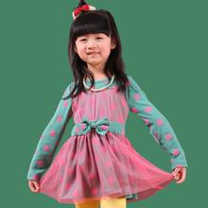
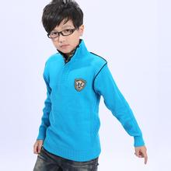
The girl wears a dress.
The girl in a dress is very beautiful.
The boy wears a blue sweater.
The boy in a blue sweater is very cute.

Slide 11
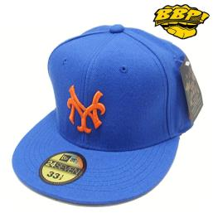
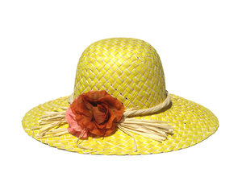
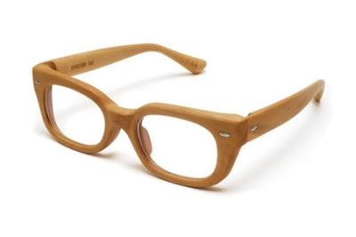
a cap
a hat
glasses

Slide 12
with的用法
表示： 有；和……在一起；带有；具有；在身上。 with + n
如： with a cap / with a hat /
with glasses / with a ball /
with a baby /with a bag

Slide 13
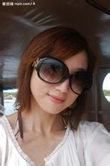
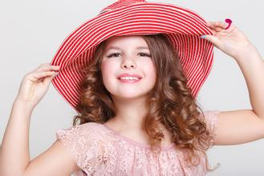
The girl wears a pair of glasses .
The girl with a pair of glasses is pretty.
The girl wears a red hat.
The girl with a red hat is lovely.

Slide 14
1/ David is a boy with glasses in a blue shirt and brown trousers.
2/Jim is a boy with a cap in a yellow T-shirt
and green shorts.
3/ Lily is a girl with a hat in a red sweater
And white trousers.
4/ May is a girl in a pink blouse and blue jeans.
5/ Kate is a girl with glasses and in a purple dress.

Slide 15
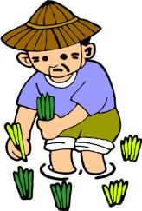
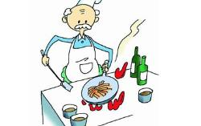
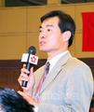
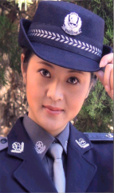
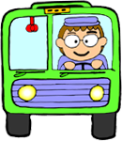
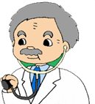
job

Slide 16
Who is the woman with a baby?
She looks like a farmer.

Slide 17
Who is the woman in a black uniform?
She looks like a policewoman.

Slide 18
Who is the old man in a white coat?
He looks like a doctor.

