Slide 1
Unit 5 MUSIC
Section Ⅳ Discovering Useful Structures
WWW.PPT818.COM

Slide 2
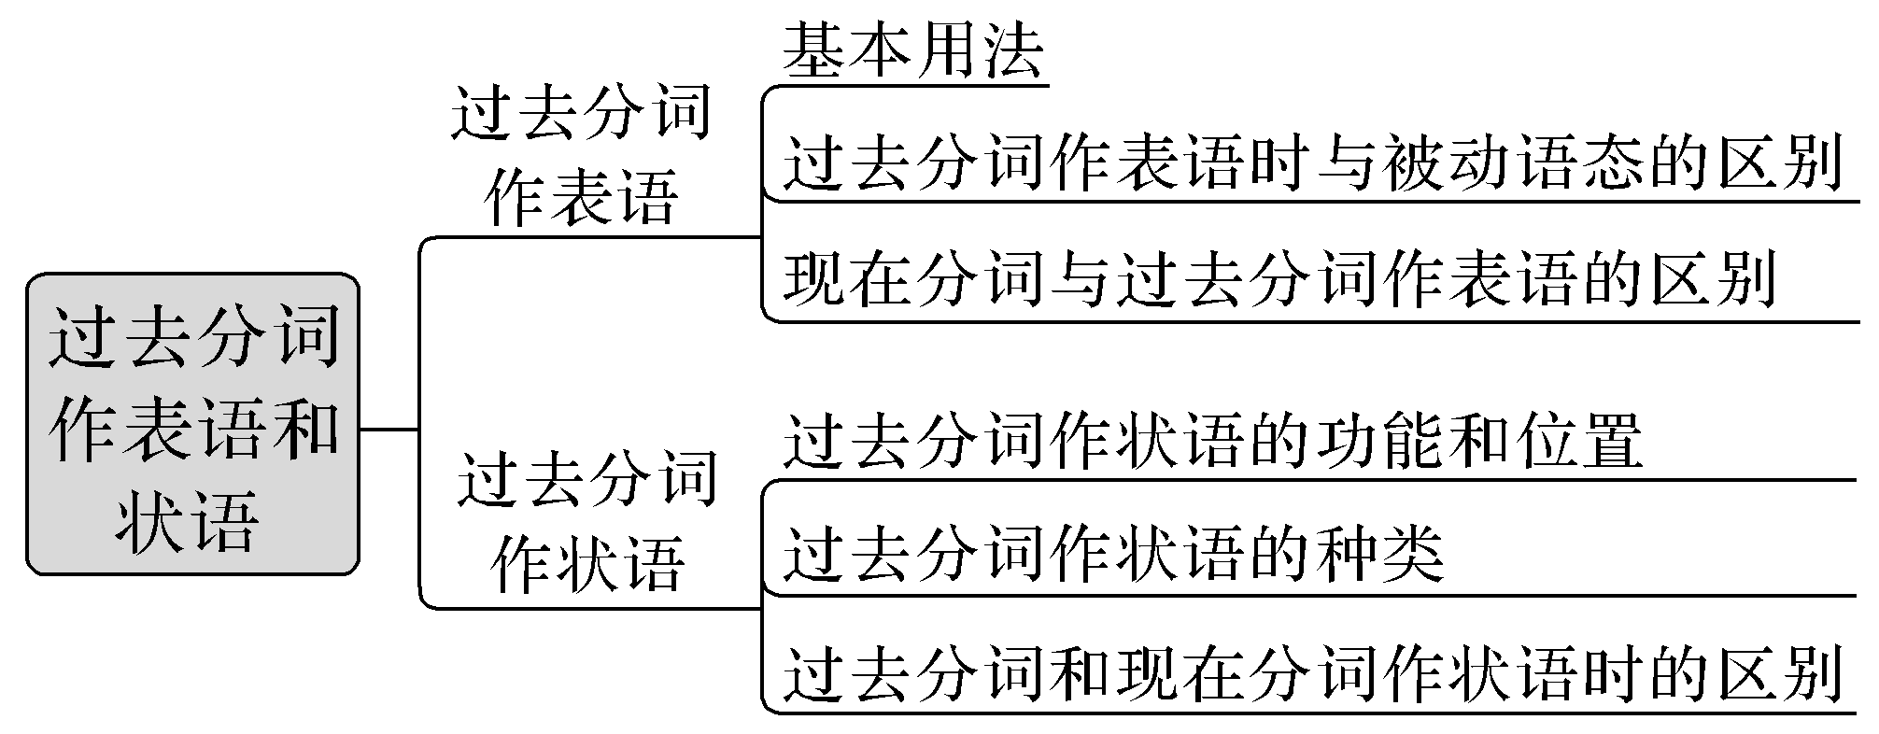
过去分词作表语和状语

Slide 3
一、过去分词作表语
1.基本用法
[合作探究]
From now on I will not be much too discouraged at failures.
从现在开始，对于失败我不会太气馁。
On the first day of new term, we remained seated, excited, waiting for our new teacher turning up.
在新学期的第一天，我们兴奋地坐在教室里，等待着新老师的到来。

Slide 4
[自主发现1]
[名师提醒]
过去分词可放在连系动词____________， ____________， get, feel, seem, look, become等之后作表语，构成“主—系—表”结构，表示主语所处的状态。
很多作表语的过去分词已经具备了形容词的性质，如：tired, amused, pleased等。
be
remain

Slide 5
2.过去分词作表语时与被动语态的区别
[合作探究]
[自主发现2]
The window is broken.窗户破了。(状态)
The window was broken by Tom.窗户被汤姆打破了。(动作)
过去分词作表语表示主语的________，常常在be，get，remain等系动词后；而被动语态则表示被动的________，通常由助动词be(有时也用get)构成，后面可由________引出动作的执行者。
状态
动作
by

Slide 6
[名师提醒]
(1)被动语态常由much，greatly等副词修饰，而系表结构常由very，quite，rather，too，so等副词修饰。
(2)当句中含有时间、地点或方式状语时多半是被动语态。

Slide 7
3.现在分词与过去分词作表语的区别
[合作探究]
At this very moment, my parents came back and were quite surprised to see all the rooms tidy and floors shining.
就在这时，我的父母回来了，他们十分吃惊地看到所有屋子很整洁，地板光亮。
His words were discouraging, which made many people discouraged.
他的话令人泄气，使得很多人灰心丧气。

Slide 8
[自主发现3]
英语中某些动词的现在分词多用来修饰________，意义为____________而其过去分词多用来指________、人的声音或表情等，表示主语________________。
物
“令人……”
人
处于某种状态中

Slide 9
二、过去分词作状语
1.过去分词作状语的功能和位置
[合作探究]
Built many centuries ago, the temple looks rather bad.
寺庙建于几个世纪之前，看起来很糟糕。
Discussed many times, the problem was settled.
经过多次讨论后，这个问题终于得到解决。
He rushed in，followed by his classmates.他闯了进来，后面跟着他的同学们。

Slide 10
[自主发现4]
(1)过去分词作状语，其逻辑主语常常就是句子的主语，且主语是过去分词所表示的动作的承受者，即过去分词所表示的动作与句子的主语构成动宾关系。
(2)过去分词作条件、原因及时间状语时，通常放于________；作伴随状语时，通常放于句末；作方式状语时，一般放于________，有时也放于句首；作让步状语时，一般放于句首，有时也可放于句末。
句首
句末

Slide 11
[名师提醒]
过去分词的逻辑主语和句子的主语不一致时，需要加上自己的主语，构成独立主格结构。
He was listening attentively，his eyes fixed on the blackboard.
他专心听讲，眼睛紧盯着黑板。

Slide 12
2.过去分词作状语的种类
[合作探究]
Asked what had happened(＝When he was asked what had happened)，he lowered his head.当被问到发生了什么事情的时候，他低下了头。
Absorbed in painting(＝As he was absorbed in painting), John didn’t notice evening approaching.由于在全神贯注地画画，约翰没有察觉到夜幕降临了。
Given another hour(＝If I am given another hour)，I can also work out this problem.
如果再给我一个小时，我也能把这道题算出来。

Slide 13
Beaten by the opposite team(＝Though we were beaten by the opposite team)，we didn’t lose heart and encouraged each other.
虽然被对方的队打败了，但我们并没有灰心并且相互鼓励。
The woman scientist entered the lab，followed by her assistants.
这位女科学家进入了实验室，后面跟着她的助手。

Slide 14
[自主发现5]
(1)表示________；相当于when, while等引导的_____________从句。
(2)表示________；相当于because, since, as等引导的_____________从句。
(3)表示________；相当于if引导的_____________从句。
(4)表示________；相当于although, though, even if, even though等引导的___________从句。
(5)表示方式或伴随。
时间
时间状语
原因
原因状语
条件
条件状语
让步
让步状语

Slide 15
3.过去分词和现在分词作状语时的区别
语法 | 逻辑关系 | 时间概念
过去分词作状语 | 句子主语与分词表示的动作之间存在逻辑上的动宾关系。 | 发生于谓语动词所表示的动作之前或表示一种状态，与谓语动词所表示的动作同时发生或存在。
现在分词作状语 | 句子主语与分词表示的动作之间存在逻辑上的主谓关系。 | 一般式(doing)所表示的动作与谓语动词所表示的动作同时发生或几乎同时发生；完成式(having done)所表示的动作发生在谓语动词所表示的动作之前。

Slide 16
Seen at a distance, the painting seems much more beautiful.
从远处看，这幅画似乎要漂亮得多。(see与句子的主语是逻辑上的动宾关系)
Not knowing how to work out the difficult physics problem, he asked the teacher for help.由于不知道如何解这道物理难题，他向老师求助。(know与句子的主语是逻辑上的主谓关系)

Slide 17
[巩固内化1]
用所给动词的适当形式填空
①There were many people waiting at the bus stop，and some of them looked very anxious and ____________ (disappoint).
②Yan’an，a city，which ____________ (locate) in northern Shanxi Province，has seen great progress in its tourism industry over the past few years.
③While waiting for the opportunity to get ____________ (promote), Henry did his best to perform his duty.
disappointed
is located
promoted

Slide 18
[巩固内化2] 对比填空
①The frightened look on her face suggested that she was ____________， for the scene was ____________.(frighten)
②The news was ____________ and they were all ____________ at it.(excite)
③The news was ____________ and we all felt ____________.(encourage)
④The film was ____________ and the audience were all ____________ to tears.(move)
frightened
frightening
exciting
excited
encouraging
encouraged
moving
moved

Slide 19
[巩固内化3]
用所给词的适当形式填空
①____________ (raise) in the poorest area of Glasgow, he had a long, hard road to becoming a football star.
②Children, when ____________ (accompany) by their parents, are allowed to enter the stadium.
③____________ (found) in the early 20th century, the school keeps on inspiring children’s love of art.
④____________ (translate) into English, the sentence was found to have an entirely different word order.
Raised
accompanied
Founded
Translated

Slide 20
[巩固内化4] 同义句转换
①When it is seen from the top of the hill, the town looks more beautiful.
→___________________________， the town looks more beautiful.
②Because they were deeply moved by the film, the children began to cry.
→___________________________， the children began to cry.
③If we were given more time, we could do it much better.
→____________________________, we could do it much better.
④The president of the company came to the factory, and he was followed by some workers.
→The president of the company came to the factory, ___________________________.
Seen from the top of the hill
Deeply moved by the film
Given more time
followed by some workers

Slide 21
[巩固内化5] 对比填空
①When I was little, my mother used to sit by my bed, ____________ (tell) me stories till I fell asleep.
②—Where is Jimmy?
—Just now I saw him sitting under the tree，____________ (absorb) in his video games.
telling
absorbed

