Slide 1
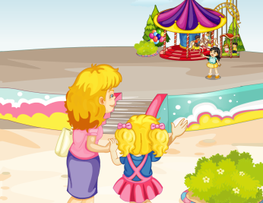
Unit2 She looks cute.
精通版五年级上册
WWW.PPT818.COM

Slide 2
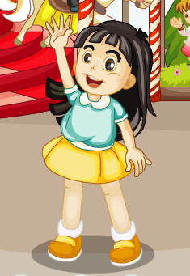
>>Review
Think and say
1. What’s her name?
Her name is Zhou Pei.
2. What’s does she look like?
She has big eyes and long hair.
3. What does Kate think of her?
She is pretty and clever.

Slide 3
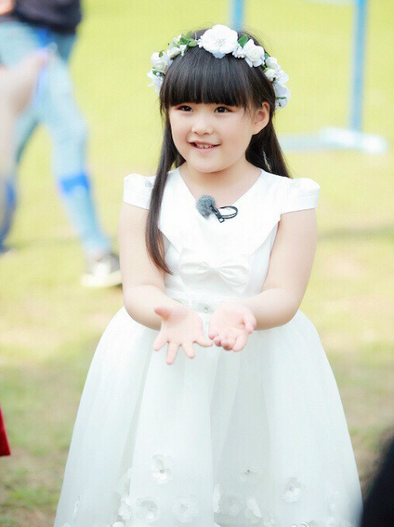
>>Presentation
Look and say
What’s her name?
Her name is Angela.
How old is she?
She is seven.
She is very cute.
cute

Slide 4
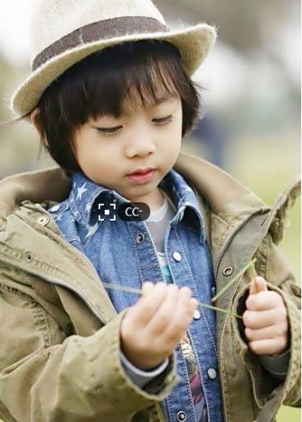
>>Presentation
Look and say
What’s his name?
His name is Kimi.
How old is he?
He is seven.
He is very smart.
smart

Slide 5
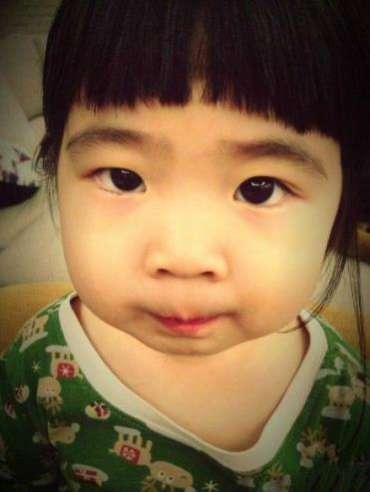
>>Presentation
Look and say
What’s her name?
Her name is Grace.
How old is she?
She is six.
She is very lovely.
lovely

Slide 6
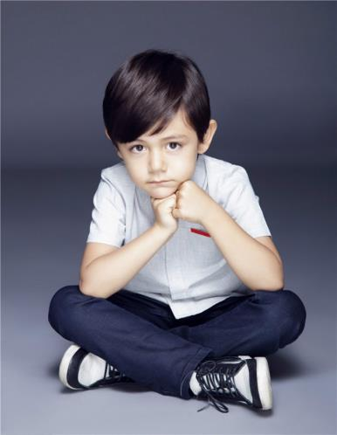
>>Lead-in
Look and say
What’s his name?
His name is Liu Nuoyi.
How old is he?
He is six.
He is very active.
active

Slide 7
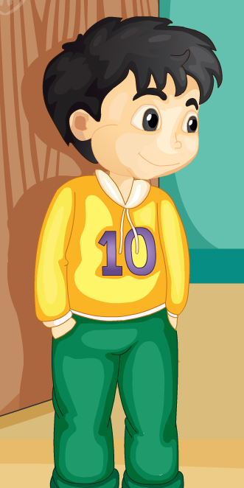
>>Presentation
Look and say
1. What’s his name?
His name is Gao Wei.
2. What’s does he look like?
He has short ___, big ____, a
small ____ and a small mouth.
hair
eyes
nose

Slide 8
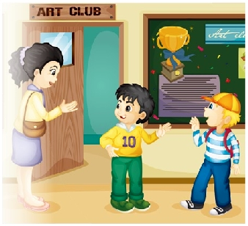
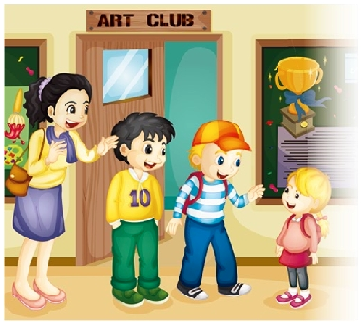
>>Presentation
Look and say
Dick is Gao Wei’s new friend at the art club.
Can you guess who this little girl is?

Slide 9
>>Presentation
Look and say
1. How old is Dick?
2. Who’s this girl? How old is she?
3. What does Gao Wei’s mum think of this girl?
4. What does Gao Wei think of Dick?

Slide 10
>>Presentation
Look and say
1. How old is Dick?
2. Who’s this girl? How old is she?
3. What does Gao Wei’s mum think of this girl?
4. What does Gao Wei think of Dick?
He is ten.
She is Dick’s sister. She is six.
She is cute.
He is smart.

Slide 11
Just talk
Gao Wei: Mum ,this is Dick, my new friend at the
art club.
Mum: How old are you, Dick?
Dick: I’m ten.
Gao Wei: Who’s this little girl?
Dick: She’s my sister.
Mum: How old is she?
Dick: She’s six.
Mum: Oh, she’s cute!
Gao Wei: And Dick is smart!

Slide 12
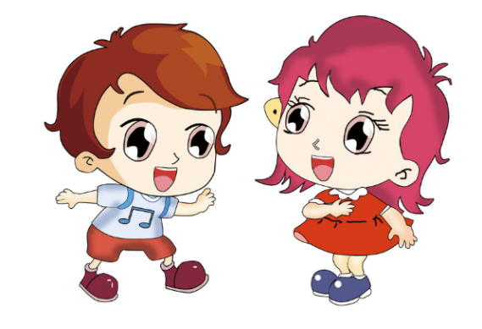
>>Practice
Pair work
Let me introduce my friend. His / her name is
____. He / She is ____. He has ____ hair and
____ eyes. He is ____.

Slide 13
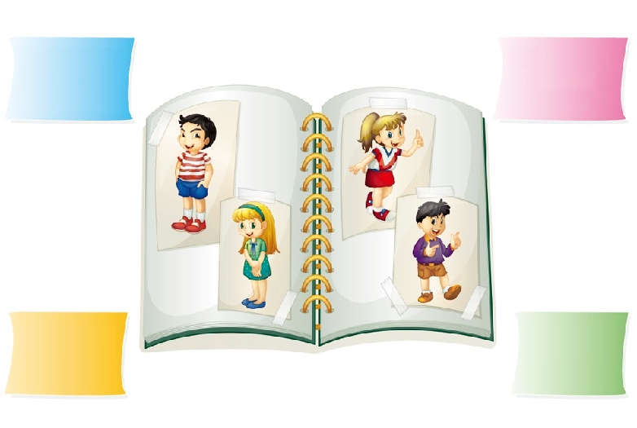
>>Practice
Group work
Name: Tim
Age: Ten
smart
Name: Carol
Age: Twelve
cute
Name: Anne
Age: Eleven
lovely
Name: Ken
Age: Nine
active

Slide 14
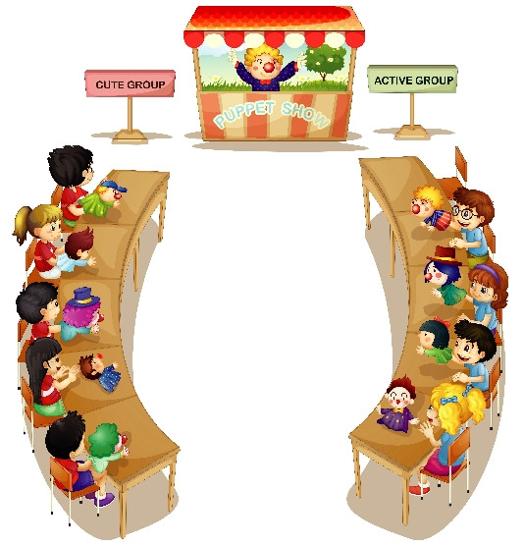
>>Practice
Let’s act
Hello! My name is Tom. I’m ten. I’m smart.
What’s his name?
His name is Tom.
How old is he?
He’s ten.
He is active, right?
No. He is smart.

Slide 15
>>Summary
如何询问和回答他人的年龄并描述他人的性格呢？
—How old is she/he …?
—She/He is …(six/seven/eight…)
She/He is …(cute/smart/lovely/active…)

