Slide 1
Unit 2 Topic2 All these problems are very serious.
Section C
WWW.PPT818.COM

Slide 2
Review
Fill in the blanks using something, anything, others, nobody, everyone, anybody, everywhere, none, other.
None
(1)________ of us knows how to stop the bad behavior.
(2) I knocked on the door but ___________ answered.
(3) Some of these books are better than__________.
(4) She was driving the car with one hand and wiping the window with the _______.
(5) They are beautiful but I am looking for ___________ useful.
(6) Is there ___________ you can do to help her?
(7) There’re 5 000 people living here and almost _________has his/her own car.
(8) He’s cleverer than ____________ I know.
(9) I’ve looked __________ but I can’t find it.
nobody
others
other
something
anything
everyone
anybody
everywhere

Slide 3
Give a speech
What can we do to protect our environment ?

Slide 4
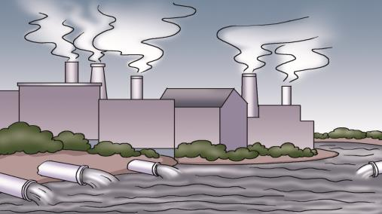
In our daily life, we should face more environmental problems.
Can you say something about them?
cities, pollute,
health problems
factories, the land and the air, dead

Slide 5
In our daily life, we should face more environmental problems. Can you say something about them?
cut down, millions of,
take away the earth,
become desert
拿走

Slide 6
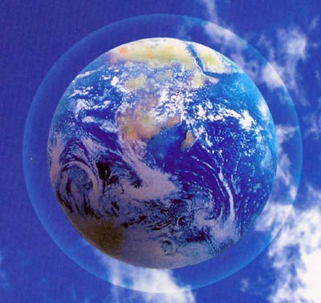
In our daily life, we should face more environmental problems.
Can you say something about them?
oxygen
氧气
a special kind of oxygen
called “ozone” (O3)

Slide 7
臭氧层
n.洞，坑
a very big hole in the ozone layer,
too much harmful radiation from the sun
放射，放射物

Slide 8
In our daily life, we should face more environmental problems.
Can you say something about them?
二氧化碳
CO₂ carbon dioxide increase a lot, form a “blanket”, the heat from the sun can’t escape
渗出；逃跑；逃脱
毛毯，毯子
v.出现，形成
n.种类，形式

Slide 9
v.上升；起床；升起
cause the level of the sea to rise
called “the greenhouse effect”
or “global warming”
温室效应

Slide 10
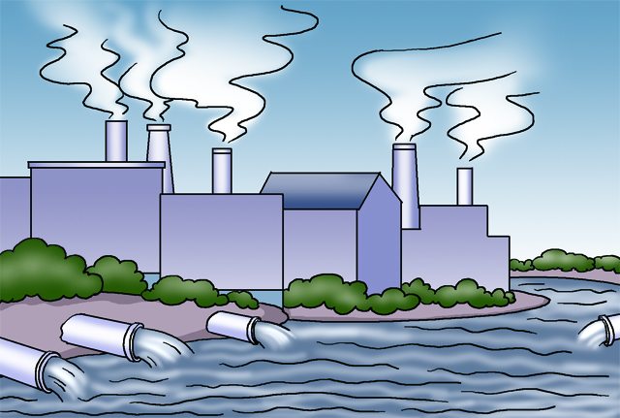
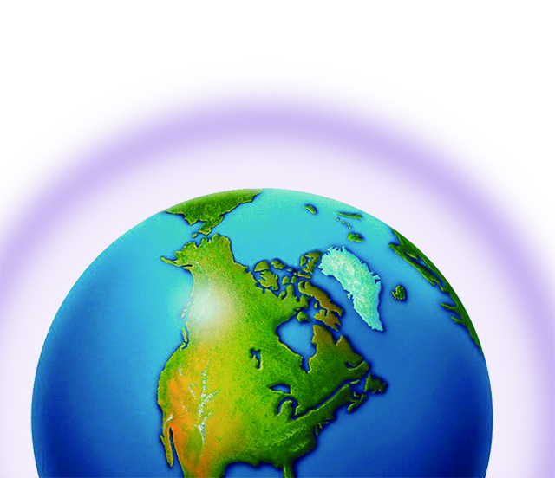
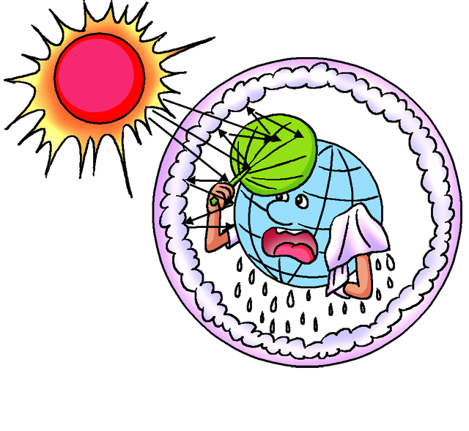
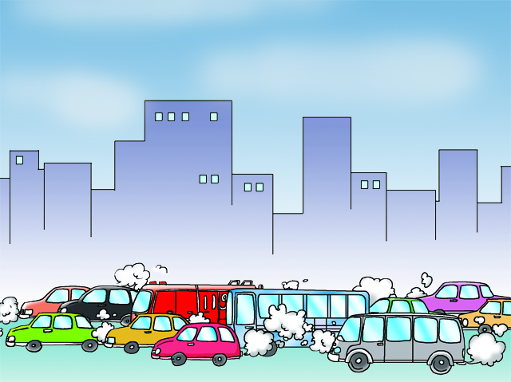
1a Read and understand.
Look at the following pictures and predict the main idea of the passage.
traffic pollution
factory pollution
more carbon dioxide
the ozone layer
fewer trees
Can you match them?

Slide 11
Choose suitable titles for Paragraphs 2-6. Then write it down in front of each paragraph.
A. Traffic pollution B. Factory pollution C. Fewer trees D. The ozone hole E. More carbon dioxide
The earth is 4.6 billion years old. We humans have lived on the earth for only 35 000 years, but during this period, we have changed our planet a lot in many ways. Some things we’ve done are very good for the earth while some are bad.
_________ All over the world, people have cut down millions of trees. When it rains or when the wind blows, the earth is taken away. Forests have become deserts, so many kinds of animals and plants are disappearing.
Fewer Trees

Slide 12
____________ In big cities, cars and buses have polluted the air. Now many people in cities have health problems.
Traffic Pollution
_____________Factories have also polluted the land and the water. As a result, many rivers and lakes are now dead.
_____________ Around the earth, there’s a special kind of oxygen called “ozone”(O3). It is important to the earth. But now air pollution is destroying it and making a very big hole in the ozone layer. Too much harmful radiation from the sun passes through the hole and reaches the earth directly. This is very dangerous because this kind of radiation can cause cancer.
Factory Pollution
The Ozone Layer
直接地

Slide 13
________________ Carbon dioxide (CO₂) in the air has increased a lot. It mainly comes from burning oil, coal and wood. This has formed a blanket around the earth. The heat from the sun can’t escape so the temperature is rising. This is called “the greenhouse effect”. It causes the level of the oceans to rise and the climate of the earth to change.
All these problems are very serious, so we must do something now.
More Carbon Dioxide

Slide 14
1b Read 1a and complete the following tasks.
2.What does our planet mean here?
A. The sun. B. Mars.
C. The moon. D. The earth.
3.In the passage, blanket refers to ____.
A. carbon dioxide around the earth
B. the ozone layer in the sky
C. the forests around the world
D. pollution all over the world
4.The word it in Paragraph5 refers to ____.
A. CO2 B. O3 C. O2 D. H2O
5. What is the best title for this passage ?
Environment Problems B. Pollution on the Earth
C. Hope for the Future D. The Greenhouse Effect

Slide 15
Write down only the key words when taking notes.
1c Complete the notes according to 1a.

Slide 16
Problem | Effect on the environment
fewer trees | forests become deserts, animals and plants disappear
traffic pollution
 | greenhouse effect, level of oceans rising, climate change
cars and buses pollute air, health problems
factory pollution
pollute land and water, rivers and lakes dead
harmful radiation reaches the earth, cause cancer
ozone hole
more CO2
Retell it

Slide 17
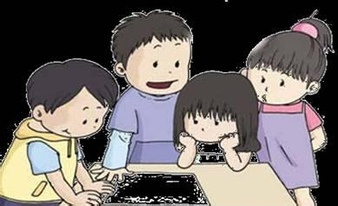
2 Surf the Internet to collect more information about environmental problems and effects. Then discuss the information in groups and take notes.

Slide 18
3. Combine the key points in 1c and 2 to form a short passage and pay attention to the proper linking words.

Slide 19
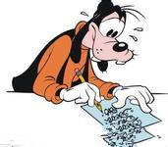
You can write it like this:
As we all know, water pollution is becoming more and more serious. Some factories pour waste water into the rivers. As a result, it makes the water dirty and smell terrible. Most of fish in the water have died and we can’t swim in the water. Water is very important to human beings, so we should do our best to protect and save it. Luckily, our government is taking measures to protect the water from pollution.

Slide 20
We learn: 1. Some words: hole, form, rise
2. Some phrases: take away,
refer to
3. Some sentences:
All these problems are very serious, so we
must do something now.
We can: 1. Talk about the harm of pollution.
2. Combine the key points to form a
short passage.
Summary

Slide 21
Assignment
1.Read 1a.
2.Memorize the useful expressions and key words which we learn today.
3.Finish Section C in your workbook.
4.Review Section A-C and preview Section D.

