Slide 1
Help others
第一课时
WWW.PPT818.COM

Slide 2
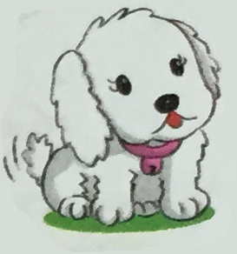
Warming
What is it?

Slide 3
Presentation
What is this?
It’s a bell.

Slide 4
Presentation
What is this?
It’s neck.

Slide 5
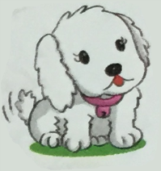
Talk in pairs
I have a dog.
Her name is _________.
She is _________(colour).
She has a ________ around her neck.
I like her very much.

Slide 6
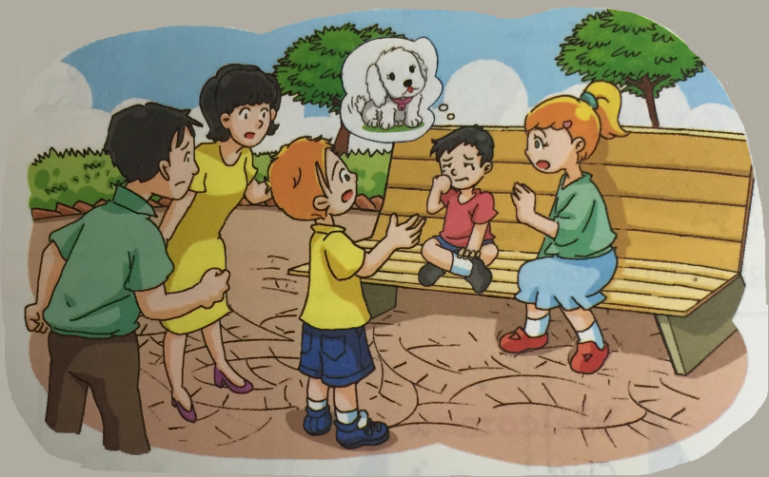
Listen to the text
此处添加课文录音

Slide 7
Presentation
I can’t find my dog.

Slide 8
Presentation
I saw her half an hour ago.

Slide 9
Presentation
I’m going to ask the gatekeeper.

Slide 10
Work in pairs
Write and complete the notice.
Lost dog
Her name is Snow. She is small.
She is __________(colour).
She has ___________ around her neck.
She was near __________ at half past ten.
She was near __________ at about eleven.
Did you see her?
My phone number is 1234567.

Slide 11
Role play

Slide 12
Show time
Act out the text

Slide 13
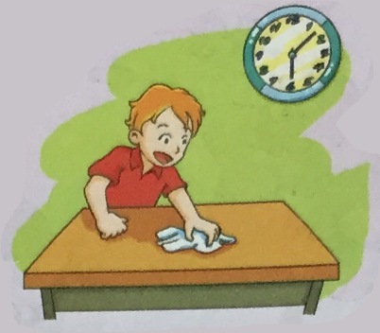
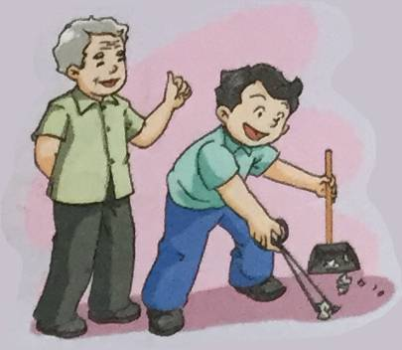
Practice in pairs
Ask and answer the question with your classmates.
How can you help others? I can …
clean the table
pick up rubbish

Slide 14
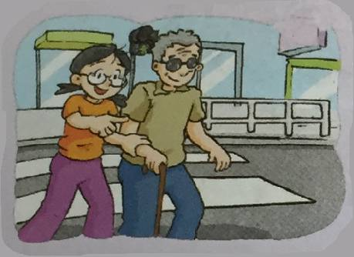
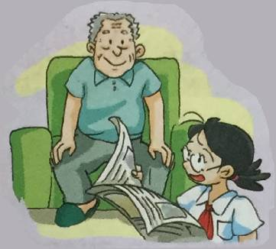
Practice in pairs
How can you help others? I can …
help the blind cross the street
read the newspaper to old people

Slide 15
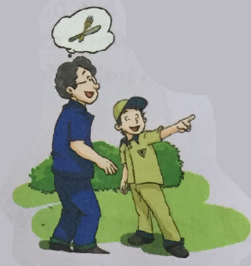
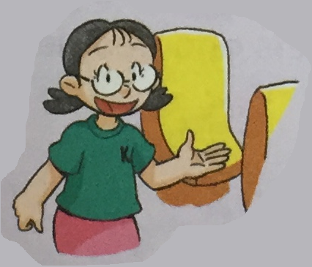
Practice in pairs
How can you help others? I can …
help tourists find their way
give my seat to old people

Slide 16
Summary
本课重点句型：
How can you help others? I can …
本课复习了语法句型：
I can’t find my dog.
I saw her half an hour ago.
I’m going to ask the gatekeeper.

Slide 17
Homework
预习Learn the sounds.

Slide 18
The End

