Slide 1
Unit 6 Food and lifestyle Reading (I)
WWW.PPT818.COM

Slide 3
A news report
Some fat boys join in a summer
camp to lose weight to keep
healthy.
Main idea
◆seldom exercise
Reasons
◆eat too much
◆exercise more
◆Don’t have too much food with sugar;
be bad for one’s teeth
Advice
(建议)
◆have fruit
◆have meals on time

Slide 4
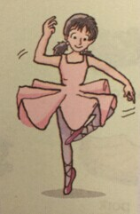
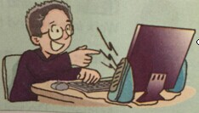
Keep fit
What we eat and how we live

Slide 5
Fast reading
Read the passage quickly and fill in the following table.
 | What she/he eats | How he/she lives
Kitty
Daniel

Slide 6
Detailed reading (I)
True or False?
F
1. Kitty loves swimming.
2. Kitty often eats healthy food.
3. There is too much sugar in cakes and sweets.
4. Daniel seldom plays computer games.
5. Daniel does not like to play sports.
6. Kitty and Daniel have healthy lifestyles.
T
T
F
T
F

Slide 7
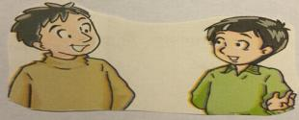
Detailed reading (II)
Role play
Simon is asking Millie some questions about Kitty's and Daniel's
lifestyles. Help Millie answer his questions.
Simon: How often does Kitty dance?
Millie: She dances (1) ___________.
Simon: How long does Kitty dance every time?
Millie: She dances for (2) ____________.
Simon: Why is healthy food so important
for Kitty?
Millie: Because she needs to (3) ________.
every day
half an hour
keep fit

Slide 8
Detailed reading (II)
Role play
Simon is asking Millie some questions about Kitty's and Daniel's
lifestyles. Help Millie answer his questions.
Simon: Does Daniel have a healthy lifestyle?
Millie: (4) _____, ____________.
Simon: What does Daniel ?plan to eat every
day?
Millie: He plans to eat (5) _________________
____________ every day.
Simon: What does Daniel plan to do?
Millie: He plans to (6) ____________ every
day.
No
he doesn’t
more fruit and
vegetables
go swimming

Slide 9
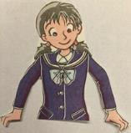
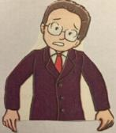
Detailed reading (III)
Kitty’s and Daniel’s lifestyles
Kitty | Daniel
◆I have _______ and ________ for breakfast every day. ◆I eat _____ and ____________ for lunch and dinner. ◆Sometimes I have an _______ or a _______ between meals. ◆I seldom eat ________ or _________. ◆I dance for _____________ every day. | ◆I love ______________ and _______. ◆My favourite meat is ______. ◆I do not eat ________ and ______________ every day. ◆I do not often eat ________. ◆I ________ exercise. ◆I plan to ______________ every day.
milk
bread
hamburgers
cola
fish
vegetables
beef
fruit
apple
vegetables
pear
fish
cakes
seldom
sweets
go swimming
half an hour

Slide 10
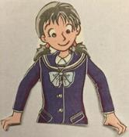
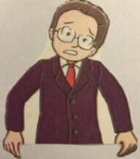
Discussion
◆Whose lifestyle is healthier (更健康), Kitty’s
or Daniel’s? Why do you think so?
◆Why do you think Daniel’s lifestyle is not
healthy?
◆What advice can you give to Daniel if he
wants to keep fit?

Slide 11
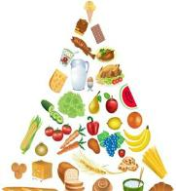
Introduce your own lifestyle
My lifestyle
Name __________ Age ___________ Lifestyle _____________________________ Exercise _____________________________ Breakfast ____________________________ Lunch _______________________________ Dinner ______________________________

Slide 12
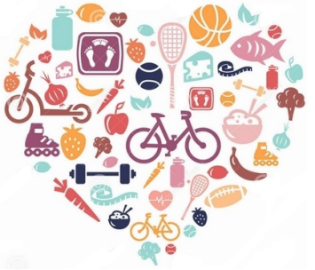
Tips for keeping fit
Have a healthy lifestyle.
★Exercise more.
★Have fruit every day.
★Have meals on time.

Slide 13
Homework
1. Read and recite the passage.
2. Try to write something about
your own lifestyle.

