Slide 1
Lesson 34
Flying Donuts
WWW.PPT818.COM

Slide 2
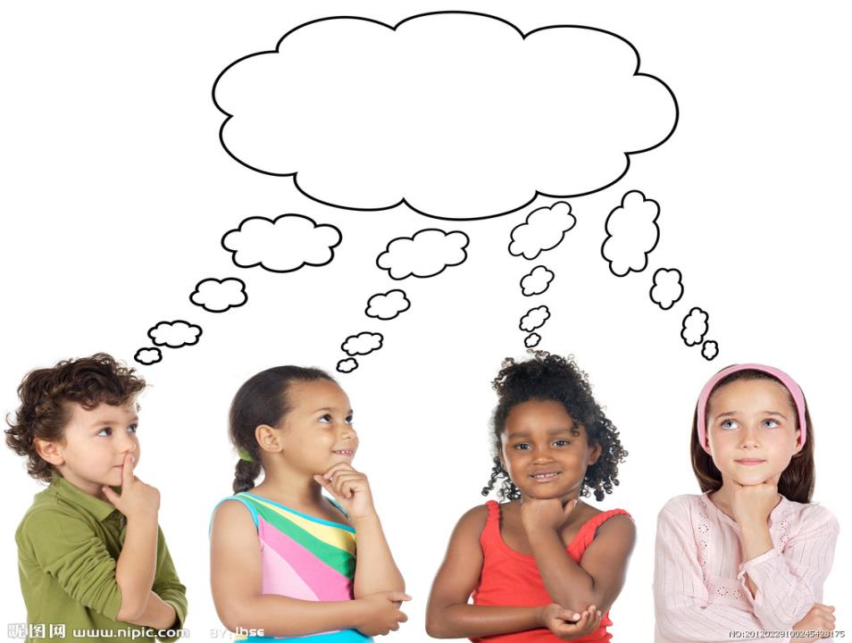
THINK ABOUT IT

Slide 3
What kinds of transportation can you
name?
Imagine a new type of transportation.
Describe it!

Slide 4
Danny has thought of a new kind of
transportation. He wants to give a presentation on
it to the class.
Last night, Danny stayed up late to make his
invention. He took an old backpack. Then he made
two cardboard rockets. He painted them red and
glued them onto the backpack. In the morning, on
his way to school, he bought ten donuts.
Now Danny is standing at the front of the classroom.

Slide 5
Danny: I would like to present my invention. I call
it “Flying Donuts”, With my invention,
you don’t need an airplane to fly. First,
you put the Flying Donuts bag on your
back. Then you turn it on and jump into
the air!
Teacher: OK, Danny. But why do you call it
Flying Donuts?

Slide 6
Danny: Look inside! See? I put ten donuts there.
Jenny: What do the donuts do, Danny?
Danny: The donuts are the fuel. I don’t need oil or
coal. One donut will carry you one
kilometre. To go ten kilometres, you need
ten donuts.
Teacher: Do other types of food make the rockets go ?

Slide 7
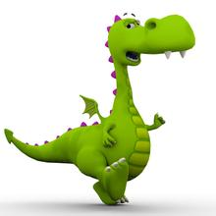
Danny: Yes, but donuts are the best.
Teacher: Why is that?
Danny: You can eat them when you get hungry!
Will Danny’s invention really work?
Probably not, but he had fun, and he
used his imagination! You can do it, too!
Do you like my invention?

Slide 8
Read the lesson and answer the questions.
1. What does Danny call his invention?
2. How does Danny’s invention work?
3. Why are donuts the best food to make the rockets
go?
4. How far will you go if you have five donuts?
Flying Donuts.
First, put on Flying Donuts. Then turn it on and jump into the air.
Because you can eat them when you get hungry.
Five kilometres.

Slide 9
1.
think of
考虑, 设想, 想出(主意), 提出(建议)
What do you think of my singing?
你认为我的歌唱得怎么样？
I can’t think of his name at the moment.
我一时想不起他的名字了。

Slide 10
2.
stayed up late 熬夜
Don’t wake him up. He stayed up late last night.
别叫他。他昨晚熬夜了。
We stayed up late to see the new year in.
我们守岁迎接新年。
Mark stayed up late to do his homework.
马克熬夜做作业。

Slide 11
invention 名词
发明；发明物
invent 动词
发明；创造
inventor 名词
发明家
The inventor invented two new things last year.
Both are great inventions.
去年，那个发明家发明了两项新东西。两项都
是伟大的发明。

Slide 12
3.
at/in the front of 在……前部
指内部的前面
前
后
in front of 在……前面
指外部的前面
前
后
He likes sitting in the front of the car.
他喜欢坐在汽车的前部。
A car parked in front of the house.
一辆车停在房子前面。

Slide 13
4. First, you put the Flying Donuts bag on your back.
首先，背上面包圈飞行器背包。
put on 穿上
反义词组 take off 脱下
It’s cold outside! Please put on your warm clothes!
外边很冷！穿上你的厚衣服！
Please take off your shoes before you go into the
computer room. 在进机房前，请脱鞋。

Slide 14
5. Then you turn it on and jump into the air!
然后打开（背包），跳向空中！
turn on 打开
反义词组 turn off 关上
Please turn on the radio. It’s time for the news.
请打开收音机。该看新闻了。
Would you please turn off the TV? I am busy
preparing for the English test tomorrow.
请把电视关了好吗？我正忙着准备明天的英语考
试呢。

Slide 15
6. Will Danny’s invention really work?
丹尼的发明能行得通吗？
句中的意思是“（计划）行得通，（机器等）能运转”
Your idea won’t work in practice.
你的想法在实践中行不通。
I don’t know why the machine didn’t work.
我不知道为什么这台机器不能工作了。

Slide 16
7. Probably not, but he had fun, and he used his
imagination!
也许不行，但是他很享受，而且发挥了他的想
象力。
probably是 副词 大概；或许；很可能
imagination是名词 想象，想象力；想象出来的事物
imagination 的动词是imagine.常用结构：imagine
doing sth.（想象做某事）
Probably next year I will look for a job.
我很可能明年找份工作

Slide 17
If you put on damp clothes, you will probably
catch a cold.
如果你穿湿衣服，很有可能会着凉的。
Ann is a woman with a vivid imagination.
安是个想象力丰富的女人。
The story shows plenty of imagination.
这个故事表现出丰富的想象力。
Can you imagine living without water?
你能想象没有水的生活吗？

Slide 18
Fill in the blanks with the correct forms of the given words.
imagination
To be a writer, you need a good___________
(imagine).
2. It’s too dark now. ____________(see) clearly,
you need ______________(turn) on the light.
3. It is one of the most important ____________
(invent) in the history of the world.
4. We would like ______________(present) our
project to the class.
To see
to turn
inventions
to present

Slide 19
Fill in the blanks with the correct forms of the
phrases in the box.
stay up late think of on one’s way turn it on put on
On Wednesday morning, Tom got up and ______
___________his clothes. After a quick breakfast,
he was _____________to school. It was going to be
an important day for him.
put on
on his way

Slide 20
stayed up late
Last night, Tom ______________doing his
project. He _____________a new kind of
transportation. He felt really excited about it. He
was ready to show his invention to his class.
At the front of the class, Tom took out his new
transporter. It looked like a banana, and it had
wings. Tom _____________, but the banana
didn’t move. Tom was very sad. He said he would
make a new one.
thought of
turned it on

Slide 21
PROJECT
TRANSPORTATION FROM THE FUTURE
In the 1900s, few people had cars. Nobody knew
about airplanes or rockets. What would they think about
the types of transportation we have today? Would they be
surprised? Now think about future transportation. What
types of transportation will be there 100 years from now?
Describe on type of transportation from the future. Don’t
forget to think and be creative! Use your imagination and
have fun!

